Slide 1
The English Renaissance 1485-1660
Yep….it’s SHAKEPEARE’S Time!

Slide 2
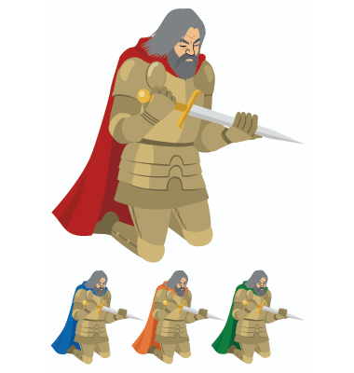
History of the time
What ever happened to Feudalism?
Feudalism declines
Money payments are now made to barons for their military protection.
Barons hired are professionally trained troops- the “knight” era ends

Slide 3
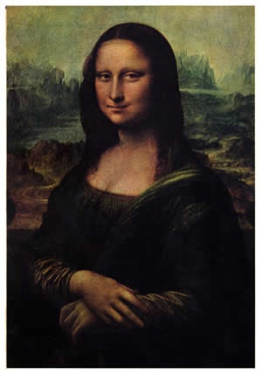
History of the time
What is “The Renaissance”
A rebirth of interest in science, art and literature
Some of the world’s finest artists and writers come from this period.

Slide 4
History of the time
The Protestant Reformation
German monk, Martin Luther, protested the sale of indulgences, as well as other practices of the Roman Catholic Church.
These protests were the beginning of a religious movement known as The Protestant Reformation.

Slide 5
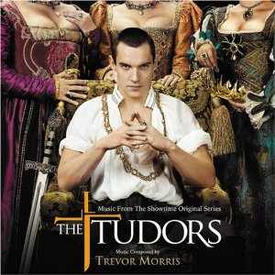
The Rulers: Tudors
.
began with Henry VII in 1485
son Henry VIII began his reign in 1509
led several successful wars
6 unsuccessful marriages
1530-Henry VIII split with the Roman Catholic Church and established the Church of England (Anglican Church) so he can get a divorce from Catherine of Aragon.

Slide 6
Tudors: The Tudors
sister of Edward VI, and half-sister of Elizabeth
became queen, briefly, after Edward died- 1553-1558
tried to bring England back to Catholic faith
became known as “Bloody Mary” because she had 300 protestants captured and burned at the stake
married Philip II of Spain; very unpopular move because Spain was England’s worst enemy
Philip persuaded Mary to join Spain in a war against France; France won. War ended in 1558; Mary died soon after, deserted by her husband and sad that Elizabeth, her protestant half-sister would succeed her to the throne.
Henry VIII had 3 children:
Edward VI
Mary I (Bloody Mary), who ruled England briefly before Henry’s second daughter came to the throne in 1558.

Slide 7
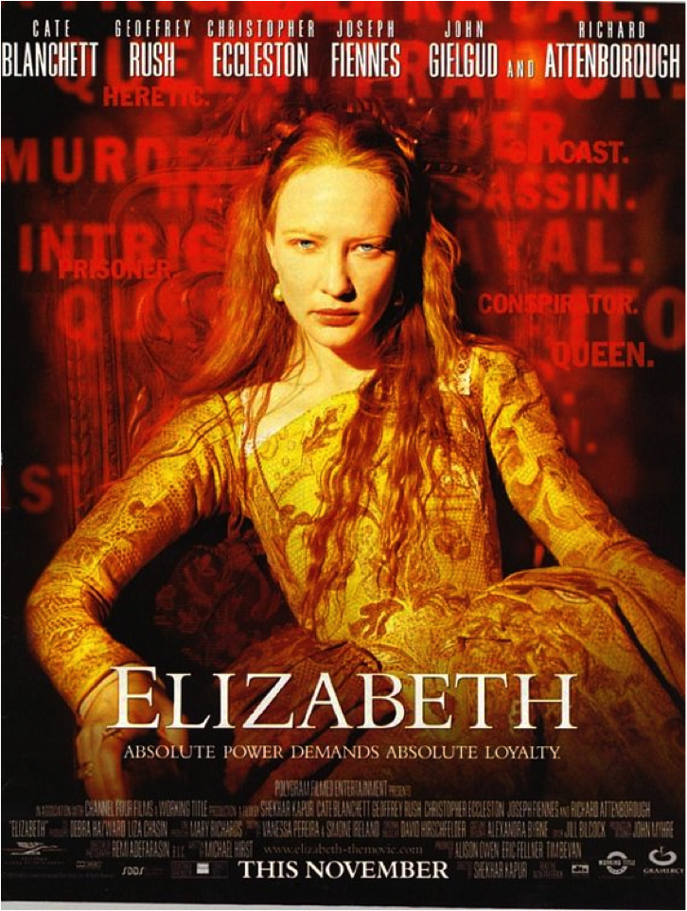
Elizabeth I
turned England into a great naval power- ruled from 1558-1603, 45 years; she never married and was a protestant.
England broke with the pope, Catholic services were forbidden, priests were allowed to marry, however, Elizabeth tried to be sensitive to both the Catholic and Protestant beliefs.

Slide 8
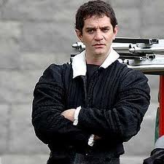
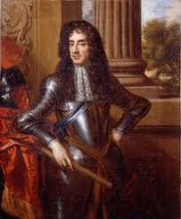
Oliver Cromwell
Created a stable government
Was a Puritan
outlawed plays
reign lasted 11 years
monarchy was restored after his death in 1658
Charles II (a Stuart)-came out of exile, takes the throne

Slide 9
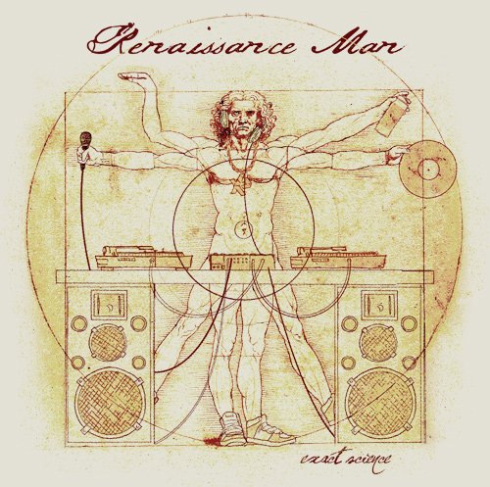
Life of the times
Exploring the World
English Explorers travel to unknown places
John Cabot
Exploring the Sky
1609-Galileo built the telescope
Exploring the Human Body
William Harvey-a physician, made significant contributions to medicine such as the heart pumping blood through the veins and arteries.

Slide 10
Food & Fashion!
Firsts
Fashion
potatoes, tomatoes, and turkey were new foods during this era
umbrellas were first used in England
heels were made on men and women’s shoes
involved bright collars, rich fabrics and large collars
white skin, fair hair and red lips became the “model” for beauty
The English ruined their teeth by scrubbing them with pumice or brick, and rinsing with a mixture of sugar, or burned salt and honey.

Slide 11
Arts and Entertainment
Music was heard everywhere, even barber shops entertained customers with lutes
All levels of society attended the theatre for plays
Dancing after dinner!
Parliament outlawed tennis, bowling, and football because they were too violent. (Lower classes still played!)

Slide 12
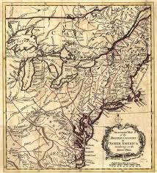
Literature of the time- reading and writing
Advertisements for America
“Experience new life in the American colonies!”
Religious books
“Book of Common Prayer” in English vs. Latin

Slide 13
The King James Version of the Bible in 1611
47 scholars from Oxford, Cambridge, and Westminster were divided into six companies and were instructed to translate the Biblical text from Hebrew and Greek into English. The translation was based on a Latin version that was completed in 405 by the Christian monk, St. Jerome.
Old Testament- 39 books-contains historical events about ancient Israel and the establishment of God’s law
New Testament- 27 books- tells about the life of Jesus Christ, his birth, death, and resurrection from the dead; also the development of the early church
First complete translation was in the 1380’s by John Wycliffe

Slide 14
Correspondence &Renaissance Drama
many people wrote letters- mail coaches were established 1640.
chapbooks- small “table” books that included literature in the form of songs, poems, fairy tales, ghost stories and travel tales.
Plays
comedies
Tragedies
Playwrights
Christopher Marlowe
William Shakespeare

Slide 15

Our Play…

Slide 16
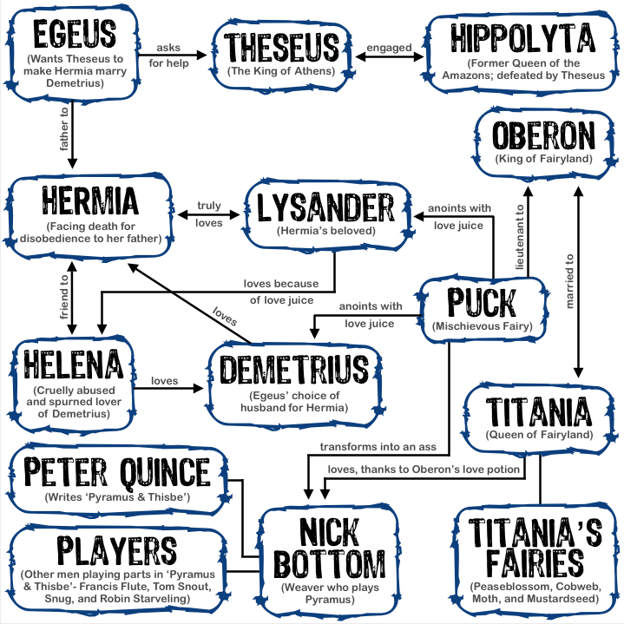
A Midsummer Night’s Dream
The Madness ensues as the characters arrive that the palace of Duke Theseus for his wedding to Queen Hippolyta.

Slide 17
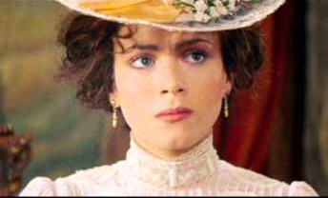
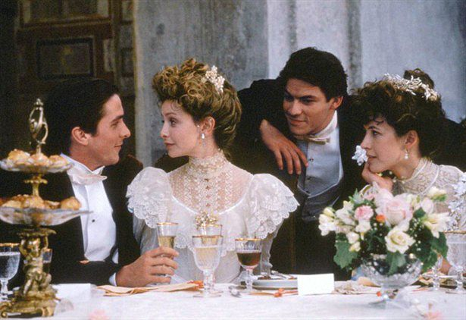
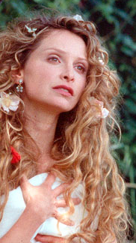
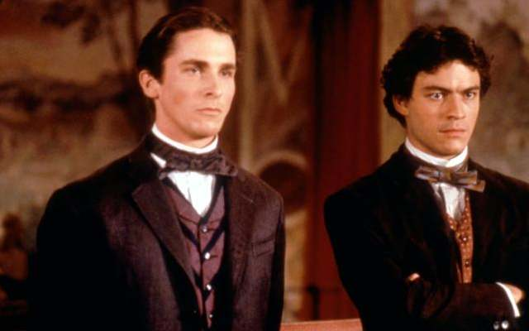
The Lovers
Hermia
Lysander
Helena
Demetrius
Hermia
Helena
Demetrius
Lysander

Slide 18
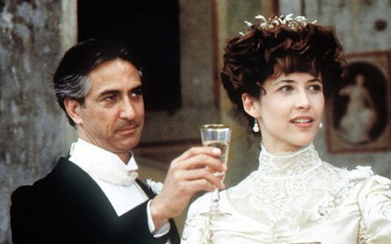
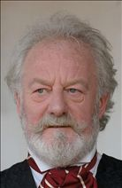
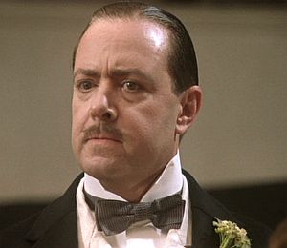
Leaders of Athens
Theseus
Hippolyta
Egeus
Philostrate
Additional Lords & Attendants
Duke Theseus
Hippolyta
Egeus
Philostrate

Slide 19
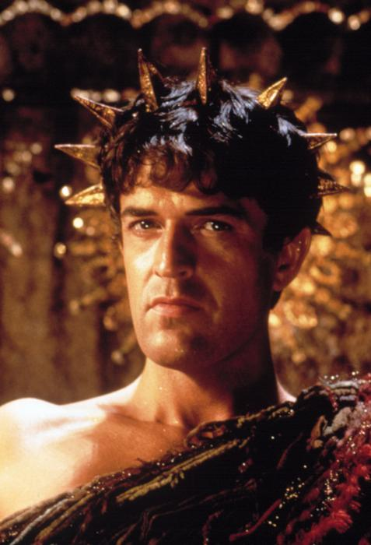
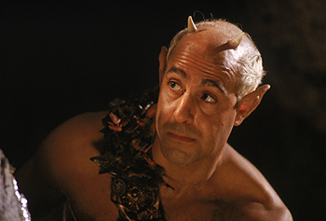
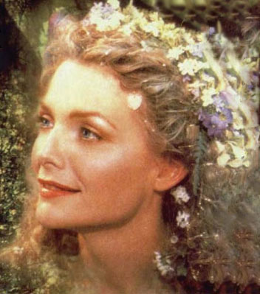
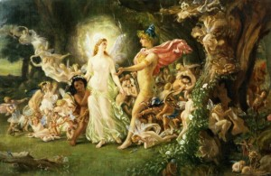
The Fairies
Puck
Oberon
Titania
Robin Goodfellow “Puck”
Serving Fairy to Titania
Peasblossom
Cobweb
Mote
Mustardseed
Additional Fairies
Oberon
Titania
Additional Fairies

Slide 20
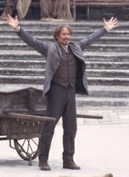
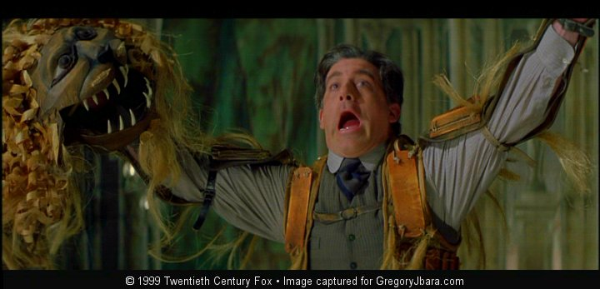
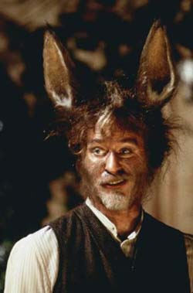
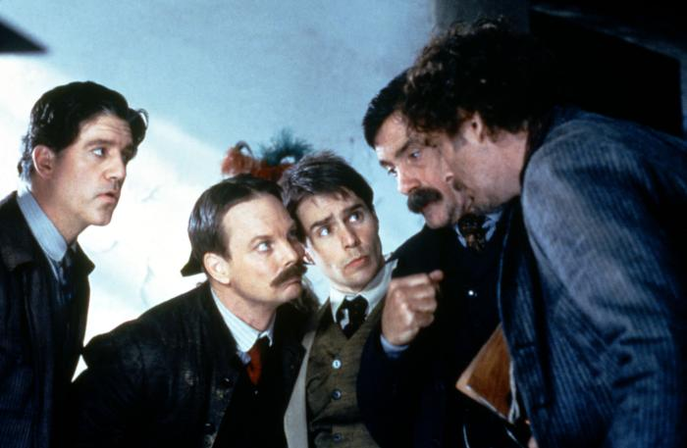
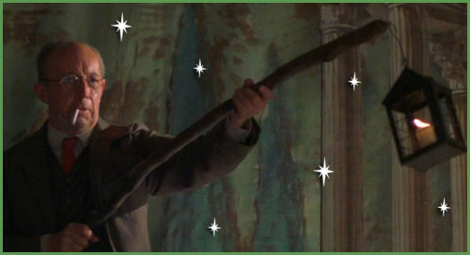
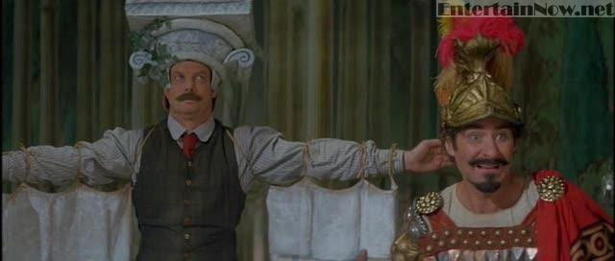
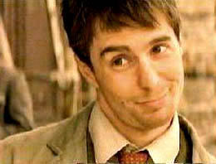
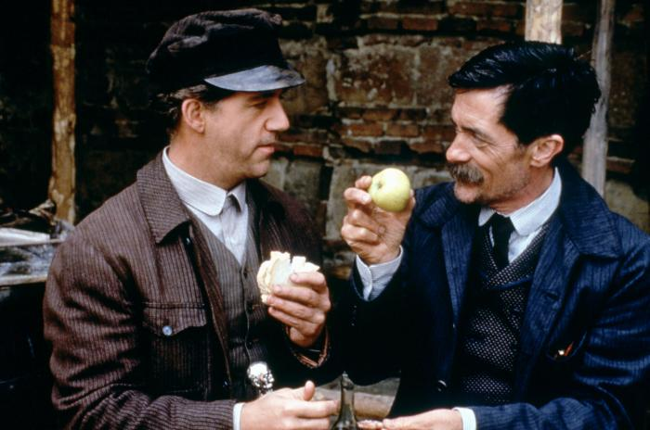
The Townies
Snug
Nick Bottom
Peter Quince
Francis Flute (Thisbe)
Tom Snout (wall)
Snug (lion)
Robin Starvling
Robin Starvling
Nick Bottom
Francis Flute
Tom Snout
Peter Quince

