Slide 1
Hero Archetypes

Slide 2
Objective for today
To learn about the concept of a Byronic hero, practice identifying them in literature, and analyze how the author develops characters’ traits.

Slide 3
What is a hero?
How would you define the term hero?
Is there more than one kind of hero?
Do they always do what is right? Do they always stand for good?

Slide 4
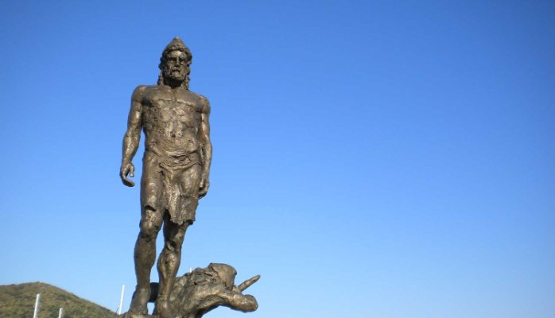
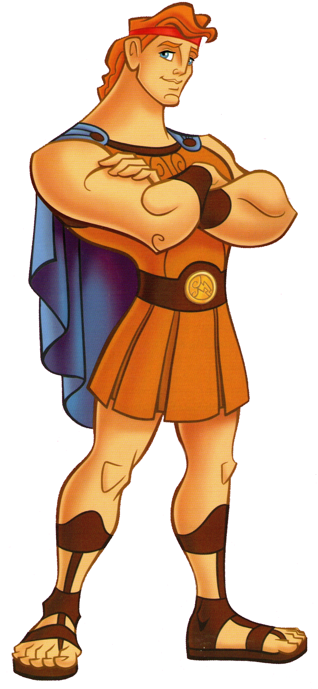
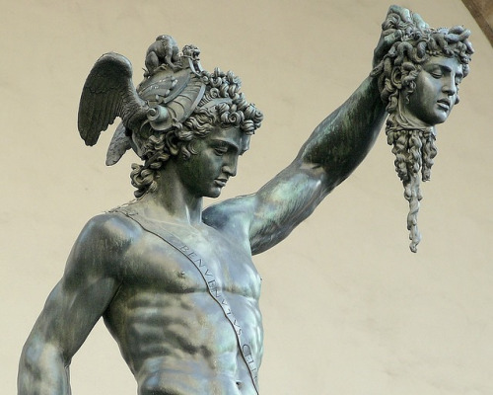
Types of heroes
Epic Hero:
This is the OG hero
Strong, handsome, manly men who fight monsters and rescue the damsel in distress
Originated in the great epics and myths of ancient civilizations

Slide 5
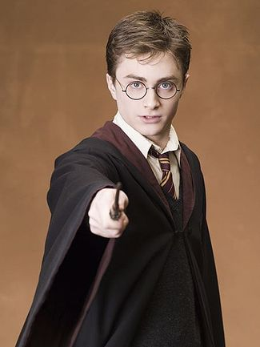
Types of heroes
Romantic Heroes:
Much less conventional than an epic hero, but still possesses positive traits
Typically, on a large quest to fulfill a personal desire but leads to a greater purpose. And usually obsessed with a lost love of some sort.

Slide 6
What is a Villain?
How would you describe villains?
Are they always evil?
Can they ever be redeemed?
What about the characters who aren’t noble enough to be an epic or romantic hero but aren’t evil enough to be a total villain?

Slide 7
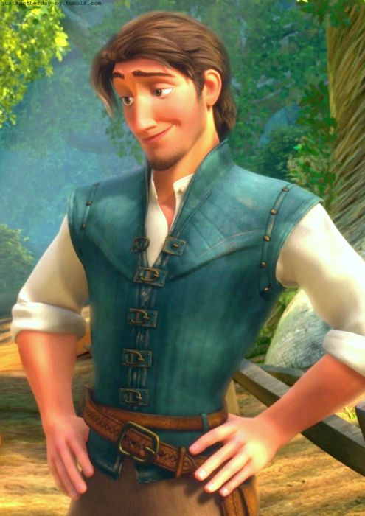
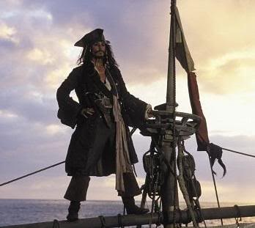
Captain Jack sparrow
FLYNN RIDER/EUGENE
CAPTAIN JACK SPARROW
Traits:
Cunning
Seductive
Outlaw
Charismatic
Struggles with integrity
Troubled past
BUT he does the right thing by not abandoning Rapunzel, returning the crown, and helping her escape Mother Gothel
Traits:
Pirate – lies, cheats, steals
Cunning
Charismatic
Arrogant
Self-destructive
BUT, he ALWAYS does the right thing by rescuing Will and Elizabeth Swann

Slide 8
Byronic heroes
Developed by Lord Byron in the 1800s
Their mantra: “mad, bad, and dangerous to know”
They aren’t a traditional hero but they are not a villain either, they’re a little in-between.
While they have all the capabilities of a hero, but they usually struggle with morality and integrity.
Their flawed characteristics make them more likable and relatable

Slide 9
Defining characteristics of a Byronic hero
Dislike for society and its norms
An exile, an outcast, or outlaw
Arrogant
Cunning
Cynical
Disrespectful of rank or privilege
Emotionally conflicted, moody
High level of intelligence and perception
Mysterious, magnetic, charismatic
Seductive
Self-critical and introspective
Self-destructive
Struggles with integrity
Troubled past
HOWEVER there is always some sort of redeeming quality or action. They always choose to do the right thing in the end.

Slide 10
Group Stations
1. Analyzing Gru from Despicable Me and Batman from The Dark Knight Rises
2. Researching Byronic heroes in popular culture
3. Casting Call- Create your own Byronic Hero for a Movie
4. Triple Venn Diagram comparing Haymitch, Edward Cullen, and Holden Caulfield
30 minutes per station
Backpacks stay along the wall and you bring only your packet and something to write with
Ask 3 people your question before interrupting me with ACHIEVE 3000 check off, please

