Slide 1
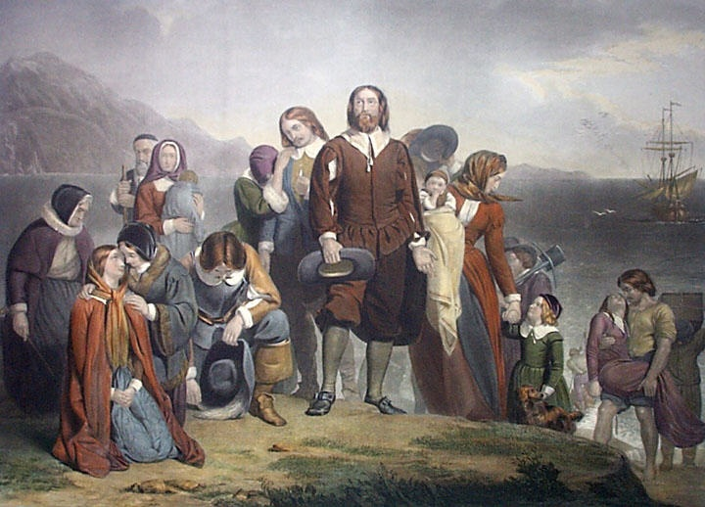
Puritans? Why do I care about the Puritans?
If you have lived in the U.S. for
a while, you probably know
something about the Puritans
(Pilgrims). That said, you still
might not know why they
should matter to you. After all,
maybe you have no European
ancestry. Maybe you are not
a religious person. Maybe you
don’t think you have anything
in common with the Puritans.
That said, the Puritans matter
to you.

Slide 2



SPAIN
(St. Augustine’s first European visitors)
FRANCE
(Jacksonville’s first European visitors)
The English Puritans were arguably the
most influential of the European groups
who arrived and settled in the New World.
In fact, they still influence your life in a
big way.
ENGLAND

Slide 3
THE FIRST REASON YOU CARE:
THEY STARTED THE TRADITION OF AMERICANS
TAKING A STAND FOR BELIEFS AND AGAINST INJUSTICE.
As literacy increased and Bibles became more accessible, many
people started to read the Bible for themselves rather than just trust
in church teachings. This contributed, of course, to the Reformation,
but also to the eventual rise of “Puritans.” Puritans felt the Church
of England was tolerating institutional practices that were not
grounded in the Bible and sought to either “purify” the church from
within, or as was the case with the Pilgrims and those who came to
America, separate from it altogether. Think about how that same
willingness to stand up for what one believes and stand against
injustice has been a part of the American spirit ever since.
(Revolutionary War, Civil Rights Movement)

Slide 4
REASON #2
YOU LIKE THE IDEA OF BECOMING PROSPEROUS.
Puritans believed that each individual was directly responsible
to God, without the need of a priest or other human mediator.
While individuality was highly discouraged in Puritan society
(being “different” was “bad”), great value was placed on each
individual as a contributor to society. The “divine right” of kings
started to give way to the rights of the common man and rise
of individual liberties. A man’s work was considered a means of
glorifying God, thus there was great dignity in working hard at
whatever vocation one felt called into. That said, working hard
was considered a virtue that could lead to prosperity.
This was the beginning of capitalism, which eventually led to the U.S.
becoming the most prosperous nation on earth.

Slide 5
REASON #3
YOU WANT AN EDUCATION (EVEN IF YOU DON’T ADMIT IT).
Puritans believed that the instruction and training of children was a very
important responsibility. Within 5 years, the Puritans established schools so
that all children could learn to read the Bible. In 1636, they established
Harvard College with the purpose of training ministers. Interestingly, in recent
decades, public schools and universities have been the subject of quite a few
“separation of church and state” debates, yet the great tradition of American
education has a lot to do with the Puritans.
If you attend public school and desire to pursue a college education,
then the Puritans matter to you.

Slide 6
REASON #4
YOU WANT TO VOTE FOR YOUR PREFERENCE, AND YOU WANT
TO KNOW WHY OTHER PEOPLE WILL VOTE FOR THE OPPOSITE.
The emphasis on godly behavior and leadership in Puritan society,
and the idea that every area of life should be influenced by Biblical
principles, set a foundation that is still very prevalent in modern
American viewpoints. Even as America has become very
diverse, debates over issues such as abortion, same-sex marriage,
sexually explicit content, and the religious convictions of private
business owners are all very much driven by a concern on one side
for protecting traditional standards of morality.
Whether you support or oppose such standards, they are still
an influence in every major election in the U.S.

Slide 7
The Puritans matter to you, so we are going to read what
one of their leaders, William Bradford, wrote in a few chapters
of his work titled Of Plymouth Plantation (beginning on page 5).

Slide 8
WARNING
The English language has changed since Of Plymouth Plantation
was written more than 300 years ago. Modern readers consider
William Bradford’s style and vocabulary to be archaic, or outdated,
and often challenging. Here are three strategies to help you
understand archaic language:
Divide long sentences into smaller parts. Punctuation such as commas
and semicolons, often mark where sentences can be split.
Identify the subject and verb. Knowing what is happening and who is
doing it in a sentence can unlock its meaning.
Paraphrase, or restate, challenging passages. Find synonyms for
unknown words.

Slide 9
ALLUSION: a reference to a person, place, event,
or other literary work the author expects will be familiar to readers.
Often, the author hopes to connect his own idea with what is
being referenced in order to make or clarify a point.
Allusions are most commonly made to literature, history, the Bible,
mythology, or pop culture. You will be asked to identify and
explain the significance of two of them in today’s reading.

Slide 10
MODIFIED CORNELL NOTES
Draw a vertical line down your paper, about an inch to the right of
the left-hand margin. The following topics will be written to the left.
(These are already written on the board).
the proud young man
great iron screw
John Howland
the shoals
1st allusion in the last paragraph
2nd allusion in the last paragraph

Slide 11
In the wider column on the right, I want you to explain the
significance of each topic with three bullet points (a total
of 18 bullet points for 6 topics).
Your bullet points can explain any of the following:
The context surrounding why that topic is mentioned
Why this topic may play a pivotal role in the larger story
What this topic reveals about the Puritan mindset
What point Bradford is making by including this topic
What consequence results from the given topic
How the context surrounding a particular topic relates to
something you or someone you know has experienced

