Slide 1
Basics of Finance and Investing
Jacob Carlson

Slide 2
A Bit About Me/Why I’m Here
Studied at UNF
Experience in both Financial Services and Corporate Finance
Financial Literacy is a gap in our education
Major decisions happen very early
I love finance!
Any opinions I express are my own.

Slide 3
Basic Agenda
What is money?
Time Value of Money
Interest and Compound Interest
Budgeting
Credit Cards and Debt (Car/House/College)
Investment Options/Retirement Accounts

Slide 4
What is Money?
Method of transaction (Avoids bartering)
Unit of account (Way in which we track units of value)
Store of Value (Holds value over time)
And…
Condensed time

Slide 5
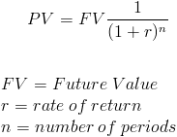
Time Value of Money

Slide 6
Interest and Compound Interest
The key to that formula is that it isn’t linear.
Say an investment earns 10%. At the end of year one, if you have $100 invested, you have $110. But at the end of year two, you have $121.
This is the key to finances, both in positive and negative terms.
Compound interest can work for or against you.

Slide 7
Examples
NPV of a College Degree
Amount you will need to retire
Paying off a Student Loan

Slide 8

Your Financial House

Slide 9
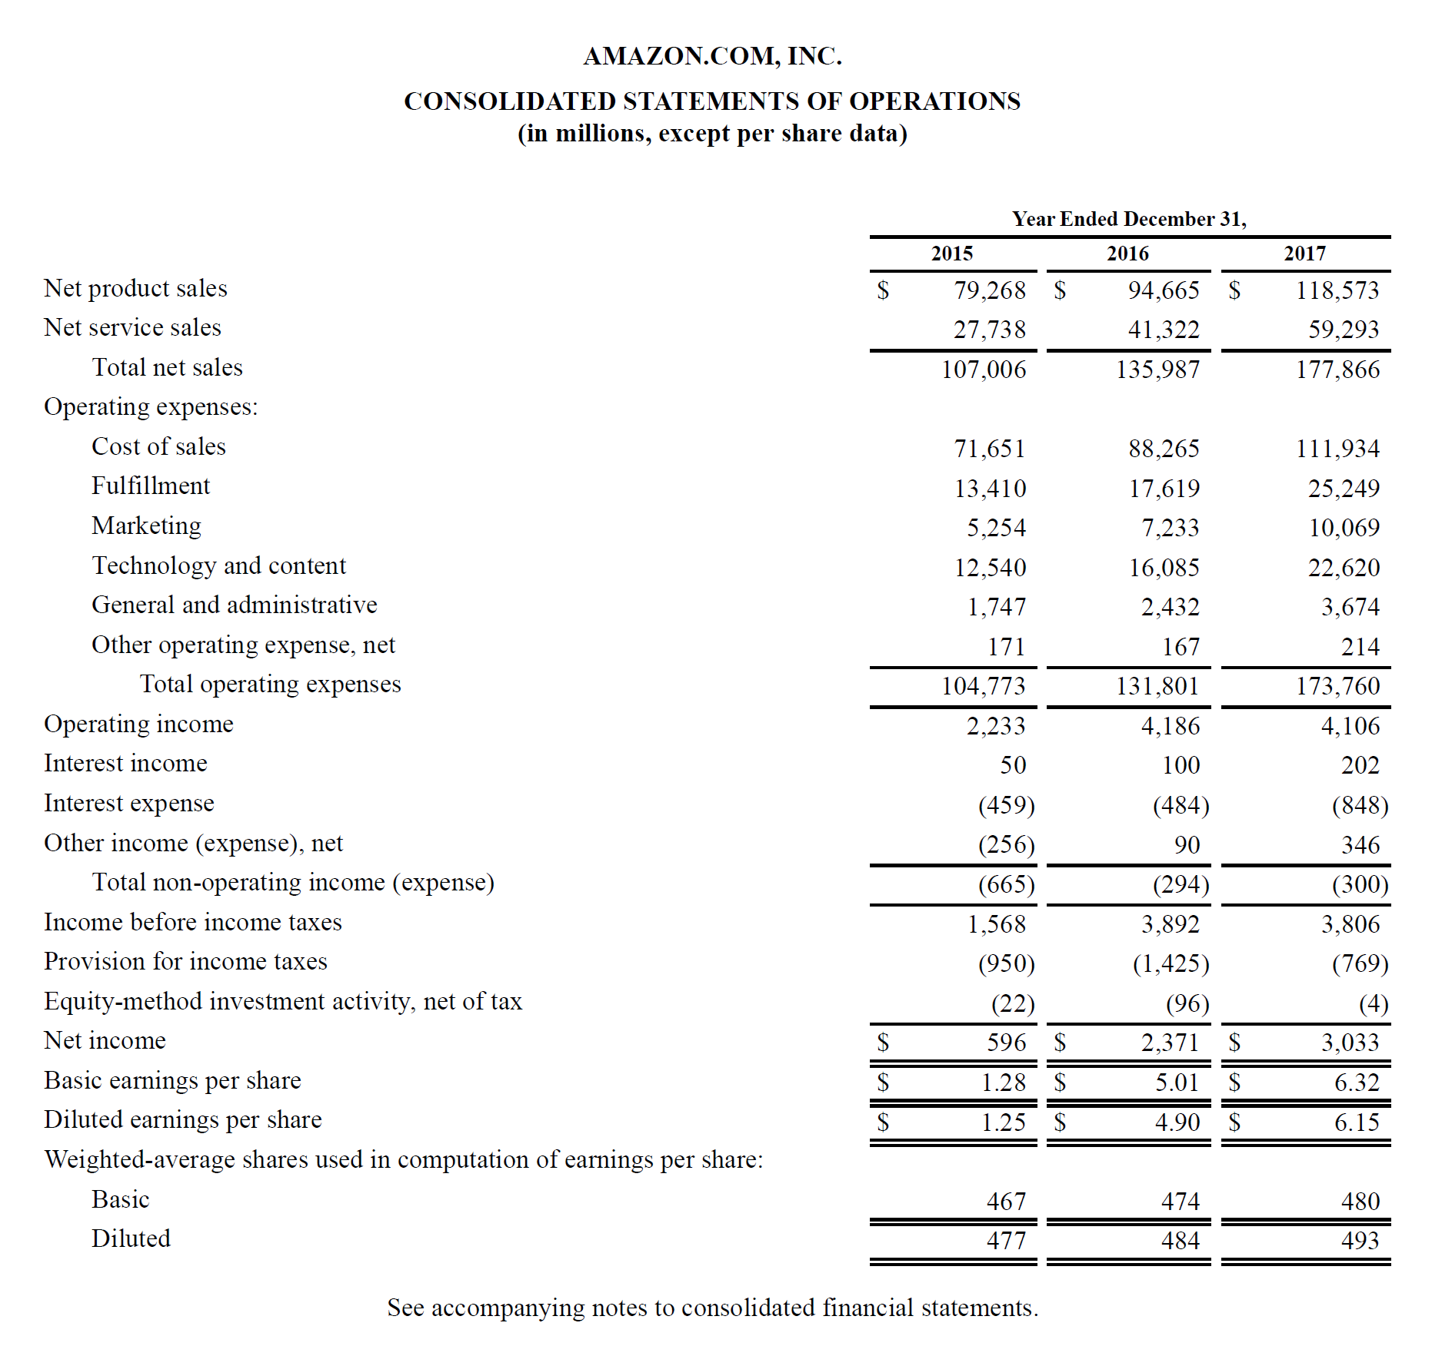
Budgeting

Slide 10
Loans
Almost any form of debt is the same.
Key factors are interest rate and duration of loan.
Longer term means lower payments, but higher total cost.
Students loans
Mortgages
CREDIT CARDS ($3,000 and 15% APR paying minimum costs $6,641)

Slide 11
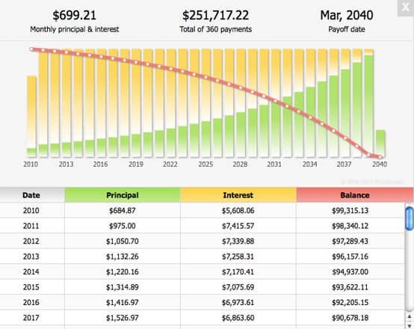
Loan Amortization

Slide 12
Investment Options
What is a bond?
What is a stock?
Diversification

Slide 13
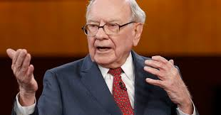
An Example of Financial Literacy

Slide 14
Follow Up
Where are the Customer’s Yachts?
Tony Robbins: Mastering the Game
The Snowball
The Intelligent Investor
Your Money or Your Life
jacobccarlson0316@gmail.com

