Slide 1
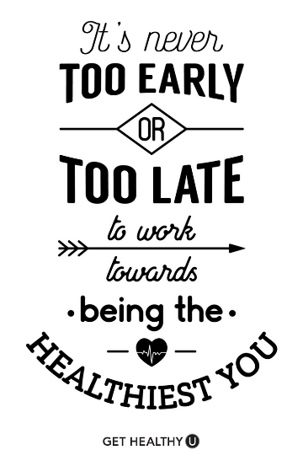
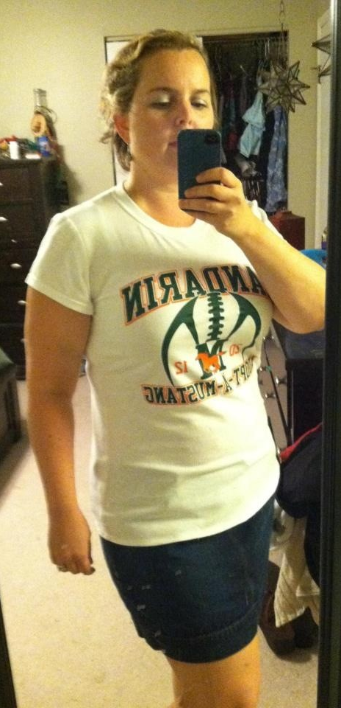


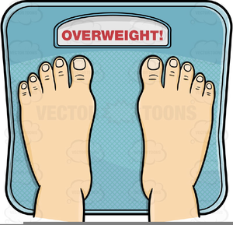


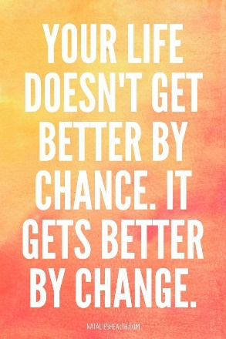
“if you’re unhappy that’s on you” (Hollis 5)

Slide 2
“women judging other women…ladies our judging has to stop” (Hollis 37)

Slide 3
“a specific dream…you used to work on it…change the way you see the word no” (Hollis 60)

Slide 4
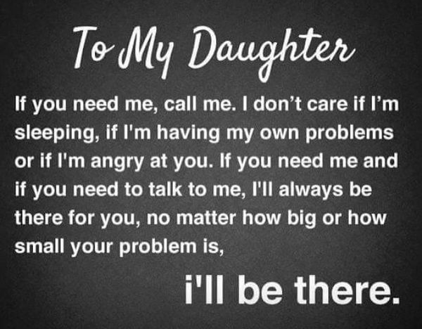

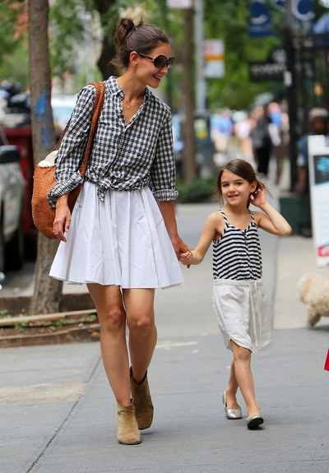
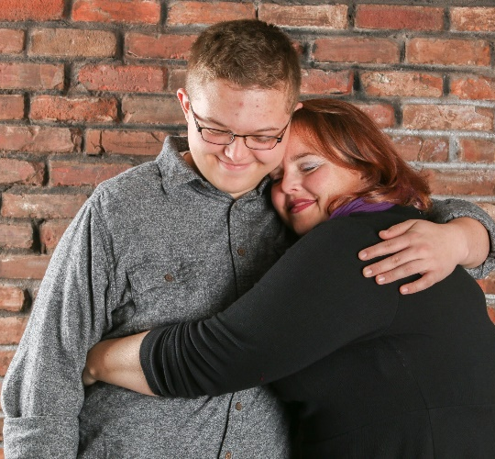

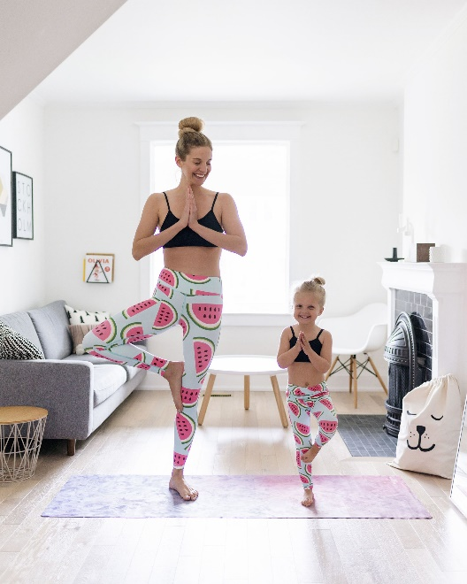
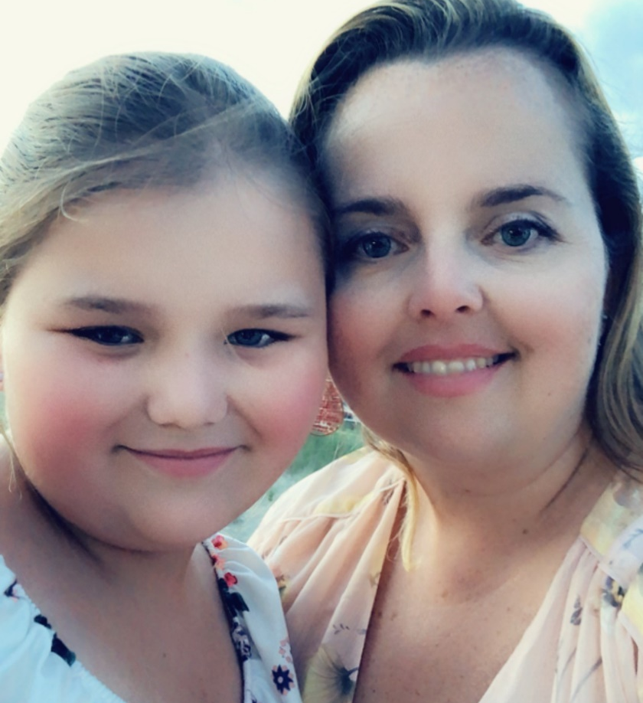
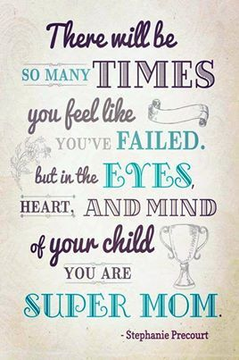
“my perception of this role was based on images I saw online & in magazines” (Hollis 85)
“like all the other moms” (Hollis 90)

Slide 5
“tapestry of people from all over the world” (Hollis 199)

Slide 6
Question 2: What life lesson, message, or theme conveyed in this book resonates with you the most? In other words, why do you find this book inspiring?
Question 4: How does the content of this book connect with your personal life and/or goals as you see them in the future—as a graduate with many choices to make?

