Slide 1
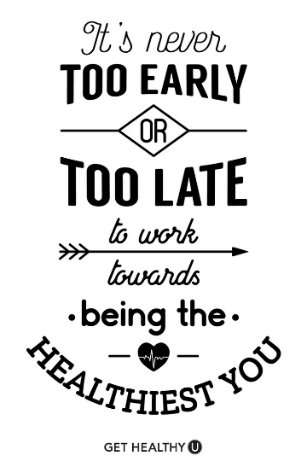
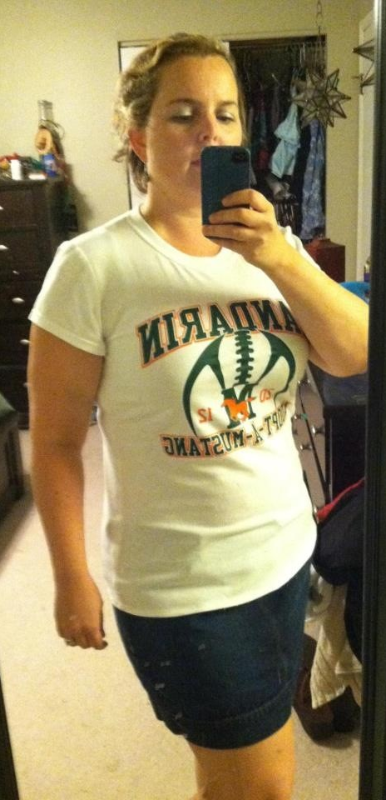

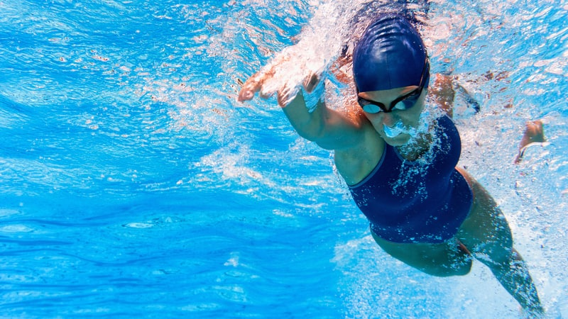
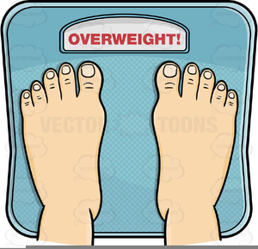
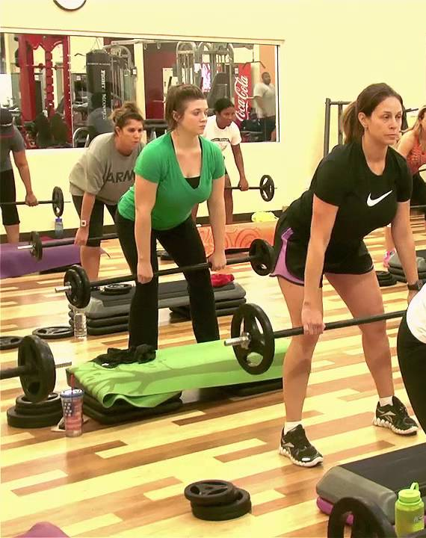
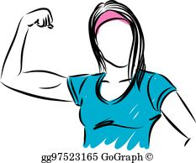
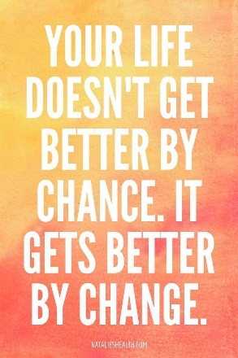
“if you’re unhappy that’s on you” (Hollis 5)

Slide 2

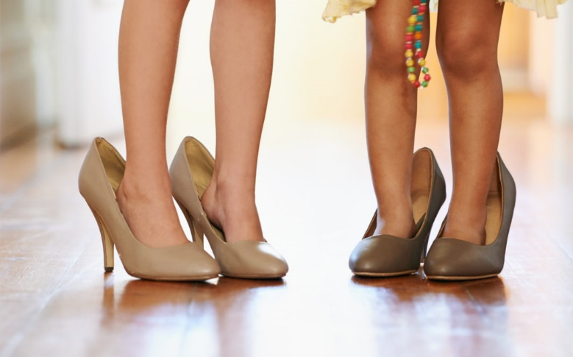
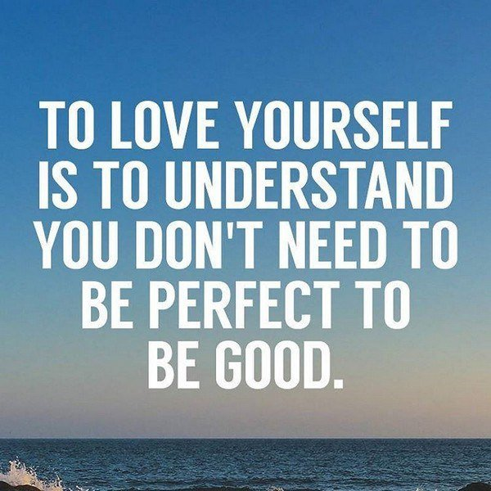
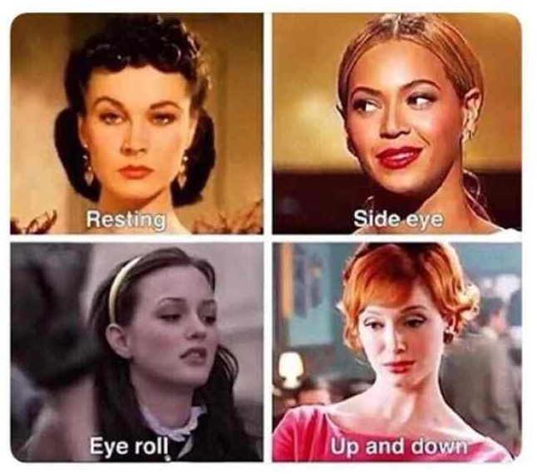
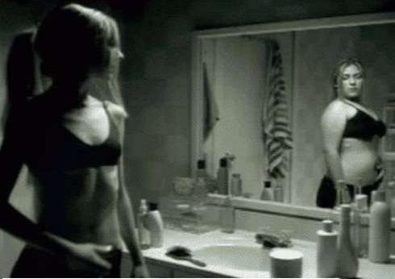
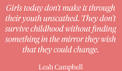
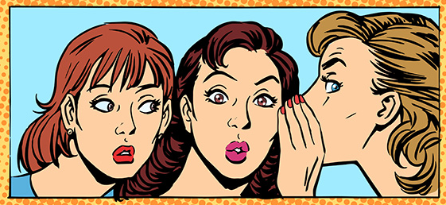
“women judging other women…ladies our judging has to stop” (Hollis 37)

Slide 3
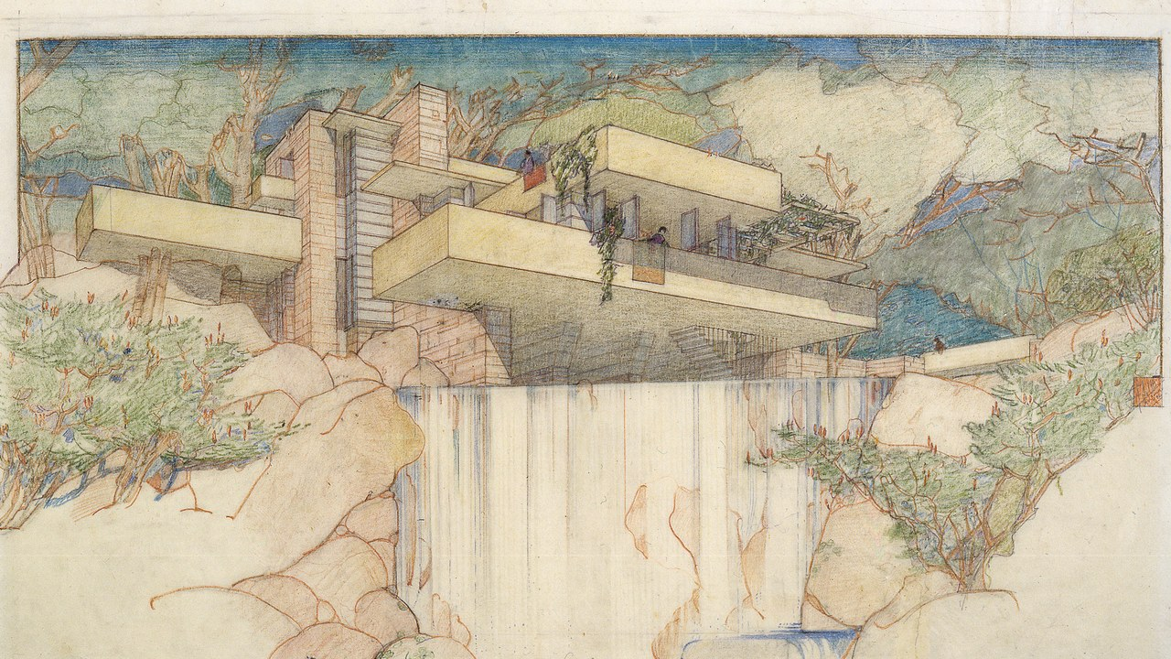

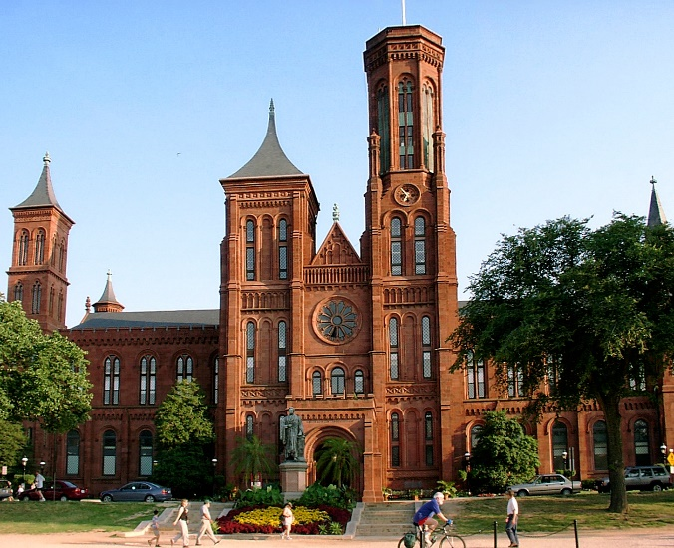
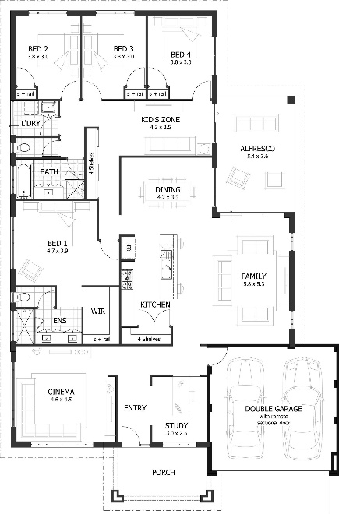


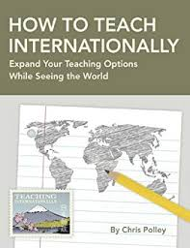
“a specific dream…you used to work on it…change the way you see the word no” (Hollis 60)
Museum Docent or Collection Curator
Architect
Live Internationally or in NYC

Slide 4
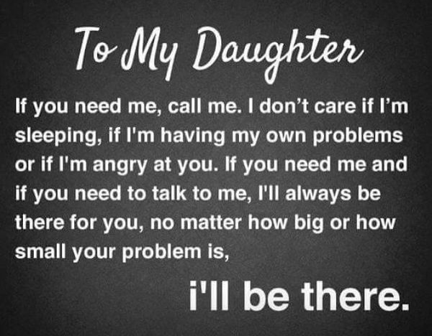

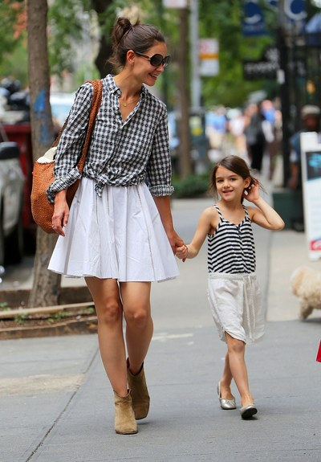
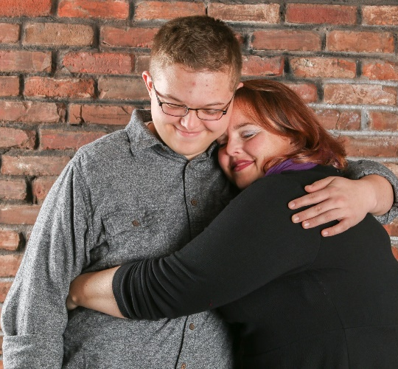
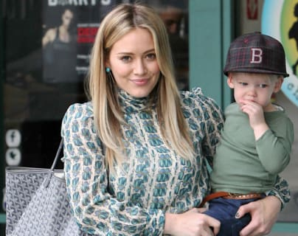
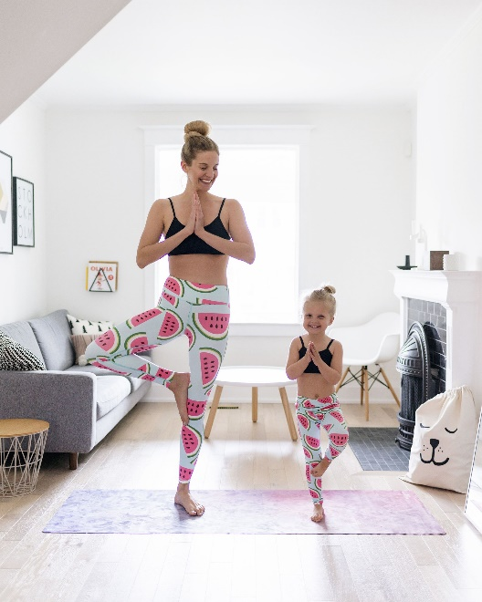
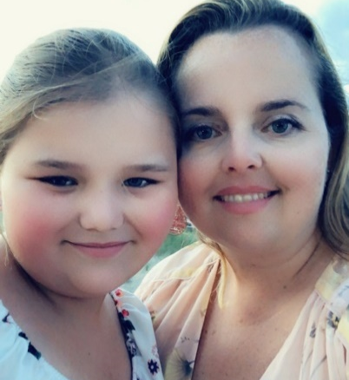
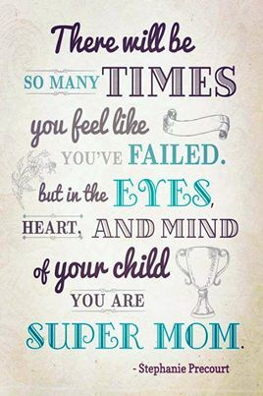
“my perception of this role was based on images I saw online & in magazines” (Hollis 85)
“like all the other moms” (Hollis 90)

Slide 5

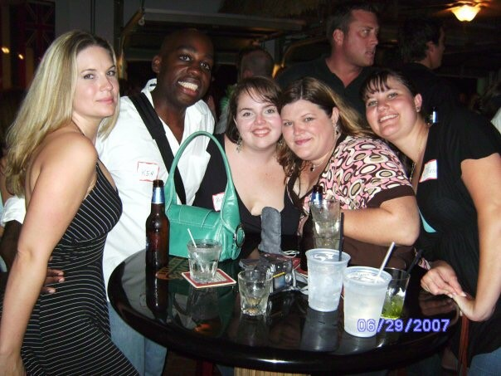

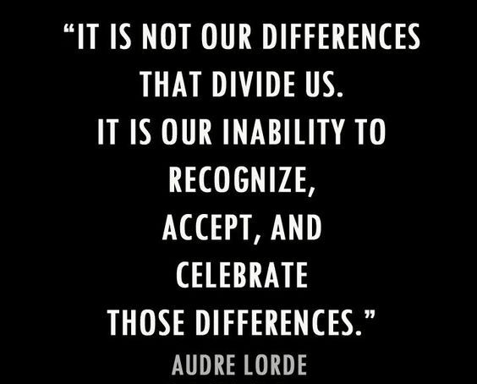

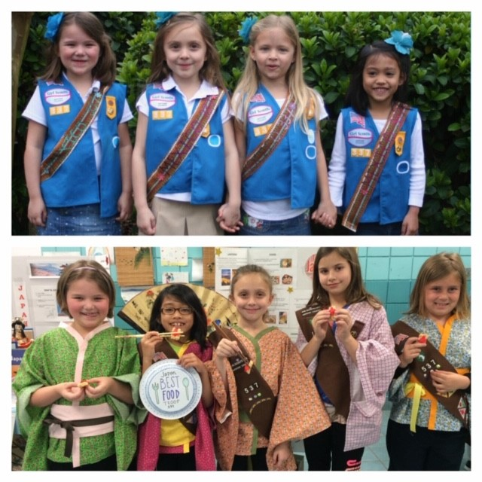
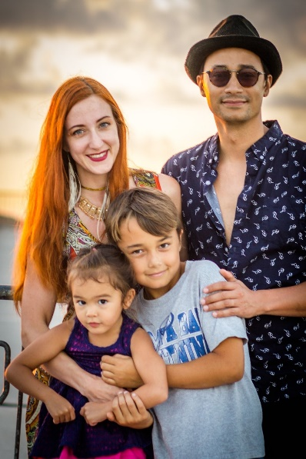



“tapestry of people from all over the world” (Hollis 199)

Slide 6
Question 2: What life lesson, message, or theme conveyed in this book resonates with you the most? In other words, why do you find this book inspiring?
Question 4: How does the content of this book connect with your personal life and/or goals as you see them in the future—as a graduate with many choices to make?
  In reading Girl Wash Your Face I was truly struck by the concept that “if you’re unhappy that’s on you” (Hollis 5) because, as many people do, I wanted to put the blame on multiple other factors as to why I wasn’t as happy in my life. Honestly, I am the one putting the junk in my mouth and not getting off the couch and going to the gym; so it really is on me to achieve my goal of being healthier. I have always wanted to be that healthy, fit “yoga mom” that I would see in magazines, but I have not been doing anything productive to get myself towards this goal. I know that I am like so many other “women judging other women…[and] ladies our judging has go to stop” (Hollis 37), well I have been judging myself. I keep wondering why I couldn’t get myself down to that perfect size six that my best friend from high school has always been, but in reality I’m not built like that, I have a bigger frame, and I need to be healthy for ME. There is Type 2 Diabetes in my family and I MUST start making better life choices now or I am going to be insulin dependent like my father. I need to break this thought process of what the “perfect mom” is supposed to look like, and just be the best I can be for my children. I need to walk away from “my perception of this role [being] based on images I saw online & in magazines” (Hollis 85) and realize that no matter how much of a Domestic Goddess I think Jennifer Garner might be, or bada** mom I find Pink to be-I am not them and don’t have those resources. I have ears to listen to my kid’s day, I have arms for hugs if they have been bullied, we can go out and get a smoothie to celebrate them for a kindness that they shared with a fellow student. I need to teach them to be good people, not just to look pretty, or to be thin, taking care of their soul health as much as I do their physical self.
  Going into college I thought I had a specific goal-to be a Forensic Psychologist, and then that changed once I was in classes and realized I was miserable. I earned a degree from Florida State University in Design/Technology for the Theatre with a focus on Scenic and Costume Design-I don’t work in the theatre anymore. I started my masters in Architecture and the Great Recession hit. I want to go back to that “specific dream…you used to work on…[it] changed the way you see the word no” (Hollis 60), so many people say that after 40 there is NO WAY that you are going to achieve your dream if you haven’t gotten there yet. Well I don’t want to hear that No, I want to be able to go on and get my Master’s Degree. To potentially be able to work for the Met or the Smithsonian, to take that love of history, theater, and art and be able to inspire future generations towards their dreams. I want to move beyond Jacksonville, to live in a place with a “tapestry of people from all over the world” (Hollis 199) and have my children be inspired by those other cultures to think outside of themselves and to make the world a better place for their generation and beyond.

