Slide 1
WHAT ARE PERSUASIVE APPEALS?
ETHOS | PATHOS | LOGOS

Slide 2

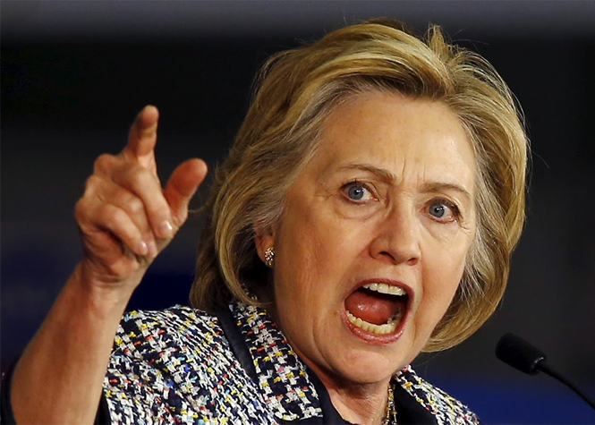
ETHOS: An ethical appeal attempts to persuade
people by appealing to their sense of right and wrong
(morals). Think of how election campaigns use character
attacks to convince voters that their own candidate is
trustworthy, of good character, or has accomplished
great things, while the opponent is crooked, dishonest,
or guilty of bad things.

Slide 3
PATHOS: An emotional appeal attempts to persuade people by
engaging their emotions. There are three main types.
1. Appeals to Fear Think of commercials that show the possible
consequences of using drugs or smoking in order to scare people
away from these activities.
2. Appeals to Pity (think of Humane Society commercials that use
sad music and pictures of homeless dogs and cats to convince
people that they should do something to help.
3. Appeals to Vanity Think of how beauty products, energy
drinks, and clothing brands are marketed to teens to convince
them that buying these items will make them feel good about
themselves.

Slide 4
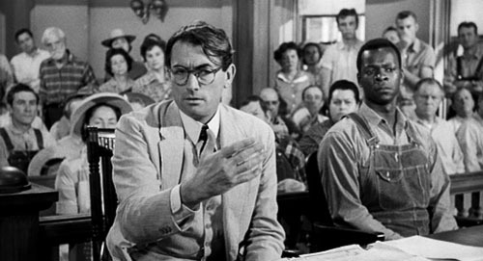
LOGOS: A logical appeal attempts to persuade people
through the use of data, evidence, experience, or other kinds
of support that lead to a logical conclusion. Think of how courts
of law must operate in order to determine guilt or innocence.

Slide 5
Ways to incorporate emotional &
ethical appeals:
LOADED LANGUAGE:
using words that have strong positive or negative connotations
Examples: suffer, majestic, ruthlessness, joyous, destructive, righteous

Slide 6
SIMILE: comparison using “like” or “as”
Example: “His future looks as bright as the sun.”
METAPHOR: comparison without using “like” or “as”
Example: “If today we plant the seeds of change,
tomorrow we’ll see a forest of new opportunities.”
HYPERBOLE: extreme exaggeration
Example: “Passing this terrible law will bring an
end to our democracy.”

Slide 7
ALLUSION: a reference made to something else
that an audience would be familiar with in order
to make or clarify a point
(The Bible, history, literature, mythology, and pop
culture are very common sources of allusions.)
Example: “With a very small budget but a perfectly
targeted message, I fought as David, and I
defeated the powerful Goliath standing in my way.”

Slide 8
PARALLELISM: repetition of words, phrases, clauses,
or sentences with the same grammatical structure
Example: With assignments at school, chores at home,
and responsibilities at work, Tina is always busy.
RHETORICAL QUESTION: asking a question not to get
a response but to make a point or get people
thinking about one’s point of view
Example: “What in the world were you thinking?”

