Slide 1

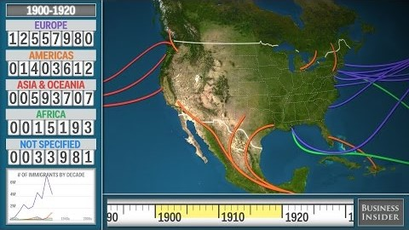



WE’RE GOING TO AMERICA!

Slide 2
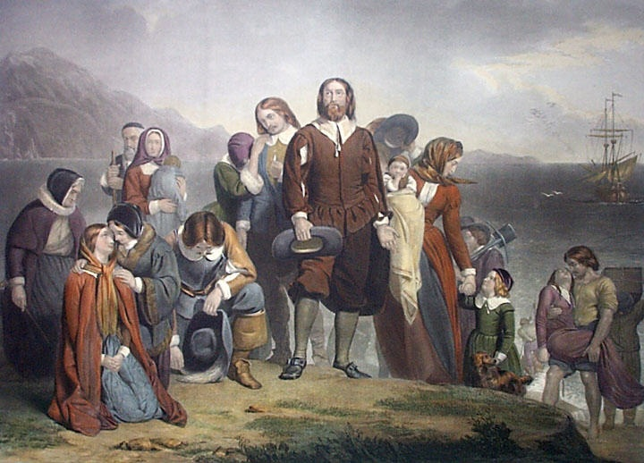
Puritans? Why do I care about the Puritans?
If you have lived in the U.S. for
a while, you probably know
something about the Puritans
(Pilgrims). That said, you still
might not know why they
should matter to you. After all,
maybe you have no European
ancestry. Maybe you are not
a religious person. Maybe you
don’t think you have anything
in common with the Puritans.
That said, the Puritans matter
to you.

Slide 3
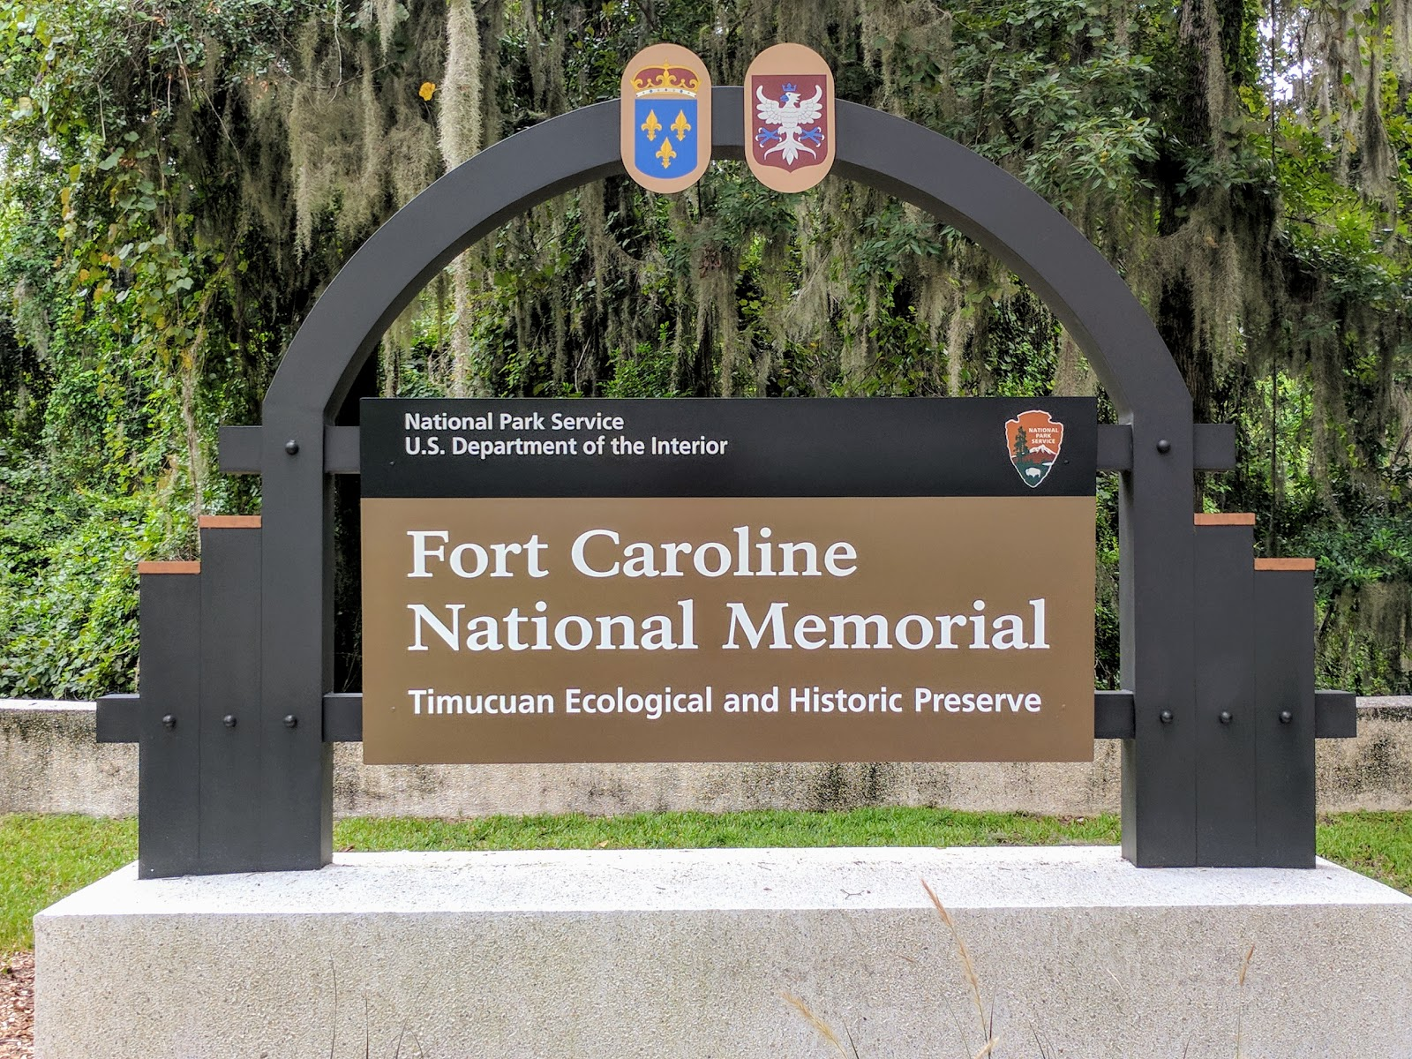
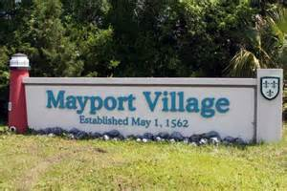
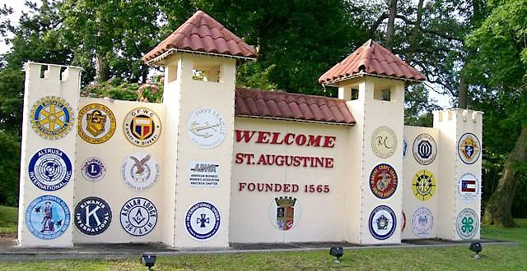
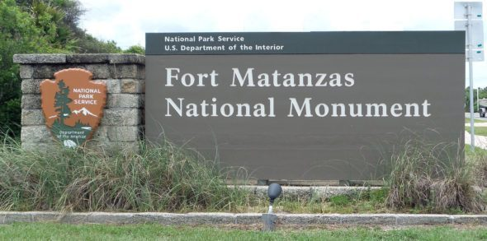
Here come the Europeans …
(a little context,
and some local flavor)

Slide 4


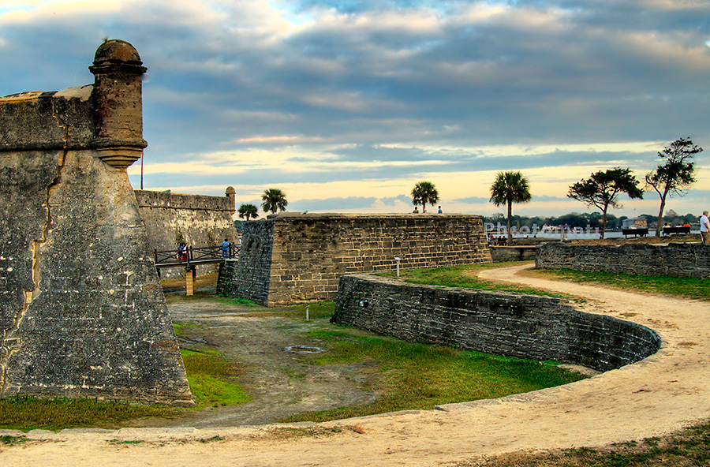
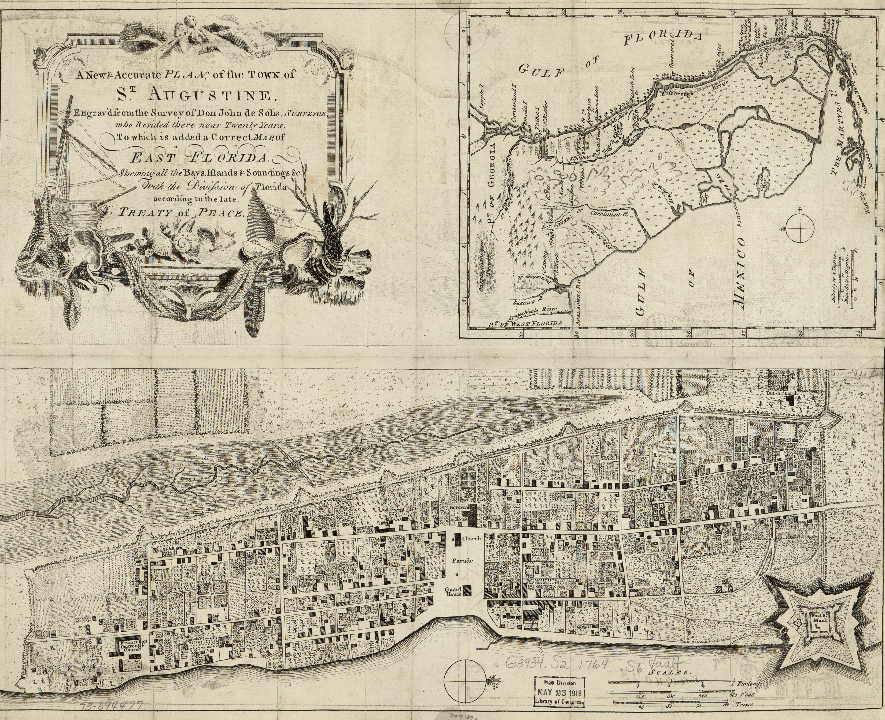
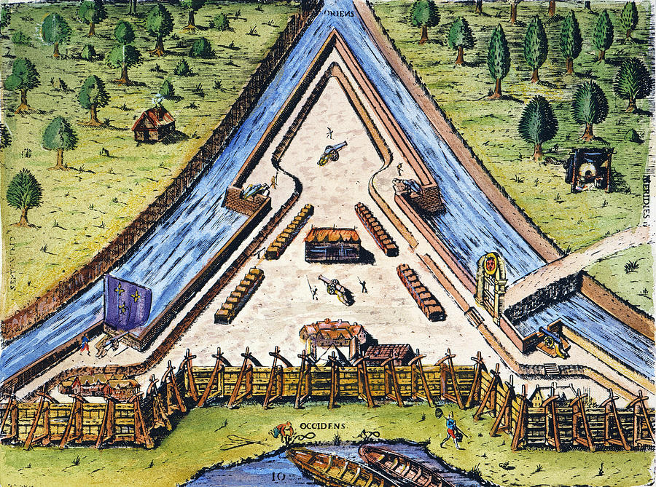
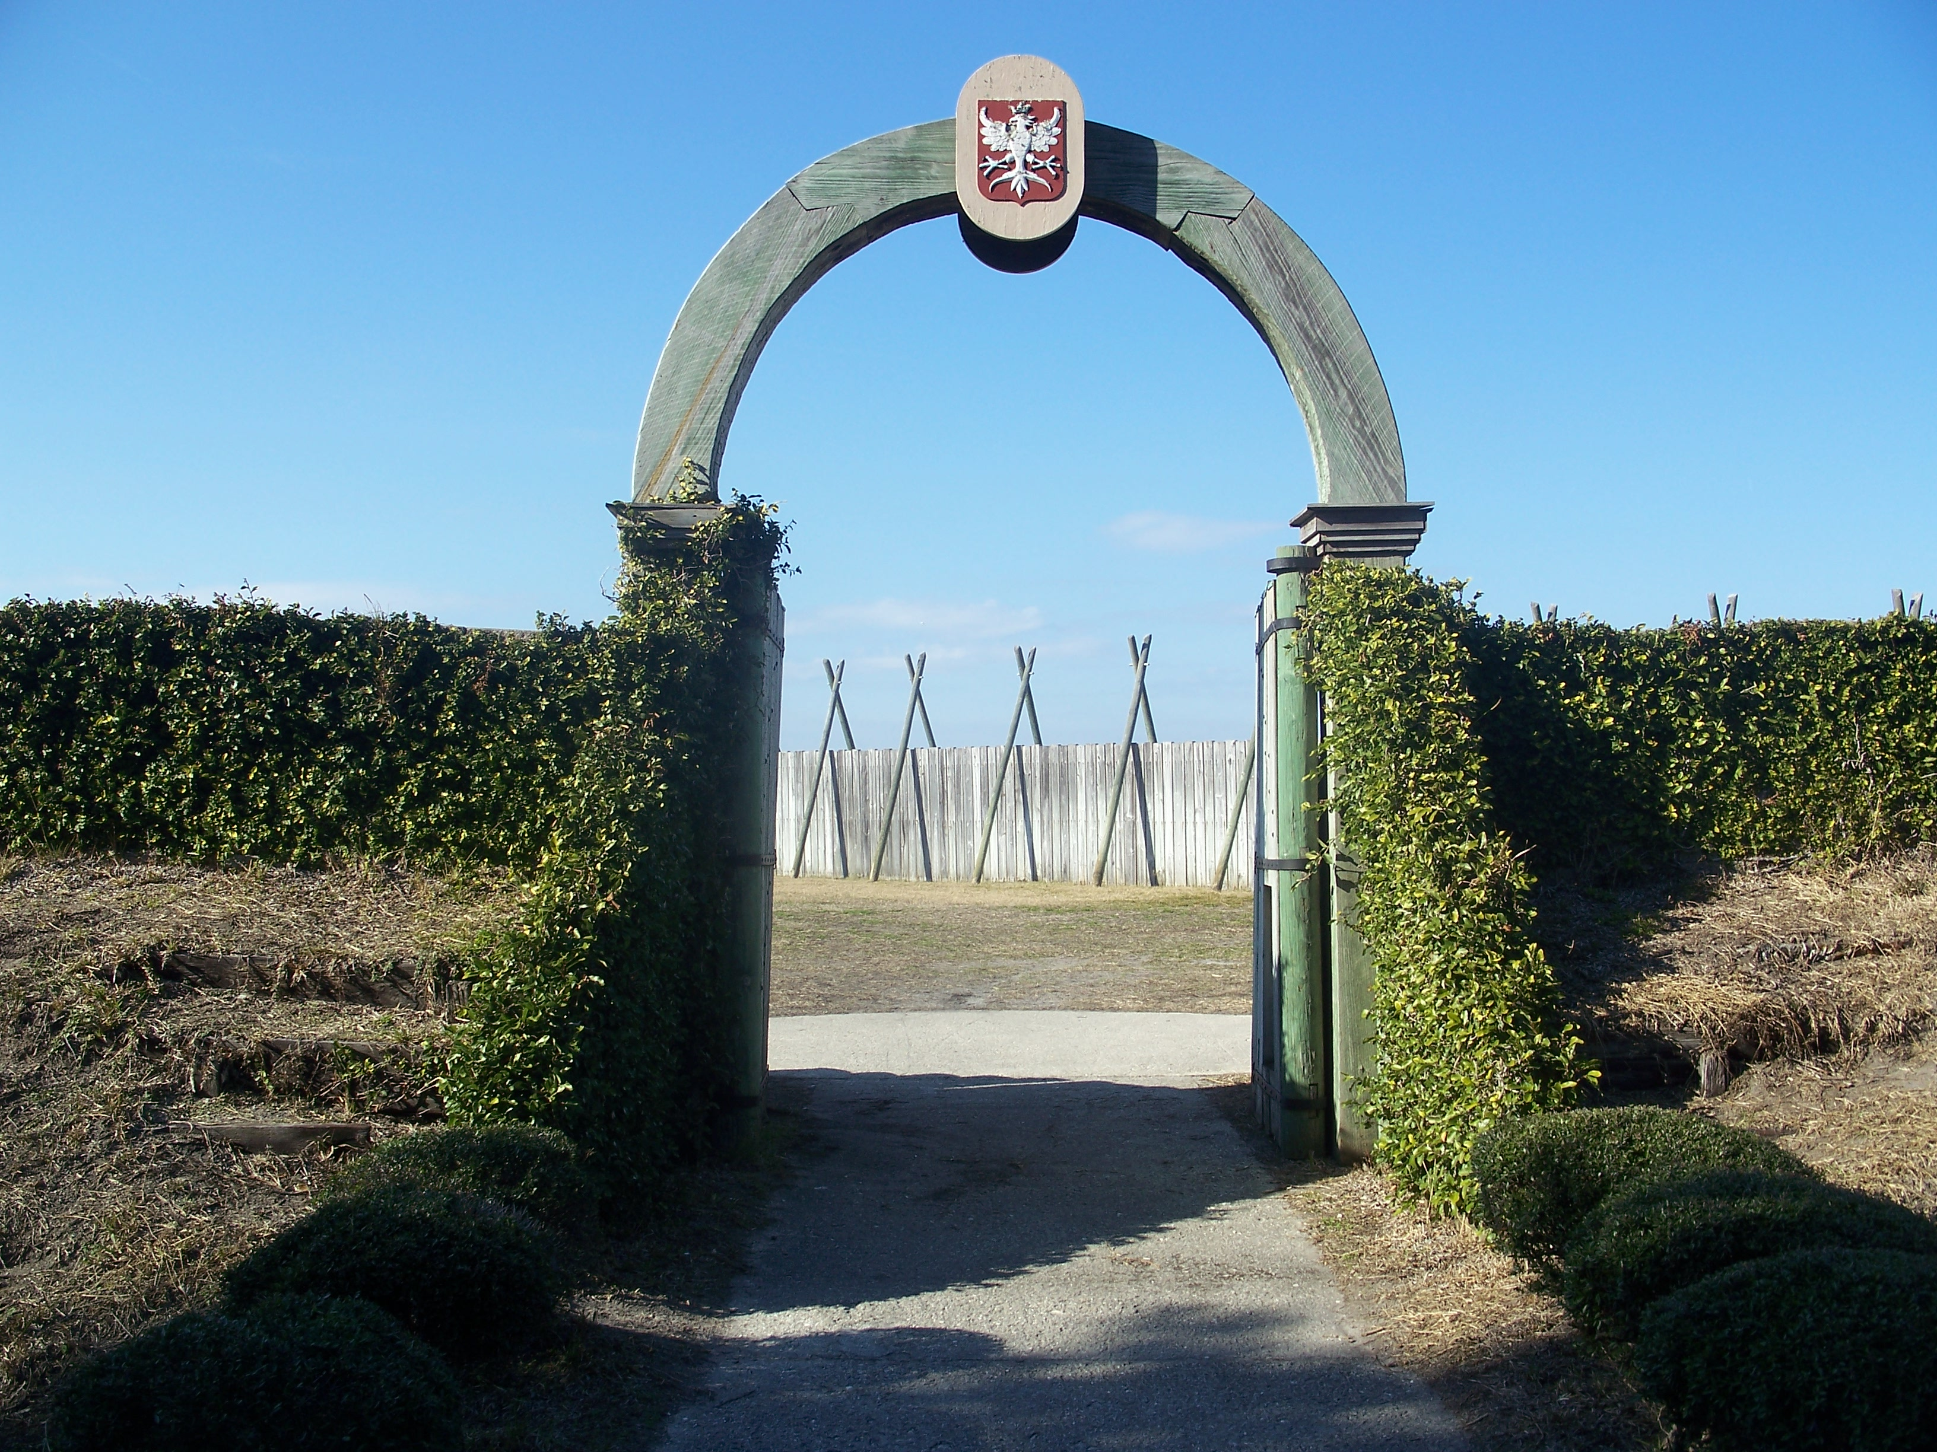
SPAIN
Florida’s (1513) &
St. Augustine’s (1565)
first European visitors
FRANCE
Jacksonville’s (1562, 1564)
& Amelia Island’s (1562)
First European visitors
1478 – start of Spanish Inquisition
1492 – Columbus (Italian) sails the ocean blue for Spain ($) and lands in the Bahamas
1513 – Ponce de Leon (Spanish) lands between Jax and St. Augustine (GTMNERR)
1517 – Protestant Reformation
1562 – Ribault (French Protestant) discovers the St. Johns River (River of Mai)
and Amelia Island (Isle De Mai)
1564 – Fort Caroline established along the St. Johns River by French Protestants
1565 – St. Augustine established by Pedro Menendez to protect Spain’s claim;
Spain defeats the French - “Matanzas” as in the Matanzas River, means “slaughter”

Slide 5

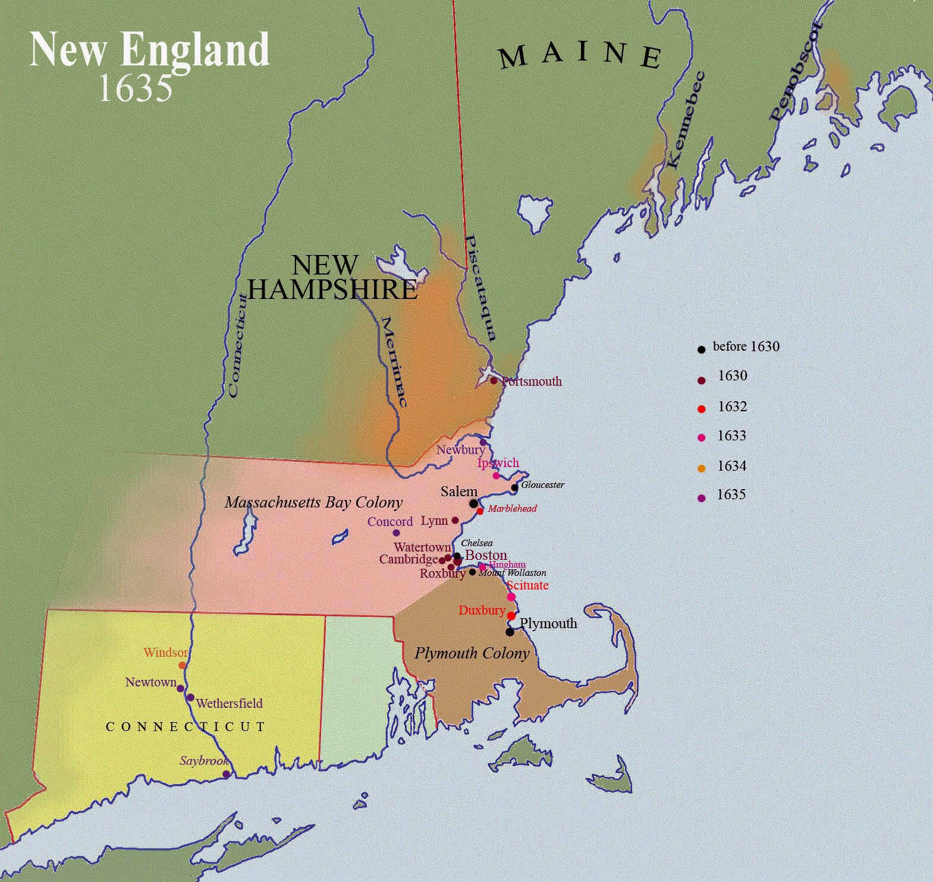
ENGLAND
Though settling well north of Florida, by the
1600s English Puritans became arguably the
most influential of the European arrivals in
the New World. In fact, they still have an
influence on life in America a big way.

Slide 6
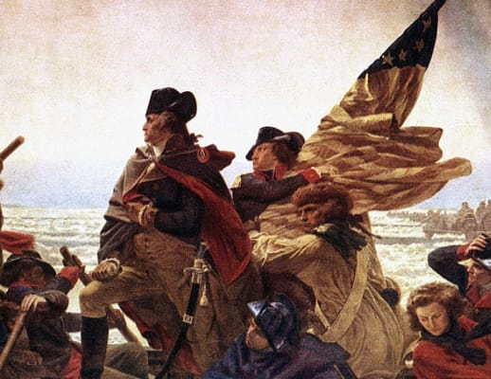
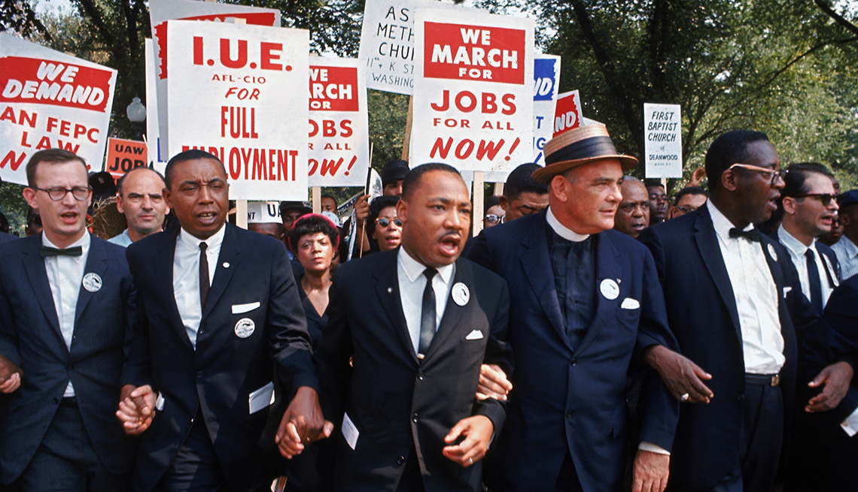
THE FIRST REASON YOU CARE:
PURITANS STARTED THE TRADITION OF AMERICANS
TAKING A STAND FOR BELIEFS AND AGAINST INJUSTICE.
As literacy increased and Bibles became more accessible, many people started to read the Bible for themselves rather than just trust in church teachings. This contributed, of course, to the Reformation, but also to the eventual rise of “Puritans.” Puritans felt the Church of England was tolerating institutional practices that were not grounded in the Bible and sought to either “purify” the church from within, or as was the case with the Pilgrims and those who came to America, separate from it altogether.
That same willingness to stand up for what one believes and stand against injustice has been a part of the American spirit ever since. (Revolutionary War, Civil Rights Movement, etc.)

Slide 7

REASON #2
AMERICANS LIKE TO BE PROSPEROUS.
Puritans believed that each individual was directly responsible to God, without the need of a priest or other human mediator. Though individual expression was limited, great value was placed on each individual as a contributor to society. The “divine right” of kings started to give way to the rights of the common man and rise of individual liberties. A man’s work was considered a means to glorify God, so there was great dignity in working hard at whatever vocation one felt called into.
Hard work led to personal prosperity, and capitalism was born.

Slide 8

REASON #3
YOU WANT TO BE EDUCATED (EVEN IF YOU DON’T ADMIT IT).
Puritans believed that the instruction and training of children was a very important responsibility. Within 5 years, the Puritans established schools so that all children could learn to read the Bible. In 1636, they established Harvard College with the purpose of training ministers. While in recent decades, public schools and universities have been the subject of quite a few “separation of church and state” debates, the origins of American education go back to the Puritans.
If you attend public school and desire to pursue a college education, then the Puritans have had an influence on you.

Slide 9


REASON #4
ELECTIONS ARE OFTEN WON OR LOST BASED ON ISSUES ROOTED IN PURITAN VALUES
The emphasis on godly behavior and leadership in Puritan society, together with the idea that every area of life should be lived by the principles taught in the Bible, set a foundation that is still very prevalent in modern American viewpoints.
The political divide that exists today in America partly hinges on how people defend or reject certain traditional moral values and religious teachings.

Slide 10
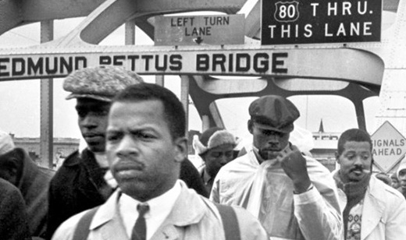

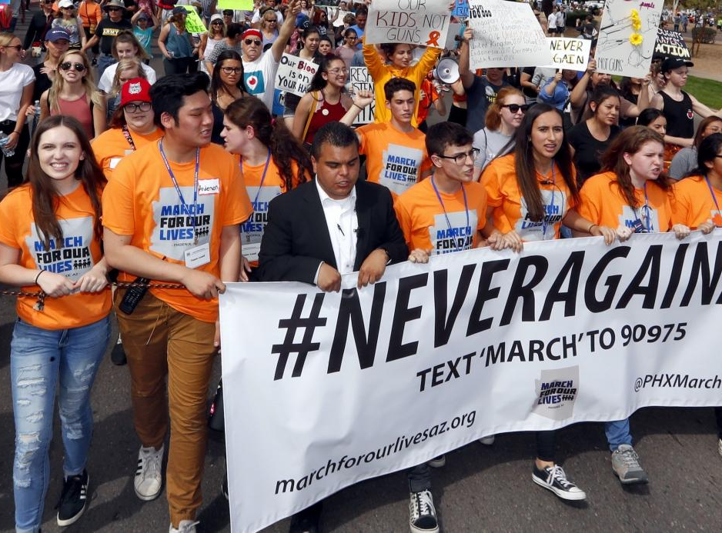


Like them or not, what the Puritans did matters to you because
it matters to American society.

Slide 11
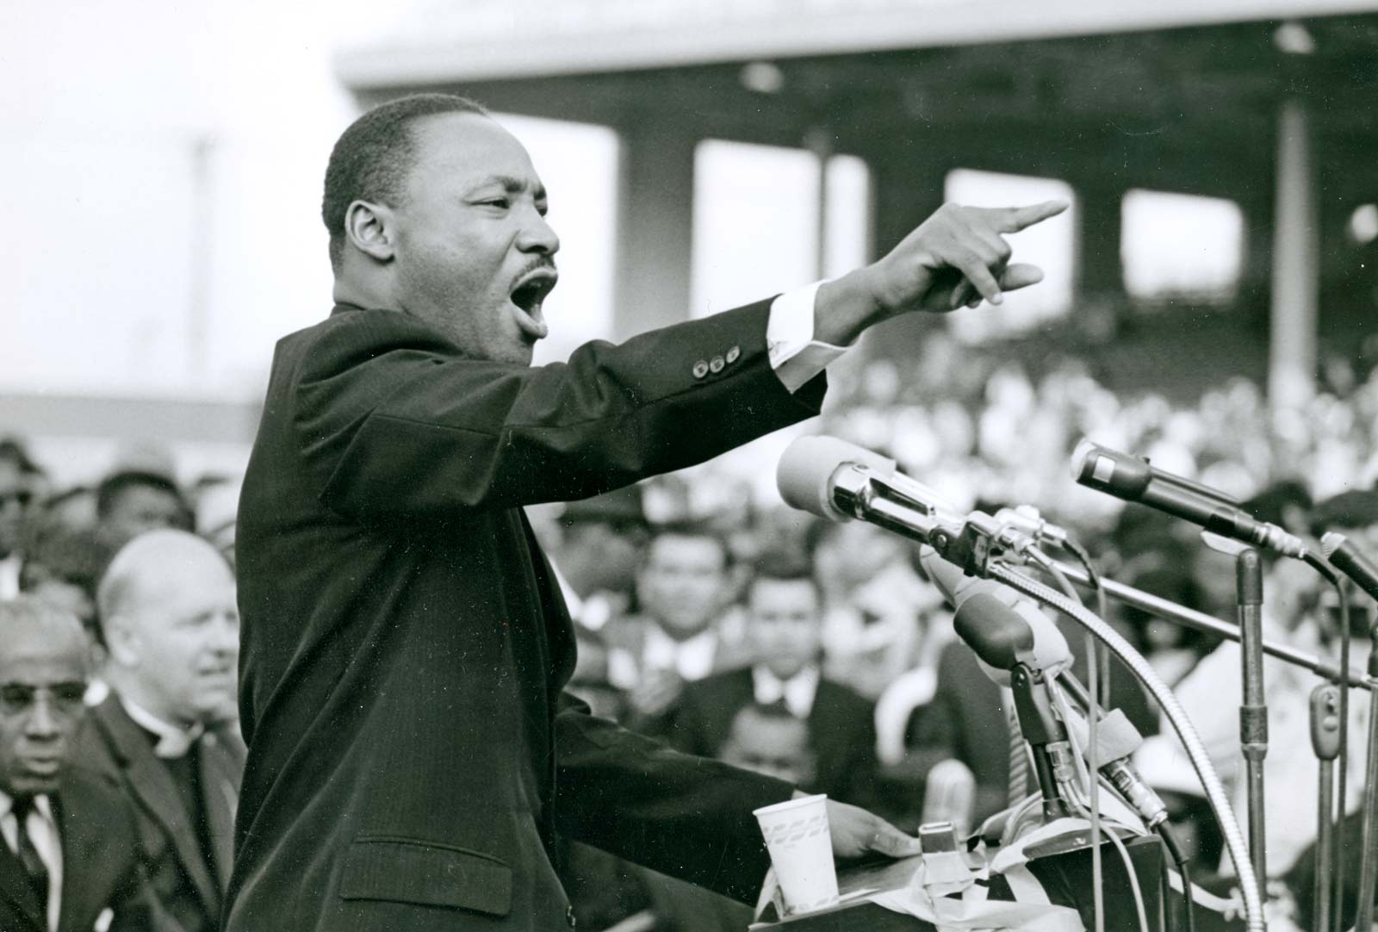


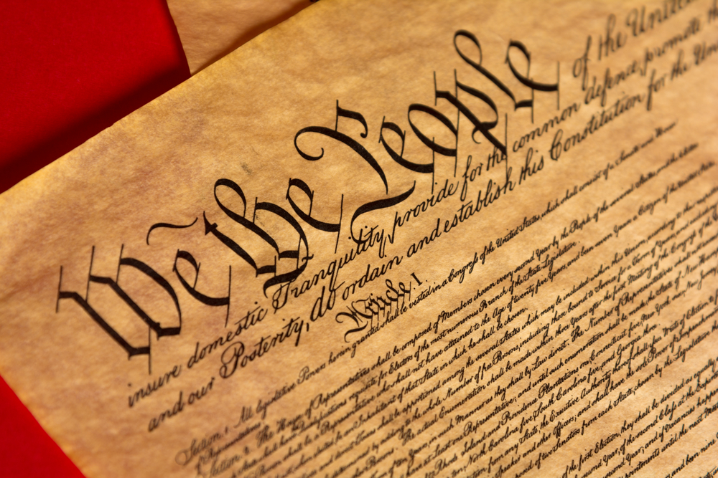
ALLUSION - a reference to a person, place, event, or other literary work that an author expects will be familiar to readers
The author hopes to connect his/her own ideas with a well- known reference in order to illustrate or clarify a point.
Literature
History

Slide 12
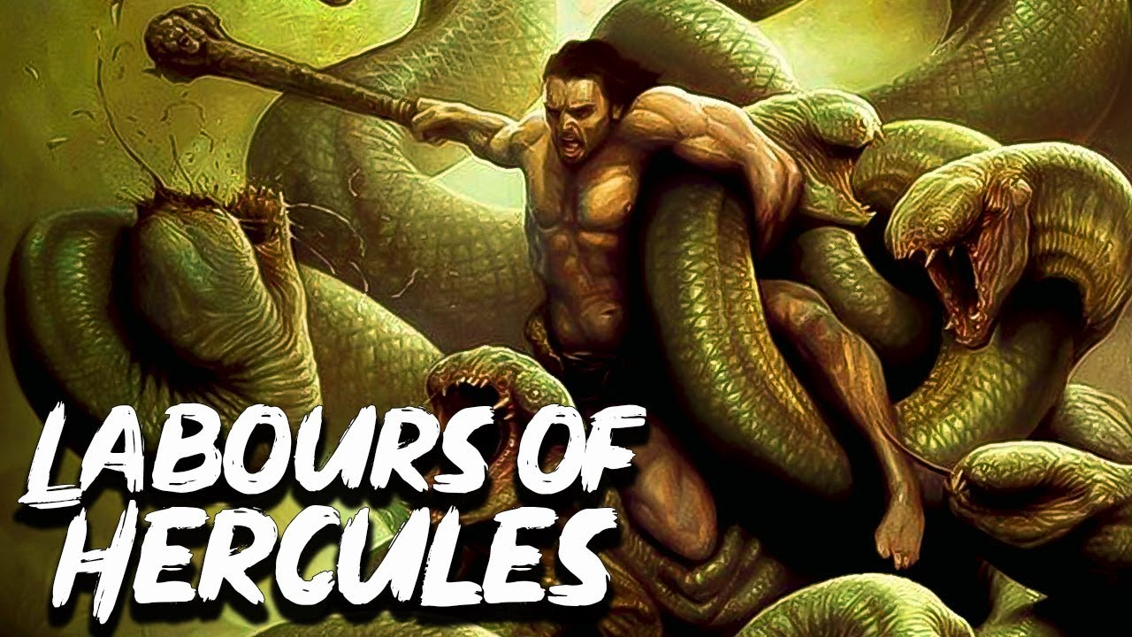
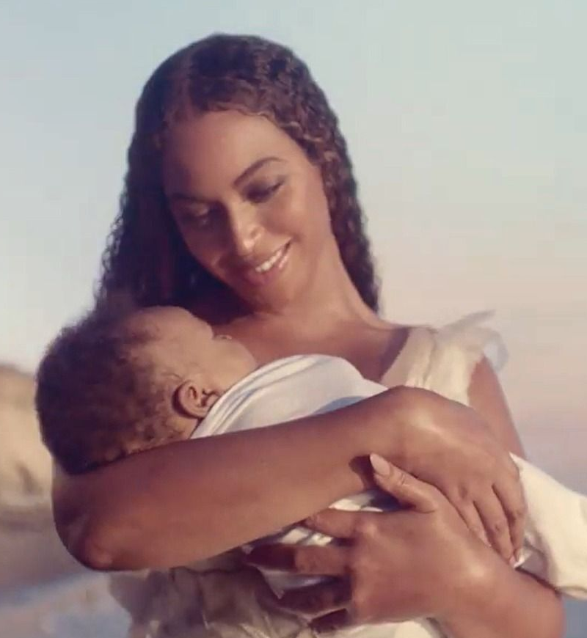
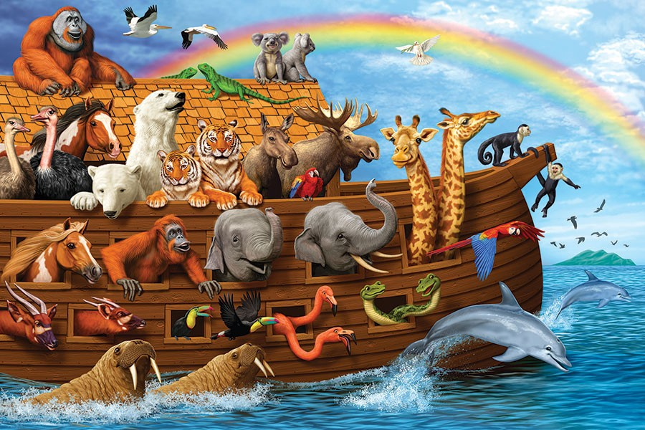


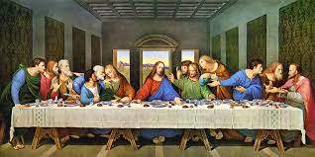
More Allusion Examples-MEMES are Allusions (if you don’t know you don’t get it)
Mythology
“We’re all in this together”
Pop Culture
The Bible
“She’s caught in a BAD ROMANCE”

Slide 13
We are going to read what one of the Puritans’ leaders,
William Bradford, wrote in a few chapters of a work titled
Of Plymouth Plantation.
For your first literature assignment, I will provide you with four topics and two questions pertaining to Chapter IX from Of Plymouth Plantation (pages 5-8 in the online textbook).
For each topic, you must provide the context (explanation of what/who the topic is), the benefit or consequence (the good thing or bad thing that comes about from this context), and the greater significance (how this particular topic led to something else even bigger)

