Slide 1

How to Add Voice Over to Power Points
Vicky Schrimsher
Mandarin High School
Sunday, March 22, 2020

Slide 2


Slide 3


Slide 4
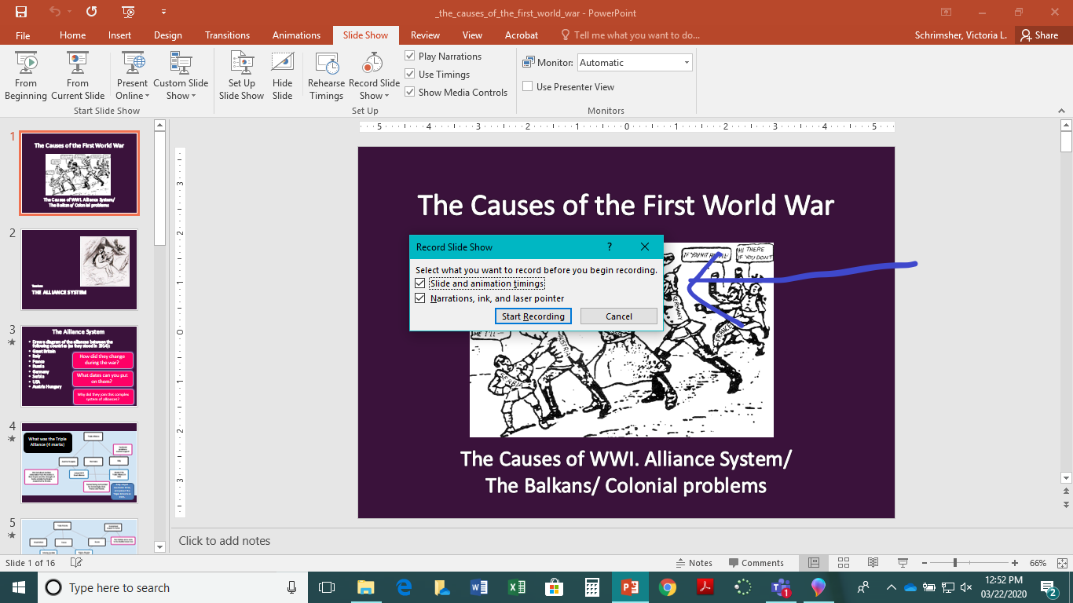

Slide 5


Slide 6


