Slide 1
A High School Student’s
Guide to (limited)
Financial Literacy
BUDGETING FOR SUCCESS

Slide 2
Financial literacy is…
the knowledge that is necessary to make financially responsible decisions that are integral to our everyday lives
the ability to understand how money works in the world: how someone manages to earn or make it, how that person manages it, how he/she invests it (turn it into more) and how that person donates it to help others

Slide 3
Why is financial literacy important?
Top reason students give for dropping out of college is financial constraints
Young adults underestimate the length of time it would take to pay off a credit card balance
One in 10 students leave college with over $10,000 in credit card debt.
Regardless of income, 78% of US citizens are living “paycheck to paycheck”
A Gallup poll found only about 1/3 of Americans (32%) maintain a household budget
Nearly 19% of Americans have nothing set aside to cover an unexpected emergency
The average 2016 graduate left school with over $37,000 in total debt

Slide 4

Budget
A step-by-step plan for meeting expenses in a given period of time.
(Also called a “personal spending plan.”)
3 Things a budget can do...
Gives you control of your financial situation
Reduces money-related anxiety
Helps you visualize where your money is being spent

Slide 5
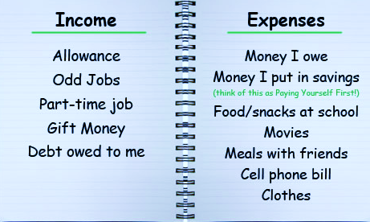
How to Prepare a Budget
Track daily spending
Determine income and expenses
Find ways to decrease spending
Find ways to increase income

Slide 6




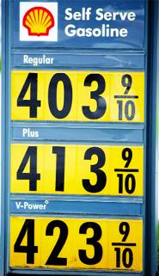

Fixed vs. Flexible Expenses
Fixed expenses | Expenses with amounts that don’t change from month to month
Flexible expenses | Expenses with amounts that may change from month to month
Let’s come up with 3 more items for fixed & flexible expenses.

Slide 7

Pay Yourself First:
SAVINGS
BENEFITS:
Learn to manage money better
Save money toward your goals
Leaves less money for frivolous spending
Have money for emergencies
When you get your paycheck, put some of that money in a savings account before you pay your bills.

Slide 8
Saving pays!
INTEREST is the profit made on money that is saved in an investment account.
$1 a day
$5 a day
Wow! That’s a $101,662 difference!

Slide 9

Keep an Accurate Record of Checking Account Activity
Record all transactions
Record maintenance fees,
interest, and other bank charges
Review the monthly checking account statement
Download mobile app
Reconcile your check register
with your monthly checking account statement
Notes:
Start 1st here

Slide 10

“Bad”
or
NSF Check
A check or transaction you write/make when there isn’t enough money in your checking account to cover it.
Bad check fees
Negative activity reported
Bank closes your account
Civil and/or criminal prosecution
Merchants may not accept your checks
Your credit may be impacted

Slide 11
FEES
Banks deduct fees from your account for:
Monthly service fee (many offer free student checking)
Minimum balance fee
Automated Teller Machine (ATM) user fee
Overdraft fee
Stop-payment fee

Slide 12

Credit
Credit is money you borrow to pay for things.
“Good” credit - making payments on time.
“Bad” credit - harder to borrow in the future.
Why credit is important:
It can be useful in emergencies.
It’s more convenient than carrying cash.
It lets you make large purchases.
It can affect your ability to get employment, housing, and insurance.
Types of Loans:
Consumer installment loans
(Cars, furniture, electronics)
Credit cards
Student loans

Slide 13
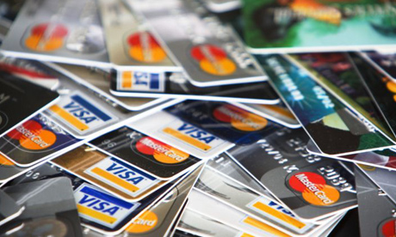
The Cost of Credit
Fees
Annual maintenance fees
Service charges
Late fees
Interest
Interest on credit is a fee you pay on top of the money you already owe. It’s the price paid for borrowing money.
Total U.S.
Credit Card Debt
$757 billion

Slide 14
Benefit of Making More Than the Minimum Payment
Original Balance | APR | Monthly Payments | Total # of Monthly Payments | Total Years to Pay Off | Total of Payments
$2,500 | 18% | Minimum Payment (MP) | 123 | 10 | $3,915
$2,500 | 18% | MP + $25 | 50 | 4 | $3,258
$2,500 | 18% | MP + $50 | 33 | 3 | $2,839

Slide 15

Understand the gimmicks!
Rewards (miles, cash-back, points, donations)
Freebies (t-shirts, music, gift cards)
Store cards: 20%+ interest rates
Pre-approved offers
Cash advances
Promotional interest rates
Seniors graduating from college acquire an average of $4,000 in credit card debt spread across at least two cards by the time they’re out of school.

Slide 16
6 Ways to
Use Credit Cards Wisely
Charge small amounts and pay off entire balance each month
Don’t make late payments
Request lower credit limits
Don’t MAX out!
Choose ONE card
NEVER accept cash advances

Slide 17
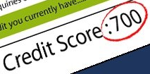
Information in a
Credit Report
A credit report is a record of how you have paid your debts.
It tells lenders:
Who you are
How much debt you have (value of the card goes against you)
Whether you have made payments on time
Whether there is negative information about you in public records

Slide 18
Inquiries and Your Credit Score
Three national credit bureaus are authorized to review credit reports: Equifax, Experian and TransUnion.
Check credit report annually for free at www.annualcreditreport.com
Information in your credit report may determine whether you will:
Get a loan or other form of credit
Get a job
Rent an apartment
Get insurance
Get utilities
Get cell phone service
Credit Score Range
Higher than 760 | GREAT!!
725-760 | Very Good
660-724 | Good
560-659 | Not Good
Lower than 560 | Bad

Slide 19
When I grow up
Now its time to make that minor choice of
WHAT AM I GOING TO DO FOR THE REST OF MY EXISTENCE ?!
So what should you consider before this life altering decision?

Slide 20
When I grow up
Your Work Style
Are you a self starter? Do you accomplish goals on your own?
Do you need structure and discipline to achieve your best?
An honest evaluation of your work style will help you decide on a career path.
If you are a day dreamer or procrastinator, you may want to choose a career with supervision to help you stay on task.

Slide 21
When I grow up
Your Talents
Choose a career that aligns with a hobby or talent that you love or achieve at.
Transform your activities into a career that will come more naturally.

Slide 22
When I grow up
Your Financial Goals
ONE aspect of choosing a career is making enough money to meet your financial goals.
If you want to own a vacation home on every continent and fly to these homes on your private jet, a job as a retail clerk will probably not help you achieve your goals.

Slide 23
When I grow up
Your Social Needs
You'll spend one-third of your life with the people you work with, so choose a career that's a good social fit.
If you're a loner who doesn't enjoy social interaction, you may be well-suited to a career where you work independently or work from home.
If you love to meet new people, you may find a career in sales fulfilling, where you work with the public.

Slide 24
When I grow up
Get Real-Life Experience
Follow the example of companies that use interns and temps to evaluate an individual before they extend a job offer. Real-life experience in the work environment where you think you want to work can help you make up your mind for certain. Job shadows, internships and temporary assignments give you a realistic view of a day in the life of a profession.

Slide 25
When I grow up
Be Patient
Finding the right career is a process, not an event.
An entry level position in your field may not be your dream job, but it can give you a foothold on the career ladder you want to climb.
It takes time to develop your career but setting goals and following a plan to achieve them can help you fulfill your career aspirations.

Slide 26
When I grow up
Go to your Packet and find the “When I Grow Up” worksheet
Find the EXCEL file on Teams entitled ‘Income by Occupation”. Use this file to guide your search.
Choose your future!!!
No Pressure.

Slide 27

There’s No Place Like Home
Now that you have selected a rewarding career,
You can start to find a place to live.
For the purposes of this project, we will assume that you are going to move out and get your own place to live.
You will more than likely need to rent before you have built up enough savings and credit to buy a home.

Slide 28
Tips to find the right place
Know Your Deal Breakers and Limitations
Your commute time to work
How do you feel about pets?
Distance to mass transit
If you want a quiet place to live
What type of amenities do you want?
Roommates
Parking and storage

Slide 29
Tips to find the right place
Check out apps
Zillow, Trulia, Realtor, Apartments.com
Don’t limit your self to just renting at an apartment complex. You may find a room for rent or a condo that is similar in price to an apartment.
Check out housing groups or ads on social media.
(BE CAREFUL! People are weird!!)

Slide 30
Tips to find the right place
Look for a Roommate
Most people starting off will not be able to afford a single bedroom apartment on their own.
Post an ad for a roommate, the more you broadcast, the better chance you have of finding someone. Try sites like spareroom.com, roomster.com, or even craigslist.com.
(BE CAREFUL! People are weird!!)

Slide 31
Tips to find the right place
STAY SAFE
Never send money, SSN, or other personal information to strangers.
Do not sign an documents or turn over cash until you investigate. If you are renting from a person, google search their name, the apartment/house listing, and key words like “scam” or “lawsuit”.
Because, people are weird.

Slide 32
Tips to find the right place
Finally,
DO NOT MAKE AN IMPULSE BUY
This process can take a lot of time, do not rush it. Once you find a potential place, look around the neighborhood and surrounding areas. Spend some time with the idea before you commit.

Slide 33
Utilities
Utilities can be both fixed and variable expenses. Most utilities like power, water, and gas are variable based on usage. While other utilities, like cable/internet and cell phones, are a fixed monthly cost.
Budgeting for Your Total Utility Cost
To get an idea of what you should be paying for variable utilities, you can check with your local utility providers for more specific information, or consult with a realtor, neighbor, or anyone else who knows the specifics of your neighborhood.

Slide 34
Utilities: Variable
Electricity
According to the most recent data from the U.S. Energy Information Administration, the average U.S. electric bill is $115.49. The average for the state of Florida is $129.65.
Water and Wastewater
A leading water-focused research group published a study last year, finding that the average bill in the U.S. for water and wastewater was $104 total.

Slide 35
Utilities: Variable and Rare
Gas
While Gas powered heating systems are more common in different areas of the country, you may find places in Florida that use gas. Gas power can be used for heating, water heaters, and cooking. Rocket Mortgage reported in 2017 that the average monthly gas bill in Florida was about $399.
Garbage Removal
A rare expense, that is usually rolled into the taxes you pay, some places do charge for Garbage Collection. You can probably expect to pay between $20 and $50 for garbage removal in most cases.

Slide 36
Utilities: Choices
Phone, cable and Internet
Unlike electricity, which costs more as you use more, typically these services charge a flat fee.
The best way to save money is to pick the most affordable services upfront. These days, there are very low-cost cell phone plans, and many people choose to skip cable and opt for a cheaper streaming service instead.
For Internet, you may be able to save money by opting for a slower speed, since oftentimes the upgraded plans do not make enough difference to warrant the cost.
For a family of two adults, a conservative budget for these expenses might be around $100 per month. However, these costs could easily creep to $200, $300 or more if you do not shop around, subscribe to many services, or opt for expensive options.

Slide 37
Utilities
Utilities can add up very quickly and take a big chunk of your budget.
Unfortunately, many traditional budget models do not properly account for these costs.
Try to spend no more than 10 percent of your monthly income on utilities, and take simple steps to lower these costs as low as you can.

Slide 38

Groceries
Healthy food can be expensive.
Therefore, it can be difficult to eat well when you’re on a tight budget. However, there are many ways to save money and still eat whole, single-ingredient foods.
Here are some tips to help keep you healthy and on budget

Slide 39

Groceries
Plan Your Meals
Plan your meals for the week and make a grocery list. Only buy what you’re sure you will use and check out what you already have in your cupboards first.
2. Stick to Your Grocery List Stick to your grocery list when you’re shopping. Shop the perimeter of the store first, as this is where the whole foods are generally located.

Slide 40
Groceries
3. Cook at Home
Cooking at home is way less expensive than eating out. Some find it best to cook for the entire week on weekends, while others like to cook one meal at a time. Cook large meals from inexpensive ingredients and use your leftovers during the following days.
4. Don’t Shop When You’re Hungry
Shopping while hungry can lead to cravings and impulsive buying. If you’re hungry, have a snack before you go grocery shopping.

Slide 41
Groceries
5. Buy Generic Brands
Most stores offer generic brands for many products. These are often of the same quality as more expensive national brands.
6. Stop Buying Junk Food
Stop buying junk food at the store. It is expensive and packed with unhealthy ingredients. It also offers little or no nutritional value.
7. Stock up on Sales
Stock up on staples and favorite products when they’re on sale. Just make sure that they won’t go bad in the meantime.

Slide 42
Groceries
8. Buy in Bulk
Many foods are available in bulk for a way lower price. They keep for a long time in airtight containers, and can be used in a variety of healthy, inexpensive dishes.
9. Pack Your Lunch
Packing your own lunch reduces the expense of eating out. This can save you a lot of money in the long run.
10. Use Coupons Wisely
Coupons may be a great way to stock up on cleaning products and healthy foods.

Slide 43
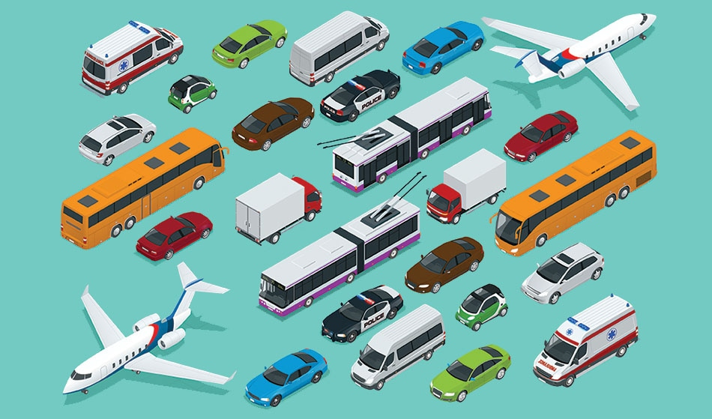
My ride
No matter where you live or what you do, we all need to go places.
Transportation is an integral part of our daily existence.
How will you get around in your new life?

Slide 44
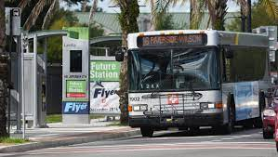



My ride
Options:
Walking/Bicycle
Personal Vehicle
Public Transportation

Slide 45
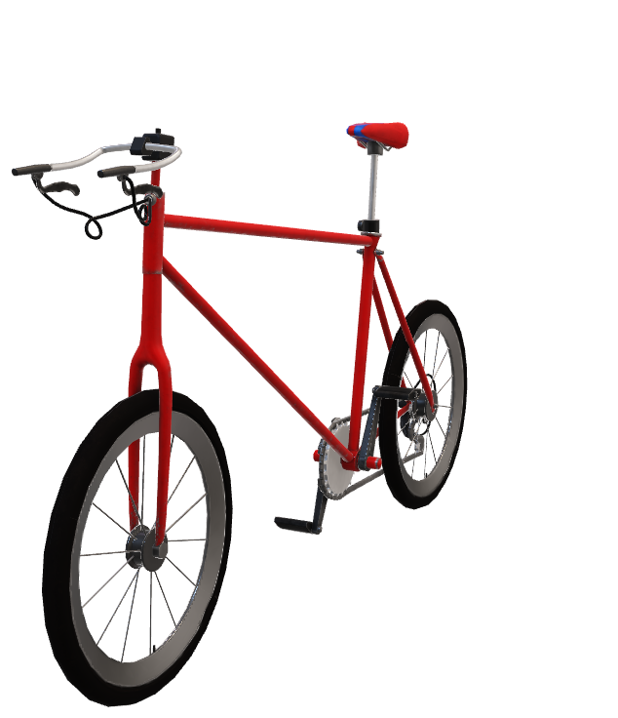
My ride
Walking/Bicycle
The most economic transportation methods are often the most impractical for the modern world.
Walking and Bicycling are great ways to get around, but impractical for the demands of most lives.
For the purpose of this project,
You can only use a bicycle as free transportation if you are within 6 miles of your destination or 3 miles for walking.

Slide 46
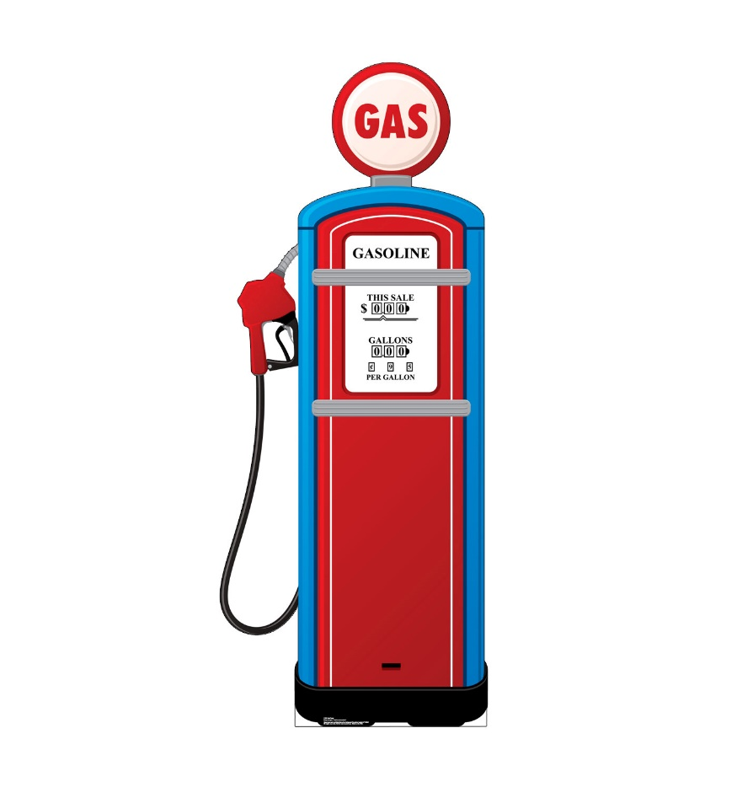
My ride
Personal Transportation
Purchasing a car is a big expense, not only do you have to account for the car payment itself, but also the expense of gas, maintenance, and insurance.
Choose an insurance provider: Insurance is a requirement in most states (except for Virginia and New Hampshire) and varies depending on driver, history, car, etc. You will need to research to find your best price.
In Florida you are required to carry a minimum insurance of $10,000 property damage liability per accident
$10,000 personal injury protection

Slide 47
My ride
Personal Transportation
Purchasing a car is a big expense, not only do you have to account for the car payment itself, but also the expense of gas, maintenance, and insurance.
Gas
The average gas price in Florida is $2.80
Make sure to use this price when calculating your gas expenses in your budget.
Figure your total milage to and from work, divide the total by your car’s miles per gallon (if you are unsure of the number, use 20 as an estimate), then multiply by the gas price.

Slide 48

My ride
Public Transportation
The only option in our glorious city for public transportation is JTA.
Most bus tickets cost $1.75 each way
You can purchase a monthly pass that will give you unlimited rides in the month for $65.

Slide 49
Unexpected cost? There’s an insurance for that.
Life will throw you a curve ball, there’s no question about that. Whether you’ll have insurance when it does is another matter entirely.
Insurance buffers you from unexpected costs.
And while most people know that insurance is important, not everyone knows the different types of insurance out there and how they can help.

Slide 50
Insurance
Here are 5 common insurances and why you might need them:
1. Health insurance
Both expected and unexpected health care expenses — including routine visits, medications, emergency stays, and serious surgeries — can add up quickly and cause a lot of debt for those who can’t afford the out-of-pocket costs.
2. Car insurance
Driving while uninsured is against the law and dangerous because the driver and their vehicle aren’t protected against an accident, collision, or general theft and vandalism.

Slide 51
Insurance
Here are 5 common insurances and why you might need them:
3. Life insurance
Death can be expensive, from settling an estate to planning a funeral, the associated costs can really set you back. A life insurance policy will ease the financial burden placed on a surviving spouse and dependents (i.e. children).
4. Homeowners insurance
Maintain your home and keep its property value high, plus be covered in the case of major damage, like a house fire. Homeowners insurance covers the house you reside in and any associated structures, such as a porch, garage, and balcony..

Slide 52
Insurance
Here are 5 common insurances and why you might need them:
5. Renters insurance
Things happen — that’s a mantra every renter knows to be true, and so they protect themselves and their property while renting. In fact, many landlords require it.
Renters insurance is used by tenants to cover personal property in case of damage or theft, which is not the responsibility of the landlord.

Slide 53
Insurance
For the purposes of this project, we are going to focus on Health Insurance.
Health insurance doesn't always cover 100% of your costs.
In fact, it's designed to split the costs of medical care with you up until a certain point, called the out-of-pocket limit.
After you hit the out-of-pocket limit, health insurance will pay 100% of your health care costs and medical bills.

Slide 54
Insurance
There are a few ways that health insurance companies might share costs with you, and they make up major features of your health insurance plan that you need to be aware of:
Deductible :
Copayment:
Coinsurance:
Out-of-pocket limit:
how much you need to pay out-of-pocket before insurance kicks in
is a fixed amount for a specific service or medication
is a percentage of the cost that you pay for covered services
the most you'd ever have to pay for covered health care services in a year

Slide 55
Insurance
How to get Health Insurance
Purchase your own: You can purchase your own health insurance through government run exchanges or directly from an insurance provider.
Employer Coverage: also called group plans, this is insurance that your employer purchases and manages. Since they are for larger groups, they are usually cheaper.
Medicare/Medicaid: Government provided insurance for Americans over the age of 65, low-income families, and children.

Slide 56
Insurance
Extra Insurances
Health Insurance does not cover everything. You might need to look into supplementary insurance to get full coverage.
Dental Insurance
Vision Insurance
Gap Insurance
Critical Illness Insurance and Short/Long Term Disability Insurance

