Slide 1
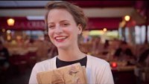
Notes:
https://www.youtube.com/watch?time_continue=11&v=AZzQdxHwRtI&feature=emb_logo

Slide 2
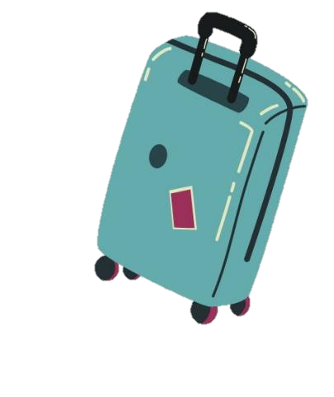
Pack your bags!
We’re going to…

Slide 3



Slide 4
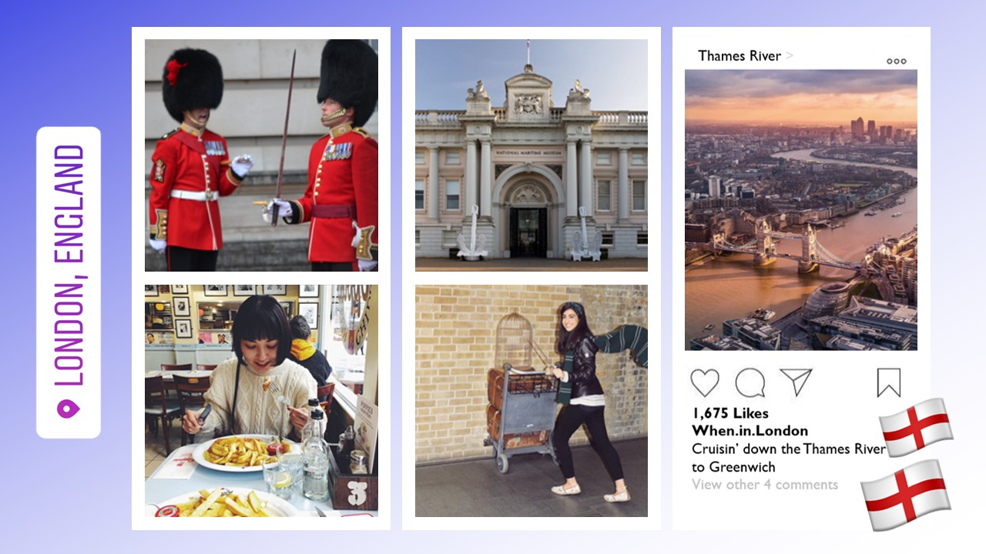

Slide 5



Slide 6
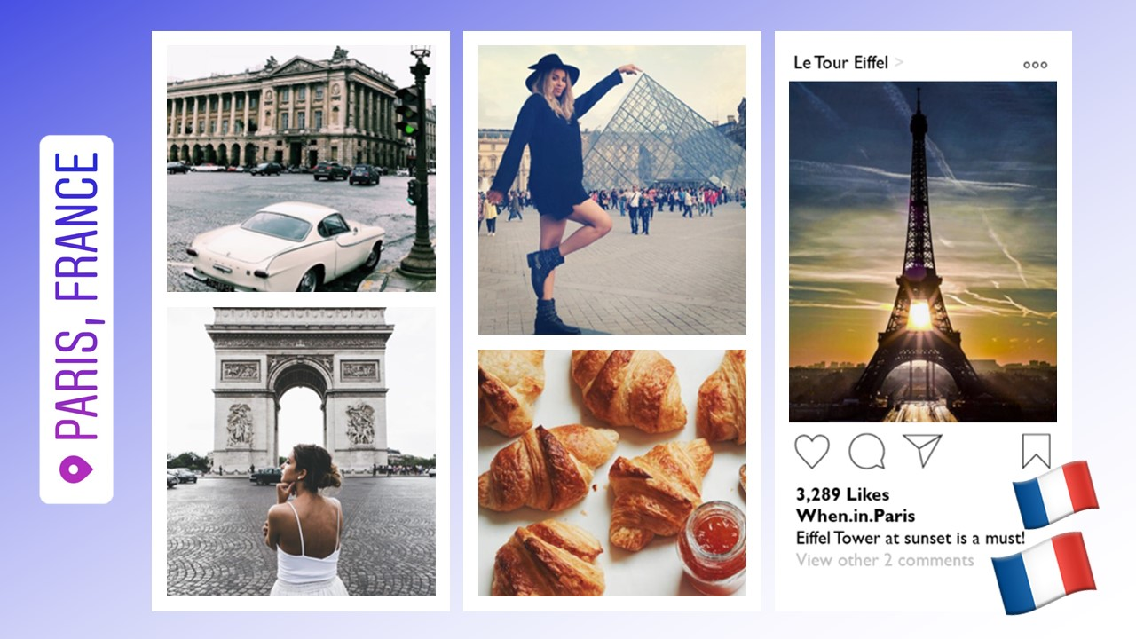

Slide 7
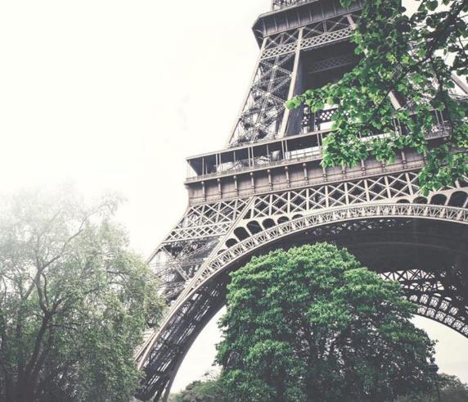
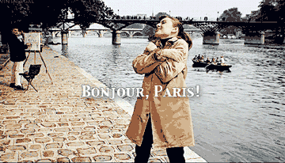
Create art in Paris
Notes:
Paris, France

Slide 8



Slide 9
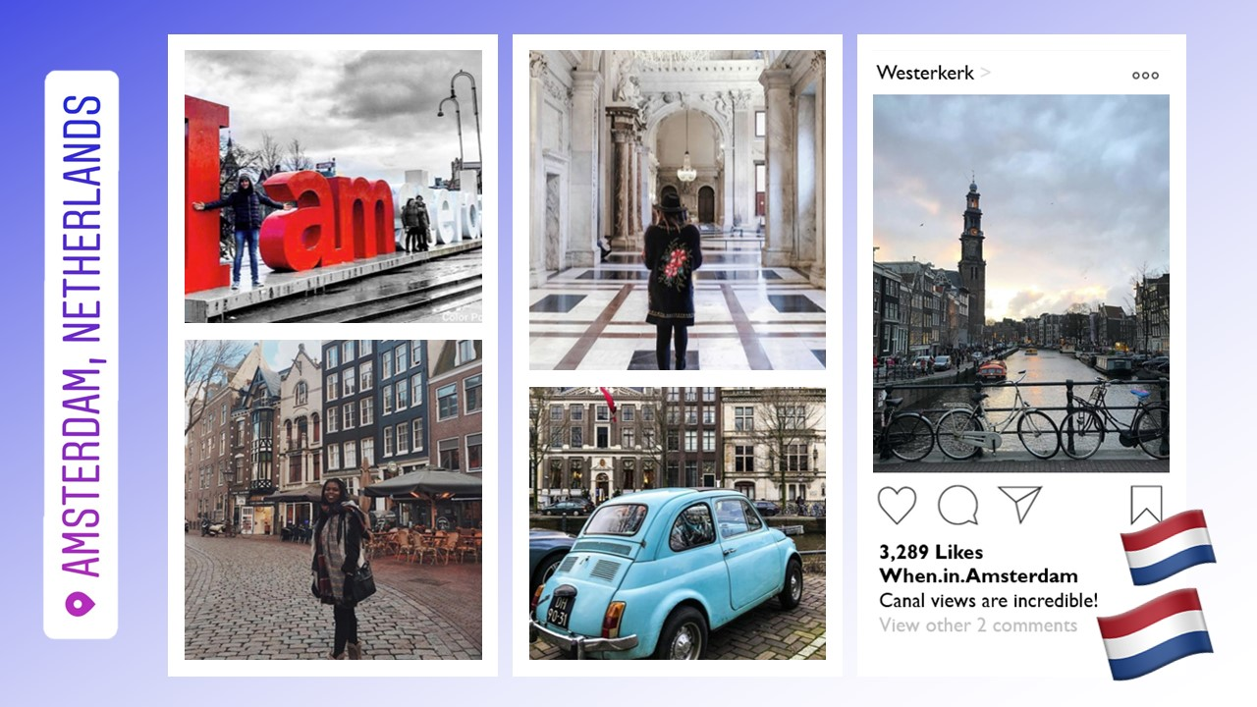

Slide 10



Slide 11
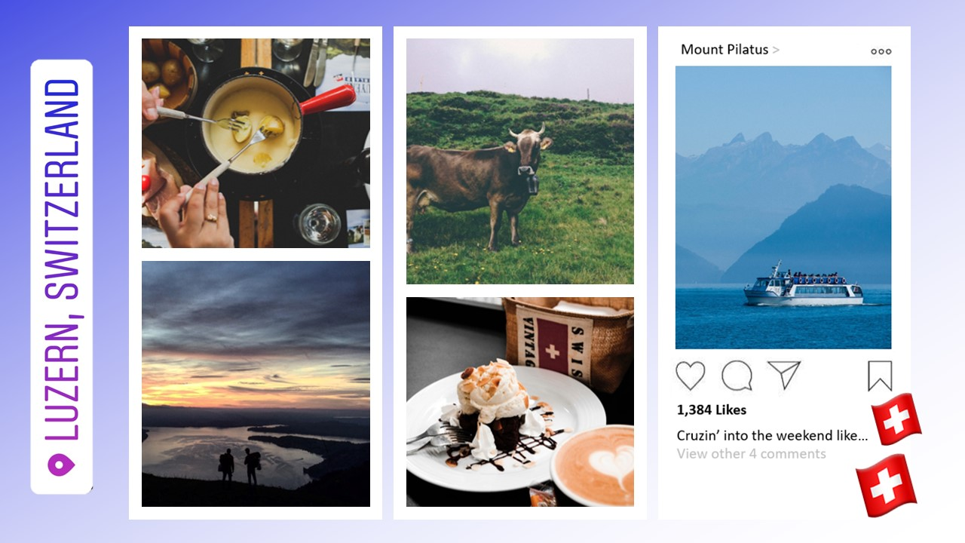

Slide 12



Slide 13
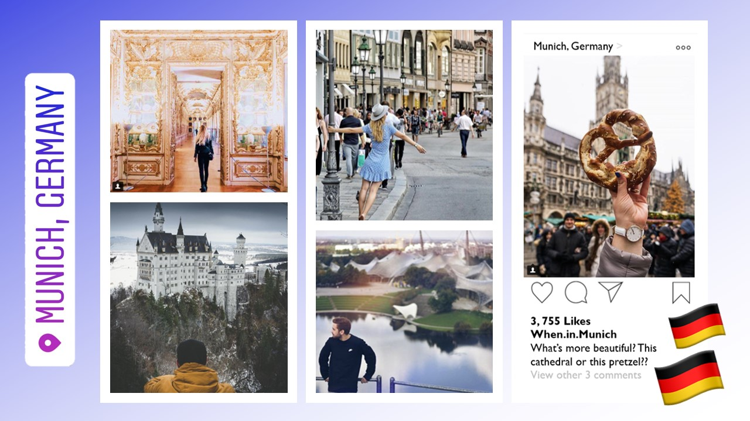

Slide 14



Slide 15



Slide 16
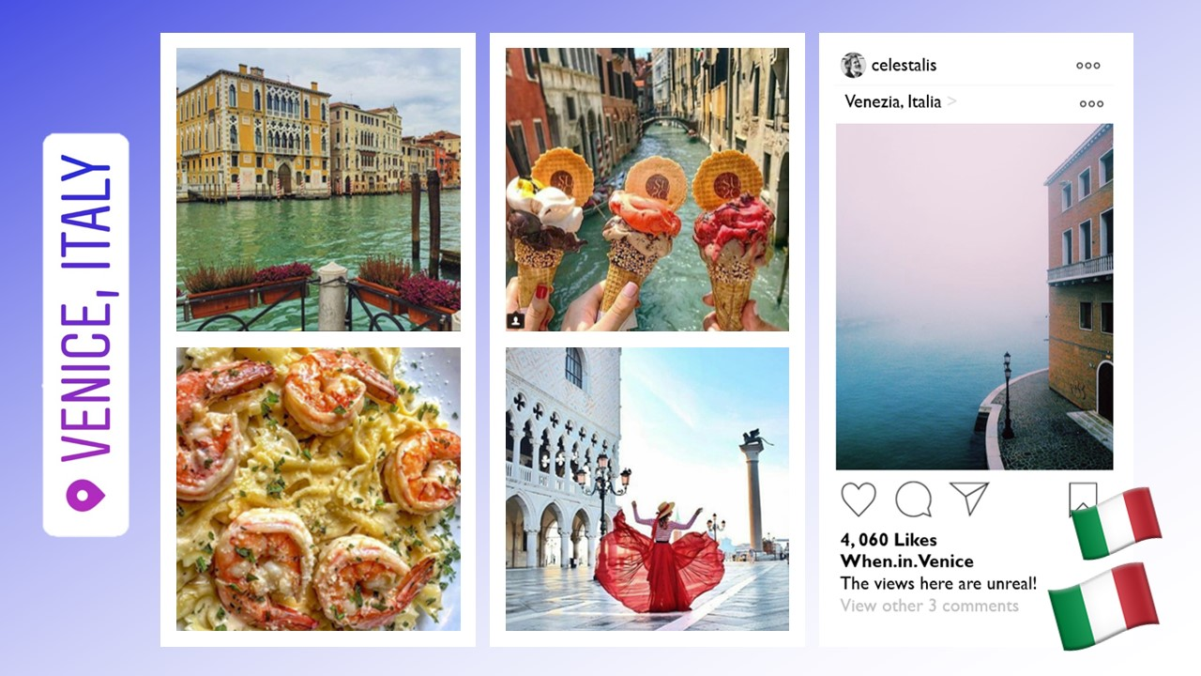

Slide 17
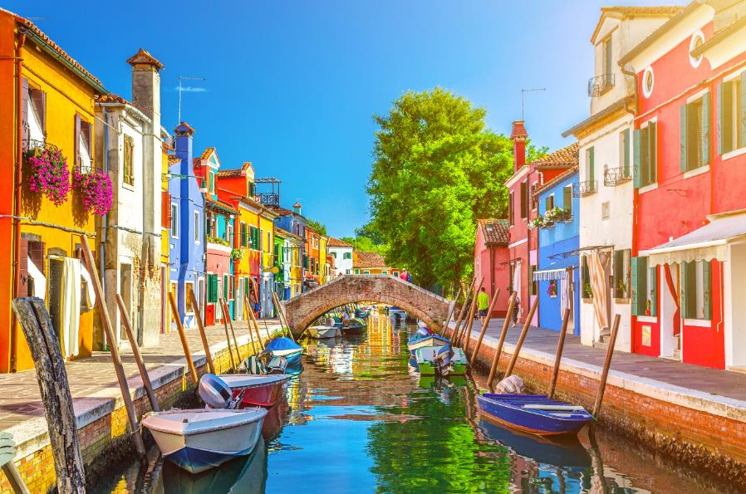
See some smooth sailing
on the Grand Canal
Notes:
Venice, Italy

Slide 18



Slide 19
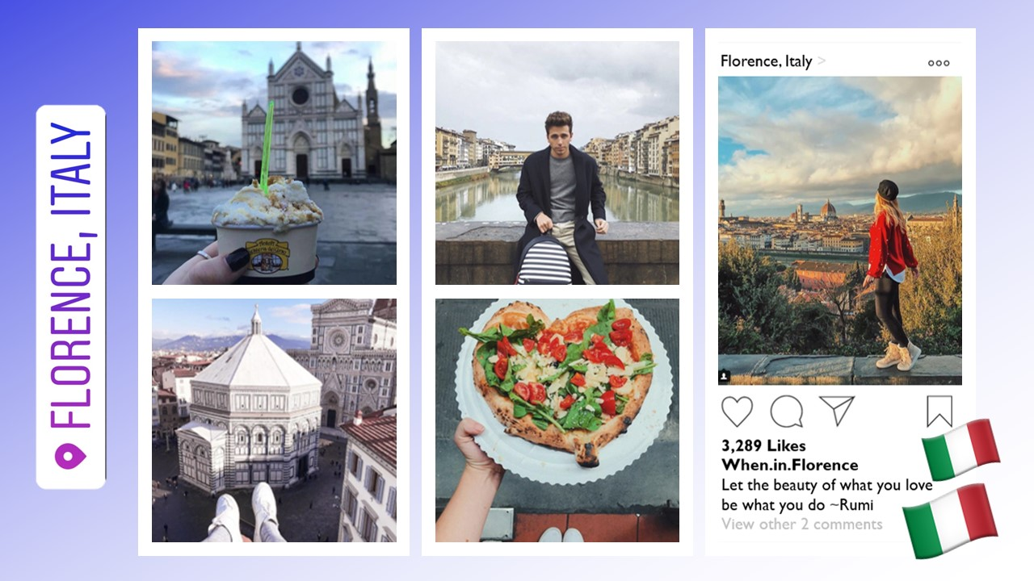

Slide 20



Slide 21
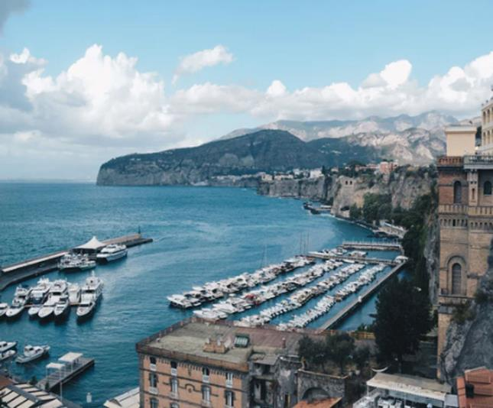
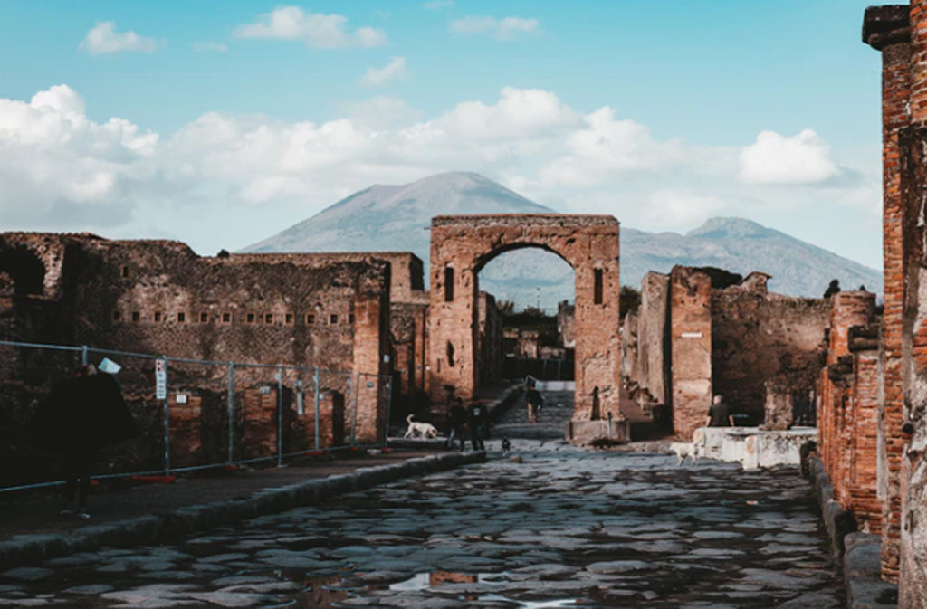

Explore the ruins
of Pompeii
Notes:
Sorrento/Pompeii, Italy

Slide 22



Slide 23
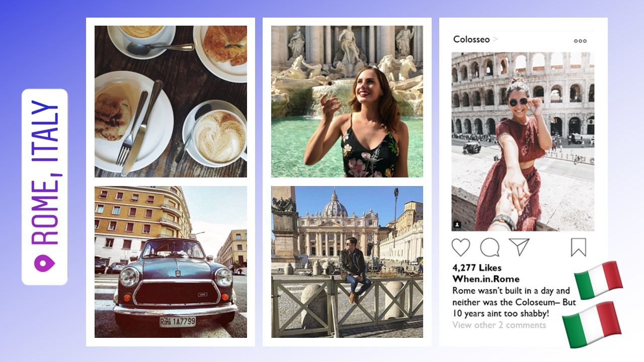
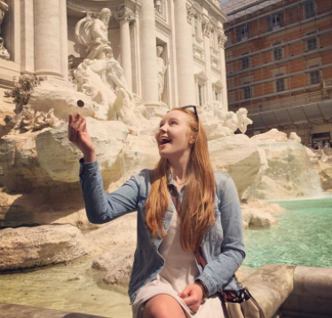

Slide 24
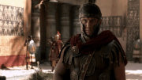
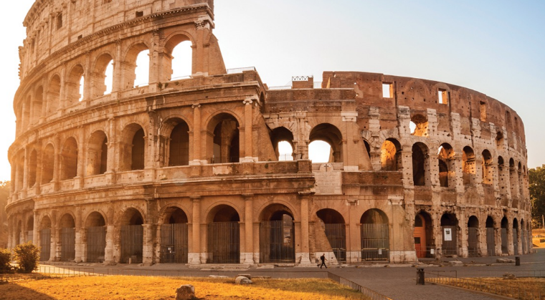
Be a gladiator at
the Colosseum
Notes:
Italy

Slide 25



Slide 26
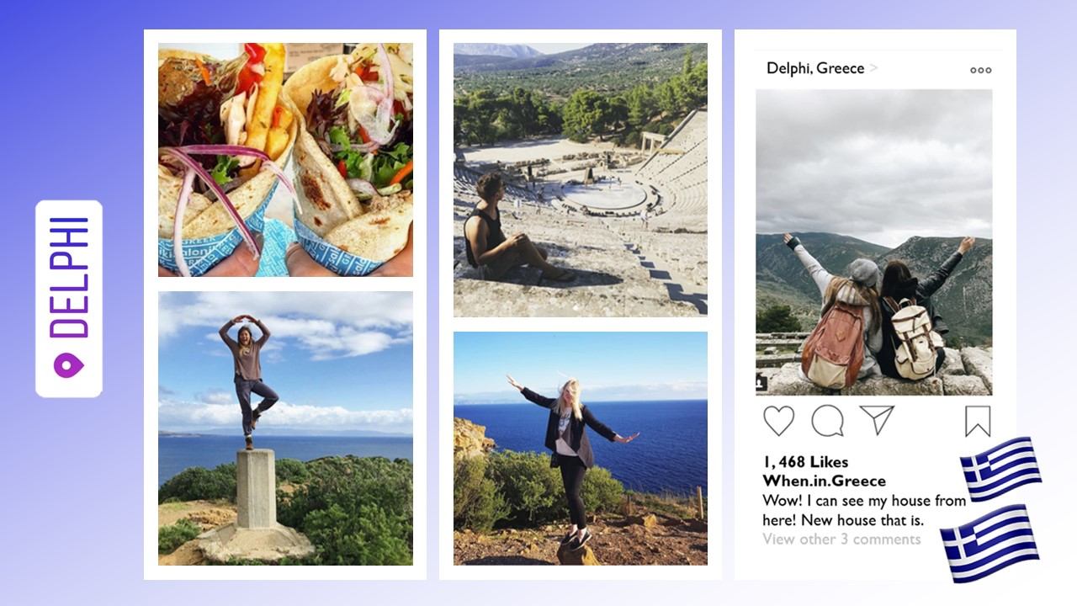

Slide 27
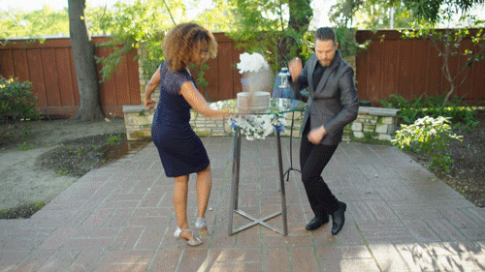
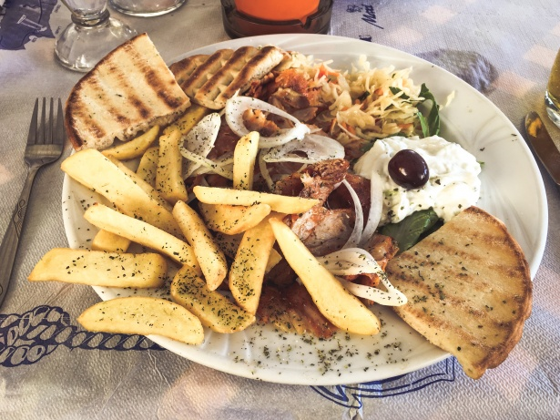
Opa! Smash some dishes
or eat some!
Notes:
Greece

Slide 28

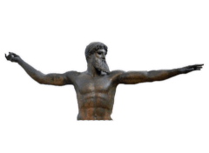

Slide 29
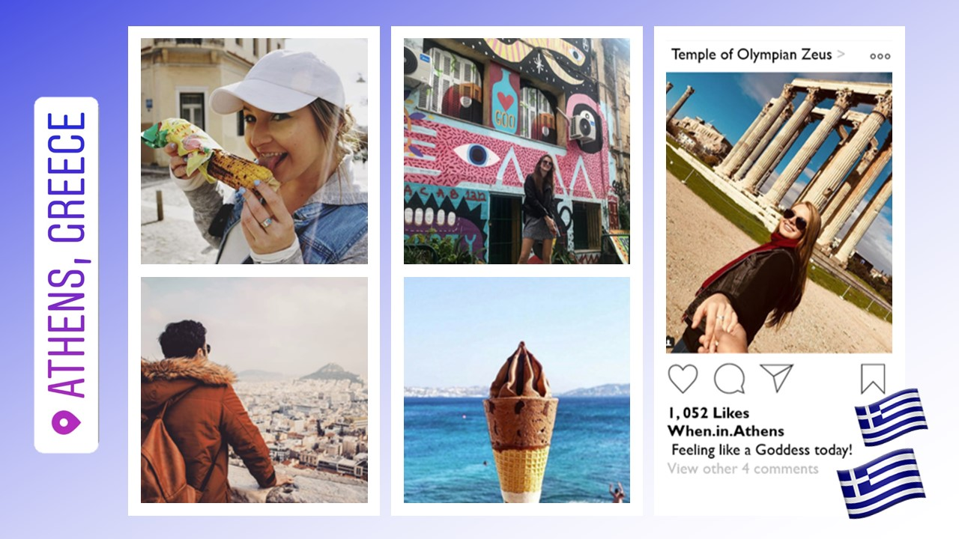

Slide 30


Are you EXCITED?!?

Slide 31
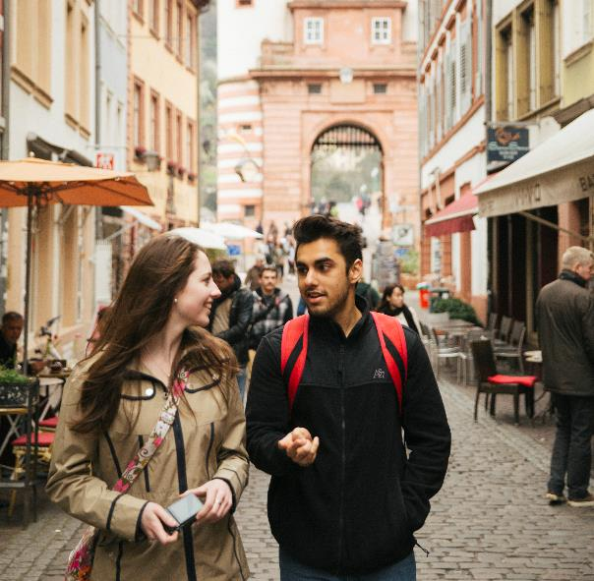
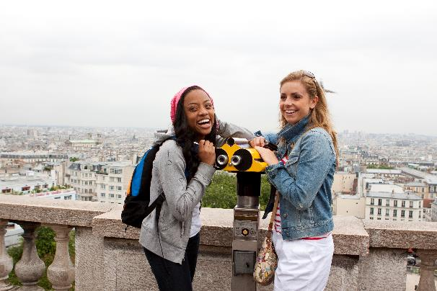
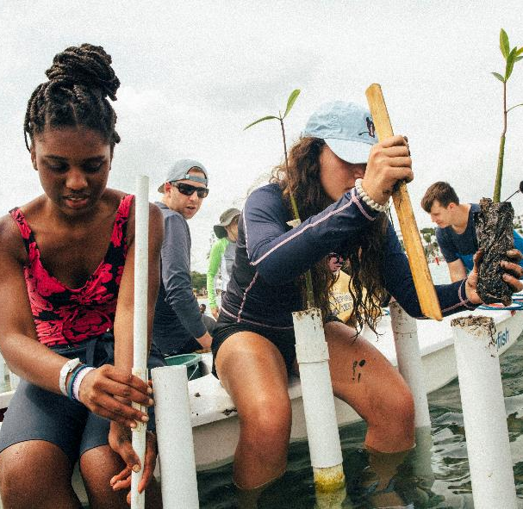
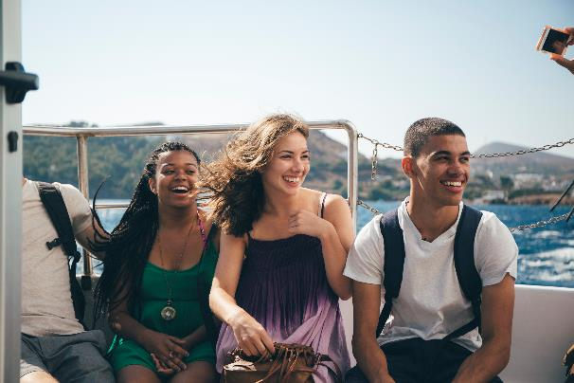
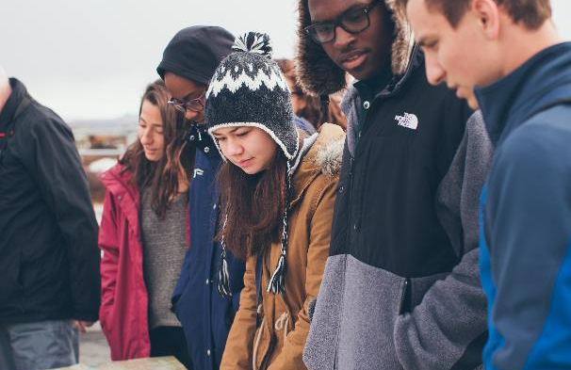
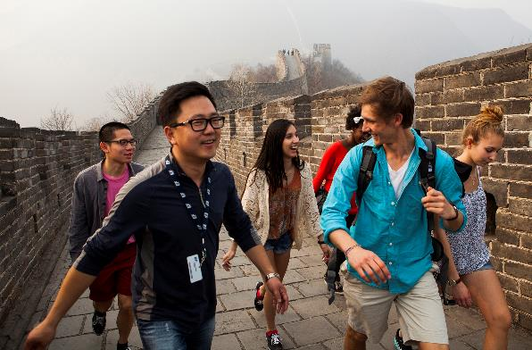
This could be YOU!
Notes:
SPEAKER:
Travel is important now more than ever and I really want all of you to have this experience of a lifetime
GOAL:
Show students and families your passion for travel– the amazing things you’ve seen and the transformation that’s happened along the way OR your excitement about having new experiences with the group!

Slide 32

Just get your folks to the meeting
We’ll cover all the specifics there!

Slide 34

Registration is mandatory
in order to attend the meeting!
(but also really easy)

Slide 35
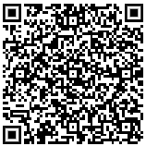
Scan the QR code below with your camera
Click the “Compose a message” notification
Change the phone number (555-555-5555) to your parent/guardian’s contact
Send invite!
If that doesn’t work, send your folks this link:

