Slide 1



The Hidden Meaning Of Children's Literature
Looking at children’s literature
to find deeper meaning
Notes:
https://youtu.be/QHWAzBZ2hDA

Slide 2
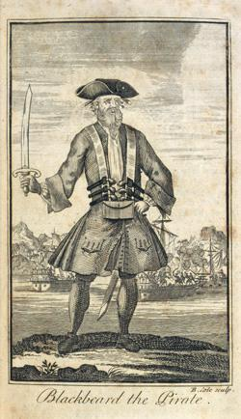

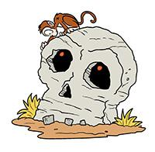
1
Good children’s literature
Can be understood on several levels
The Surface
The stuff that is easy to see.
What are the characters doing?
What is their conflict?
What obstacles have to be overcome?
What is the resolution?

Slide 3
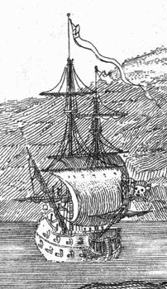
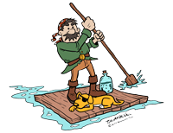
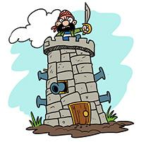
2
Good children’s literature
Can be understood on several levels
The Deep
Look a bit harder and you will see.
What is the lesson or theme?
What can children learn?
What is the positive message?
Almost every children’s book will have this!

Slide 4
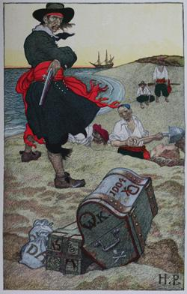


3
Good children’s literature
Can be understood on several levels
The Treasure
Look a lot harder and you might find.
What is the allegory or metaphor?
What can adults learn?
What is the hidden message?
Not every children’s book will have this!

Slide 5
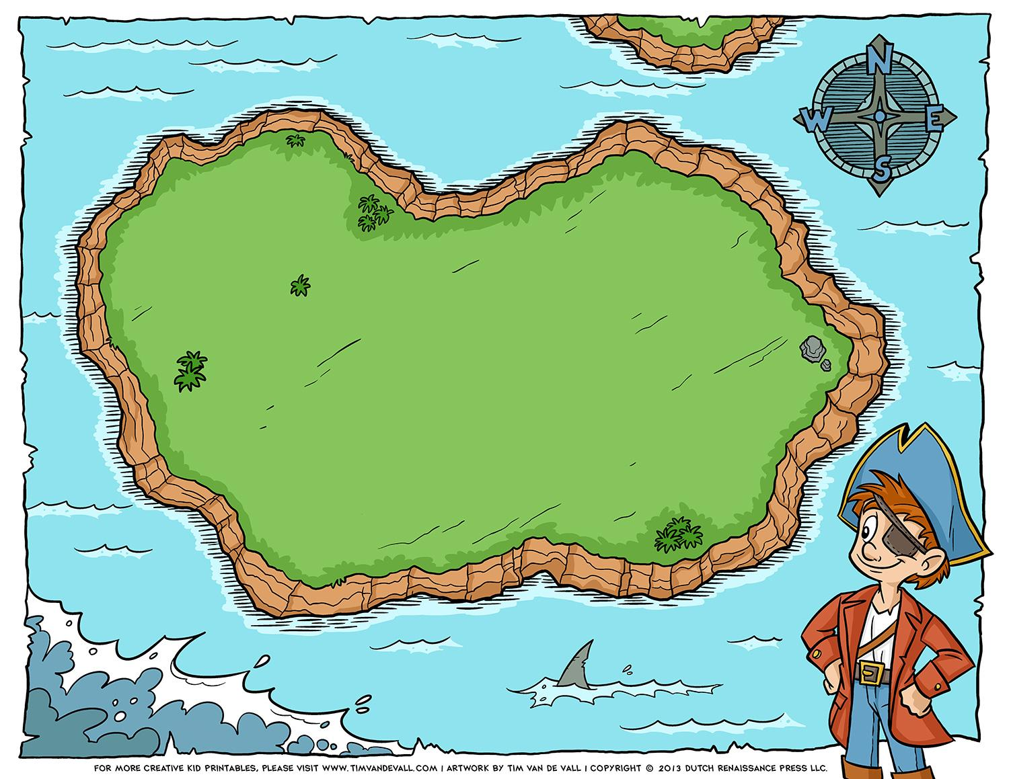
So let's look a some of children’s literature's biggest books and see if we can find some of the hidden treasure.

Slide 6
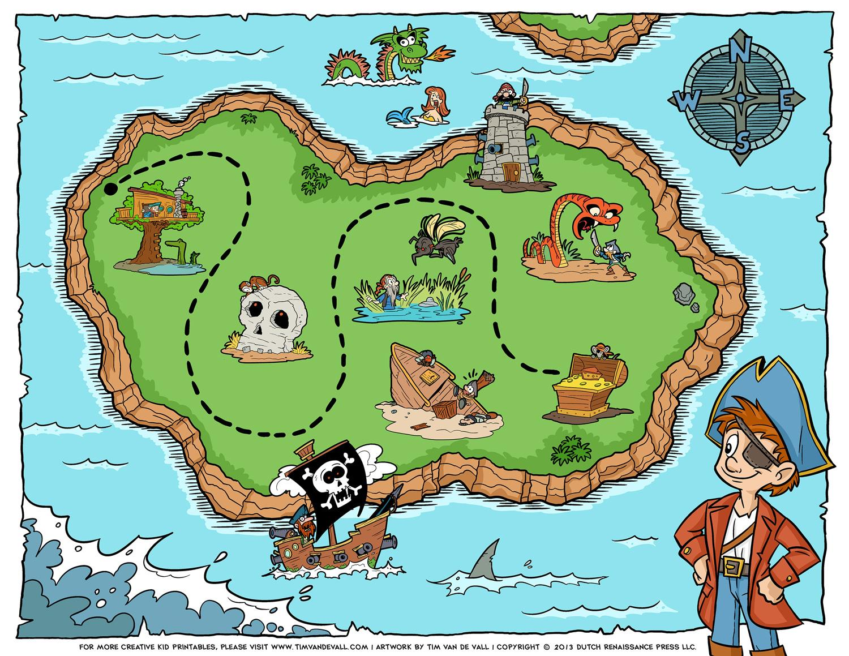
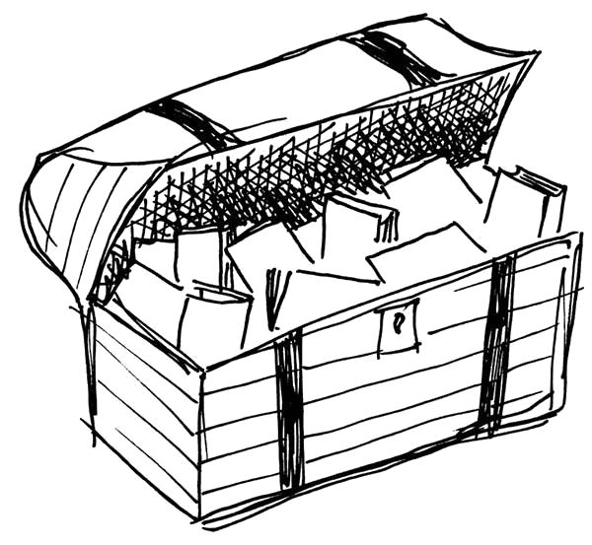
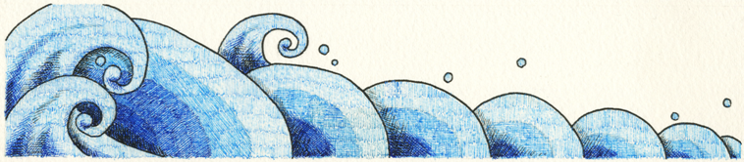
The Surface
The Deep
The Treasure

Slide 7
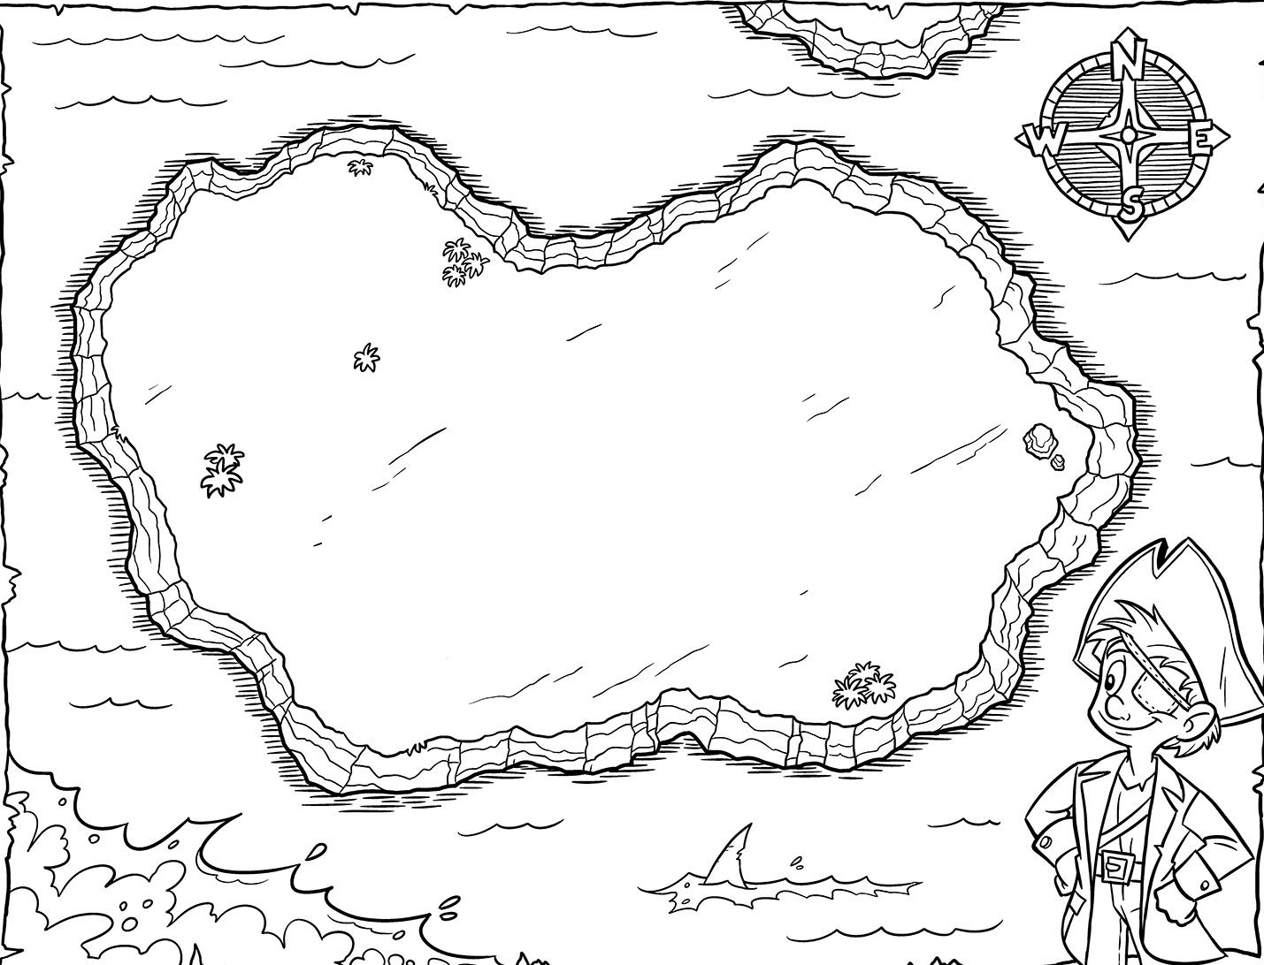
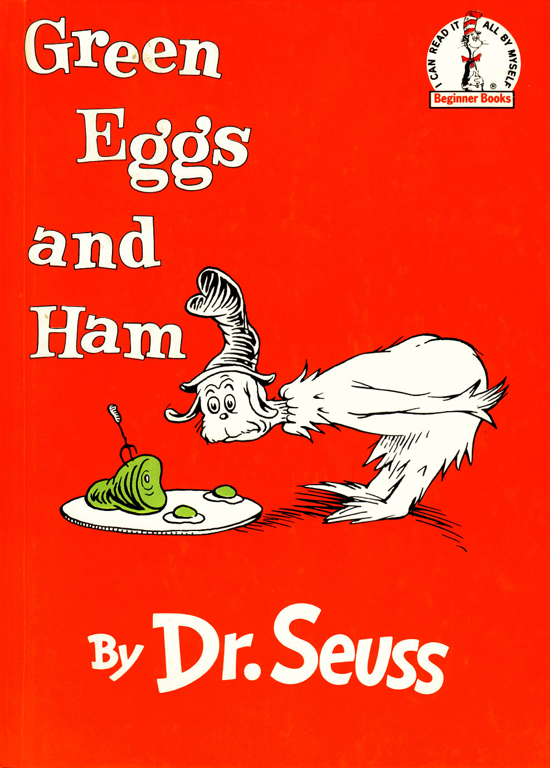

Green Eggs and Ham is not just about eating that particular food but is a comment on the benefits of an open mind.

Slide 8
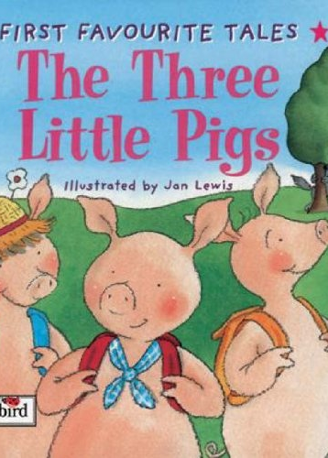
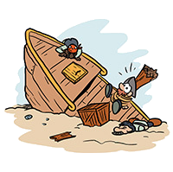
Three Little Pigs isn’t just about a wolf who blows down houses, but is about the benefits of taking the time to do something well.

Slide 9
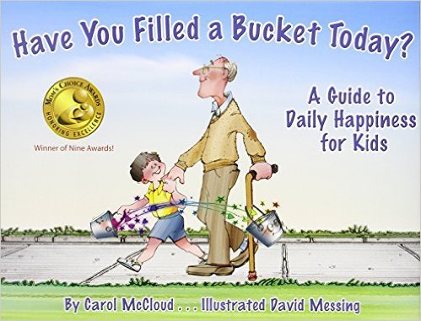
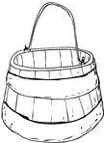
Have You Filled a Bucket Today?
Is about the benefits of being kind through the metaphor of a bucket.

Slide 10
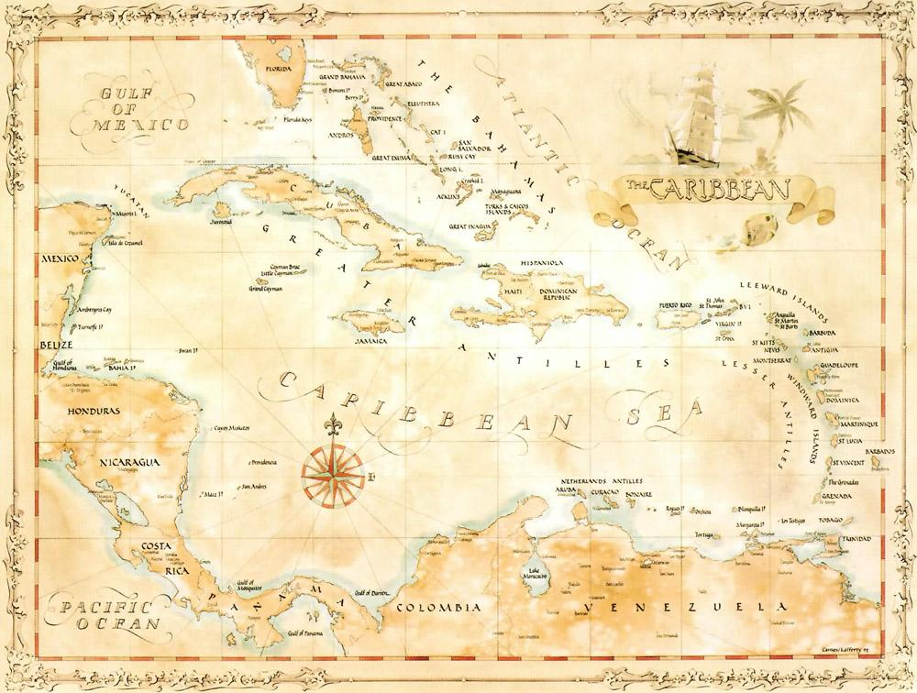

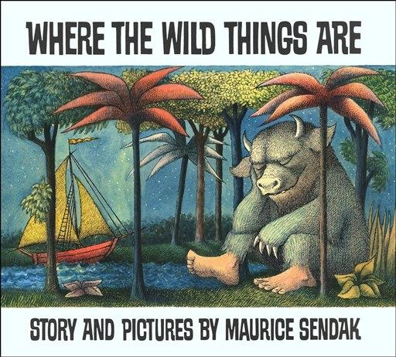
Where the Wild Things Are
It manages to deal with anger in a way that children understand and yet comes back around to love.
.

Slide 11
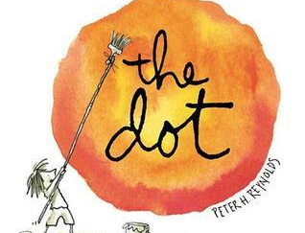
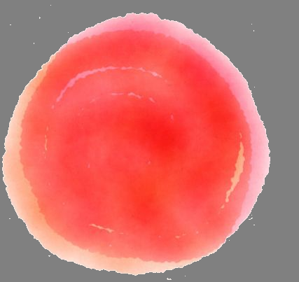
The Dot: This is a story about the courage to express yourself and really let your inner talents out.

Slide 12
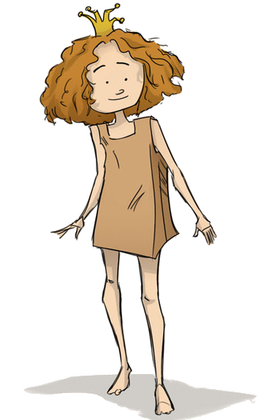
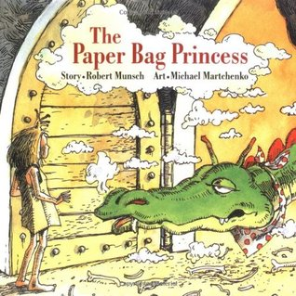
Paper Bag Princess is about being true to yourself and and challenging assumed roles.

Slide 13
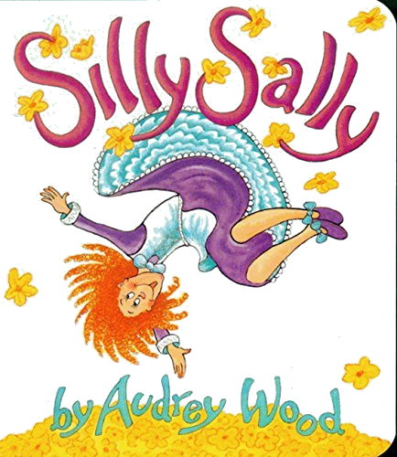
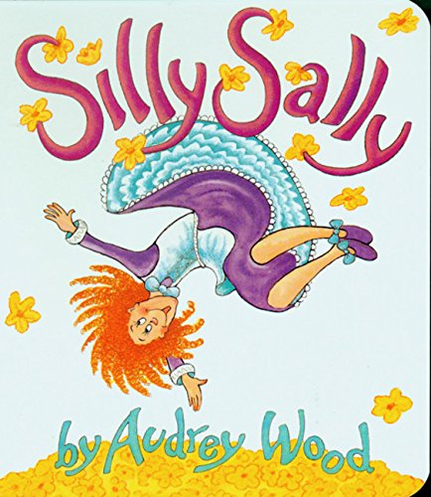
Silly Sally - the message is being unusual is alright and go ahead and be who you truly are.

Slide 14
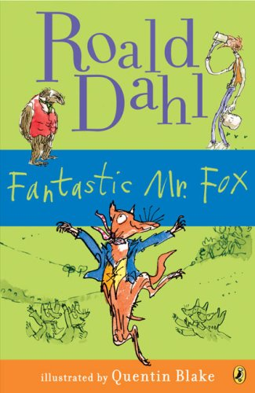
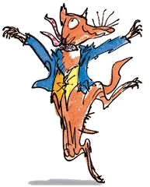
Fantastic Mr. Fox
Is about the value of friendship and family.

Slide 15
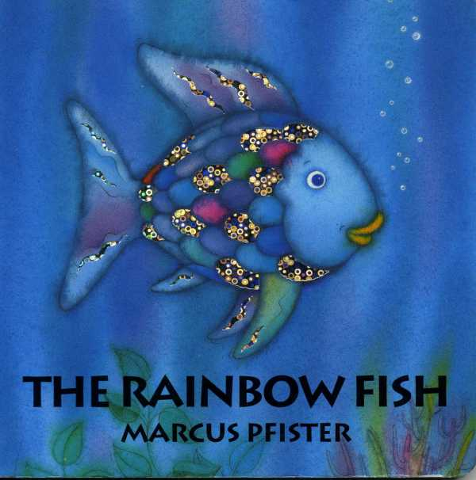
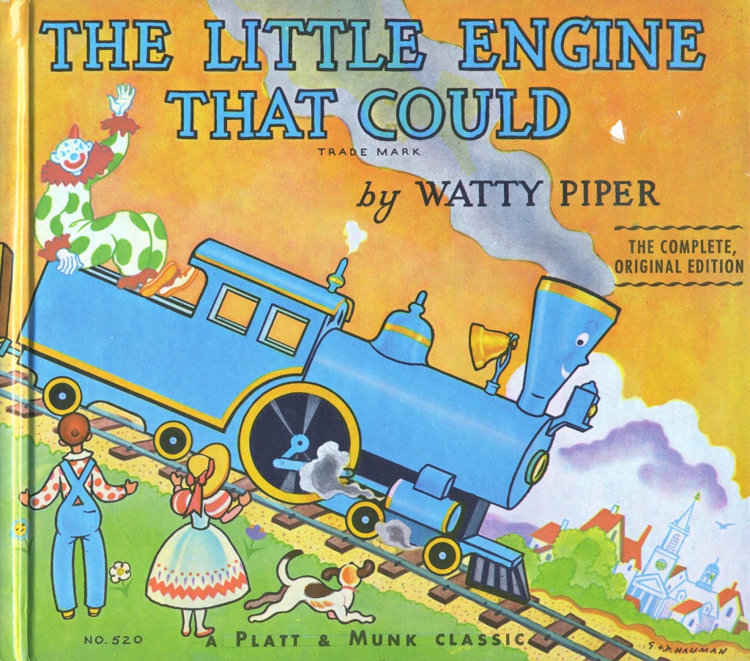
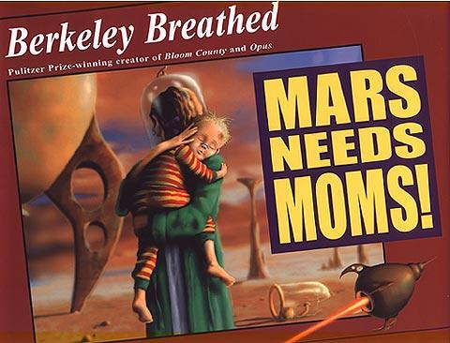
The Rainbow Fish -
is about the importance of sharing.
The Little Engine That Could -
is about perseverance and trying your best.
Mars Needs Moms! -
is about the value of parents.

Slide 16
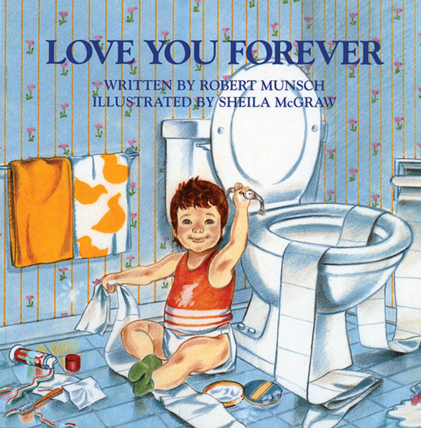
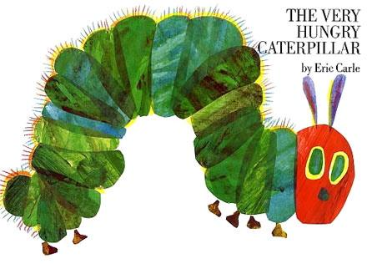
Love you Forever -
A parent’s love never waivers.
The Very Hungry Caterpillar -
Overcoming hardship and difficulty.
The treasure of literature!

Slide 17

So what will you open?
And what will you find?

Slide 18
The Hidden Meaning Of Children's Literature
Looking at children’s literature
to find deeper meaning

