Slide 1


Welcome Travelers!
Before we get started, please sign in using the QR code below
Sign in form QR Code here
https://forms.office.com/e/H8pyDMrPLu
Notes:
Directions: Play music and have this slide up as families start walking into your meeting room
Greet families as they join!
SPEAKER:
Thank you all for being here tonight – we’re SO EXCITED to talk to you all about this incredible travel opportunity. If you haven’t already, please scan this QR code to sign in. Keep this form open on your phones as we move through the presentation and write down your questions in it as we go.
GOAL:
Get parents excited for what’s to come, and encourage them to sign in.

Slide 2

From Indio, CA to Japan with student Jenny G. | EF Educational Tours – YouTube
Notes:
SPEAKER:
We’re going to get started tonight with a short video that tells the story of a student that has traveled with EF and what that experience meant to them.
Video Link: https://www.youtube.com/watch?v=8FwbUbah7gw

Slide 3
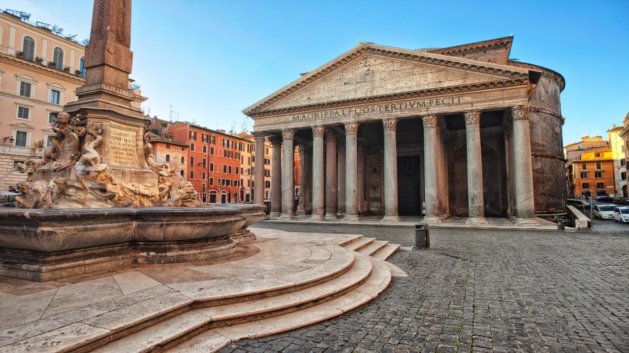
Let’s go to…
Italy
✈
Rome – 7 Days

Slide 4
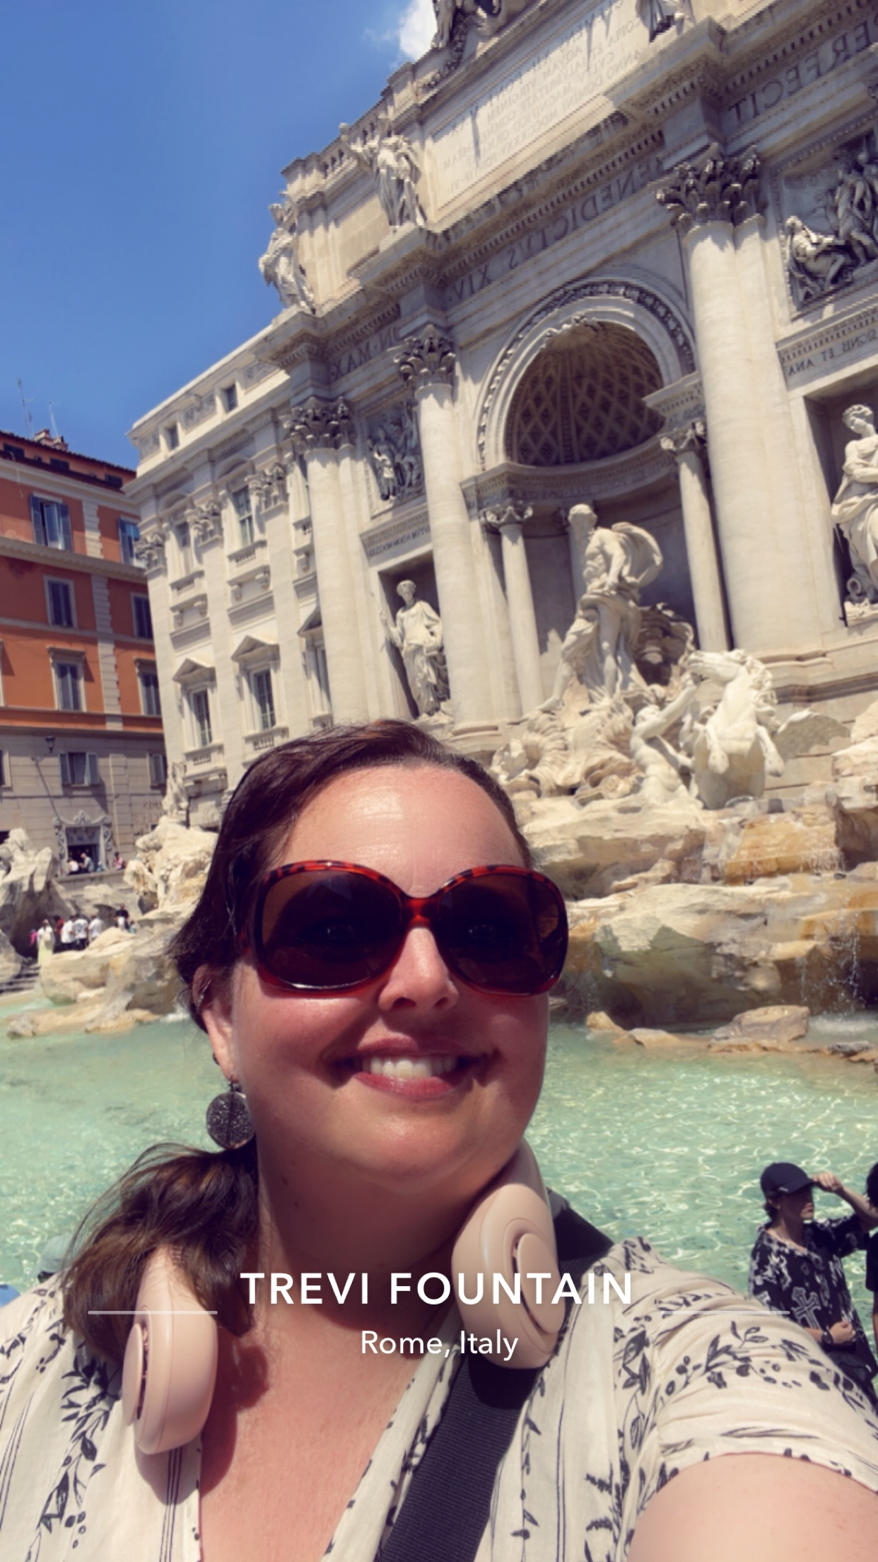
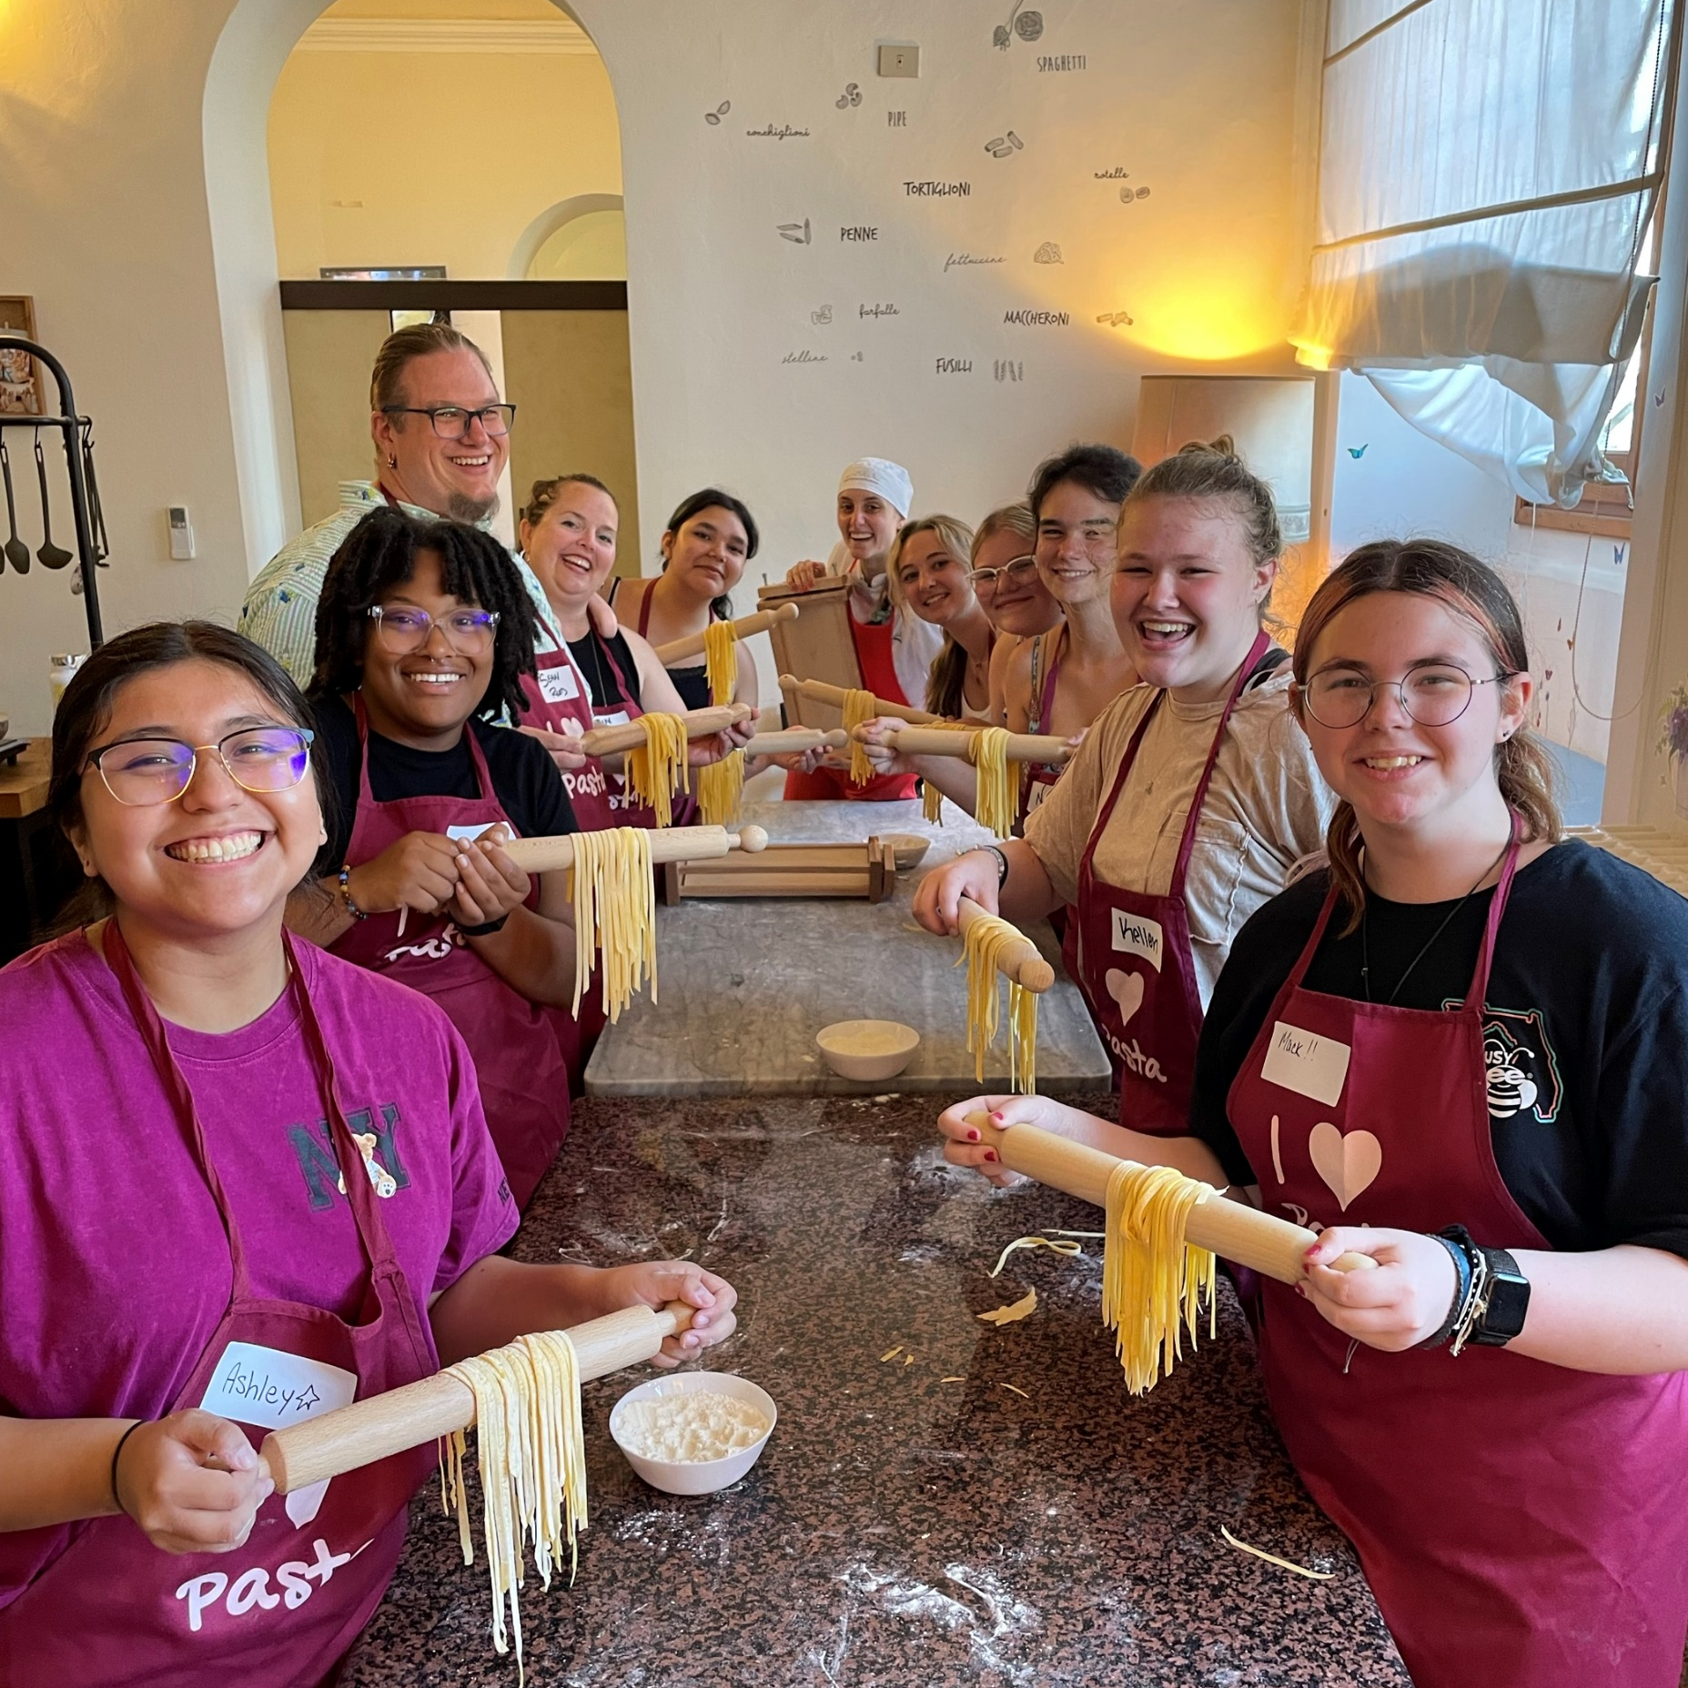
My name is
MHS Teacher for 17 school years!
10+ Years Traveling with EF
Girl Scout Leader
Notes:
SPEAKER:
[First just a little about me…]
I teach…
I’ve worked at the school for ___ years

Slide 5
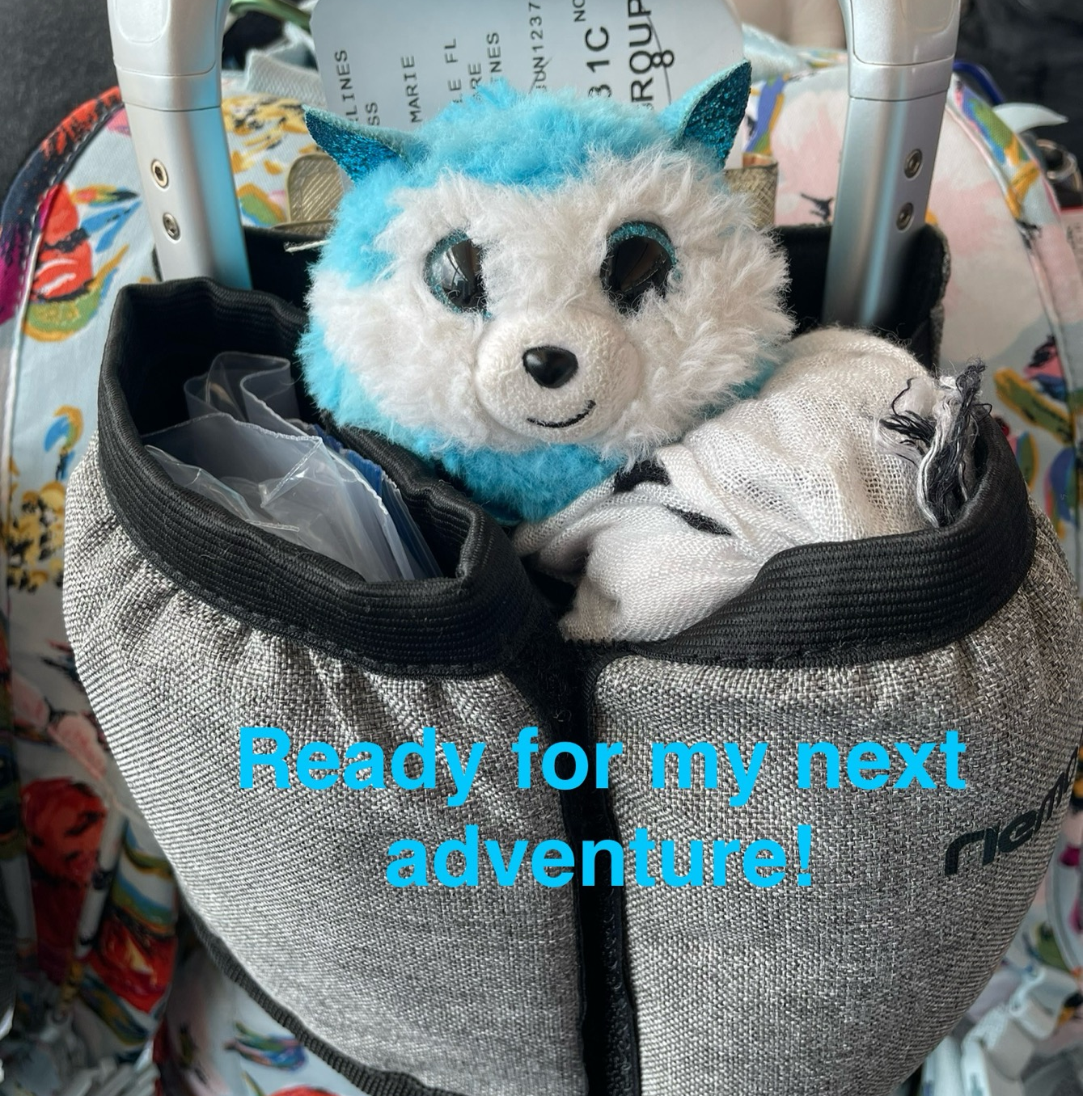
Our agenda
What we are going to cover
The Value of Travel
Our Travel Partner
What We'll See & Do
What’s Included
Price and How to Enroll
Notes:
SPEAKER:
So what are we going to cover tonight?
Why Travel - we’re going to talk about the value of travel, why it’s life-changing, how it will benefit your child and the profound impact that it will have on their futures.
Our Travel Partner - We’ll talk about EF, our travel partner for this experience, and why we’ve chosen them
Our travel plans and tour itinerary - Where we’re going and what we’ll see and experience on tour
What’s included (and what’s not) - We’ll cover everything that’s included with our tour (it’s a LOT)
Price and Enrolling - Lastly, we’ll review payment options, discuss how to enroll, and review how you can get your questions answered
So let’s dive in!

Slide 6

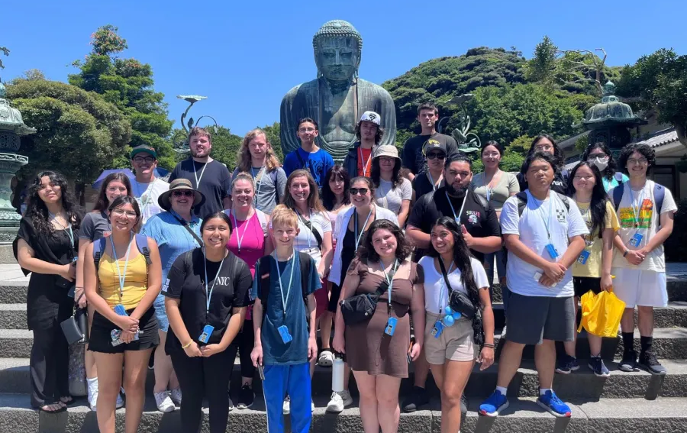
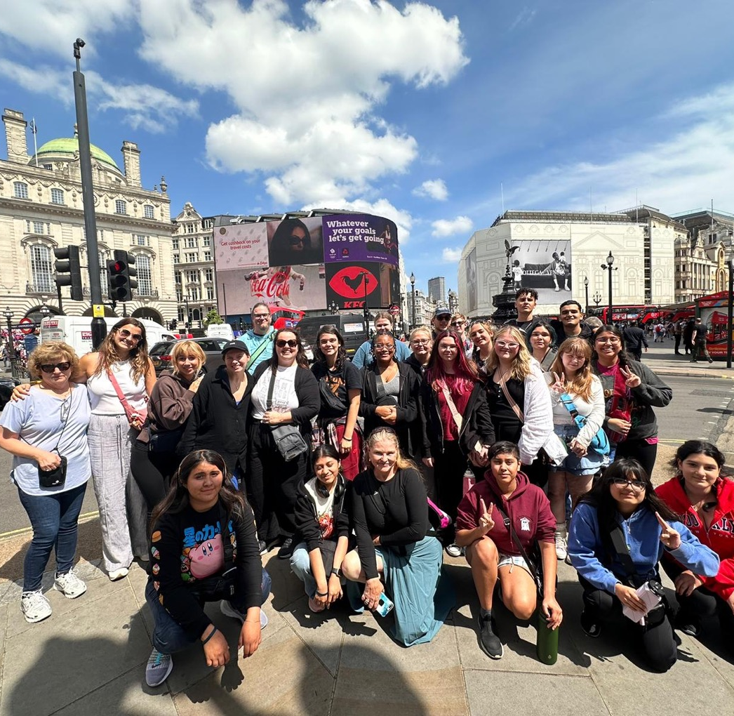
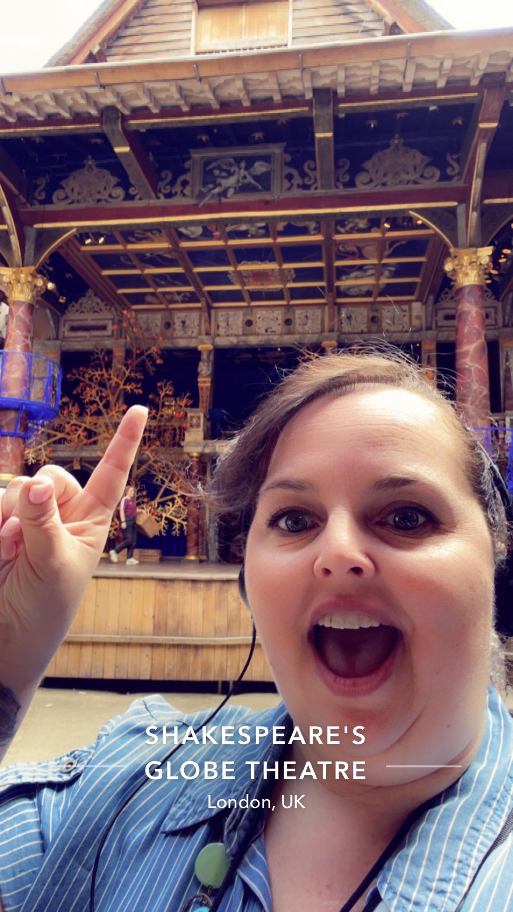
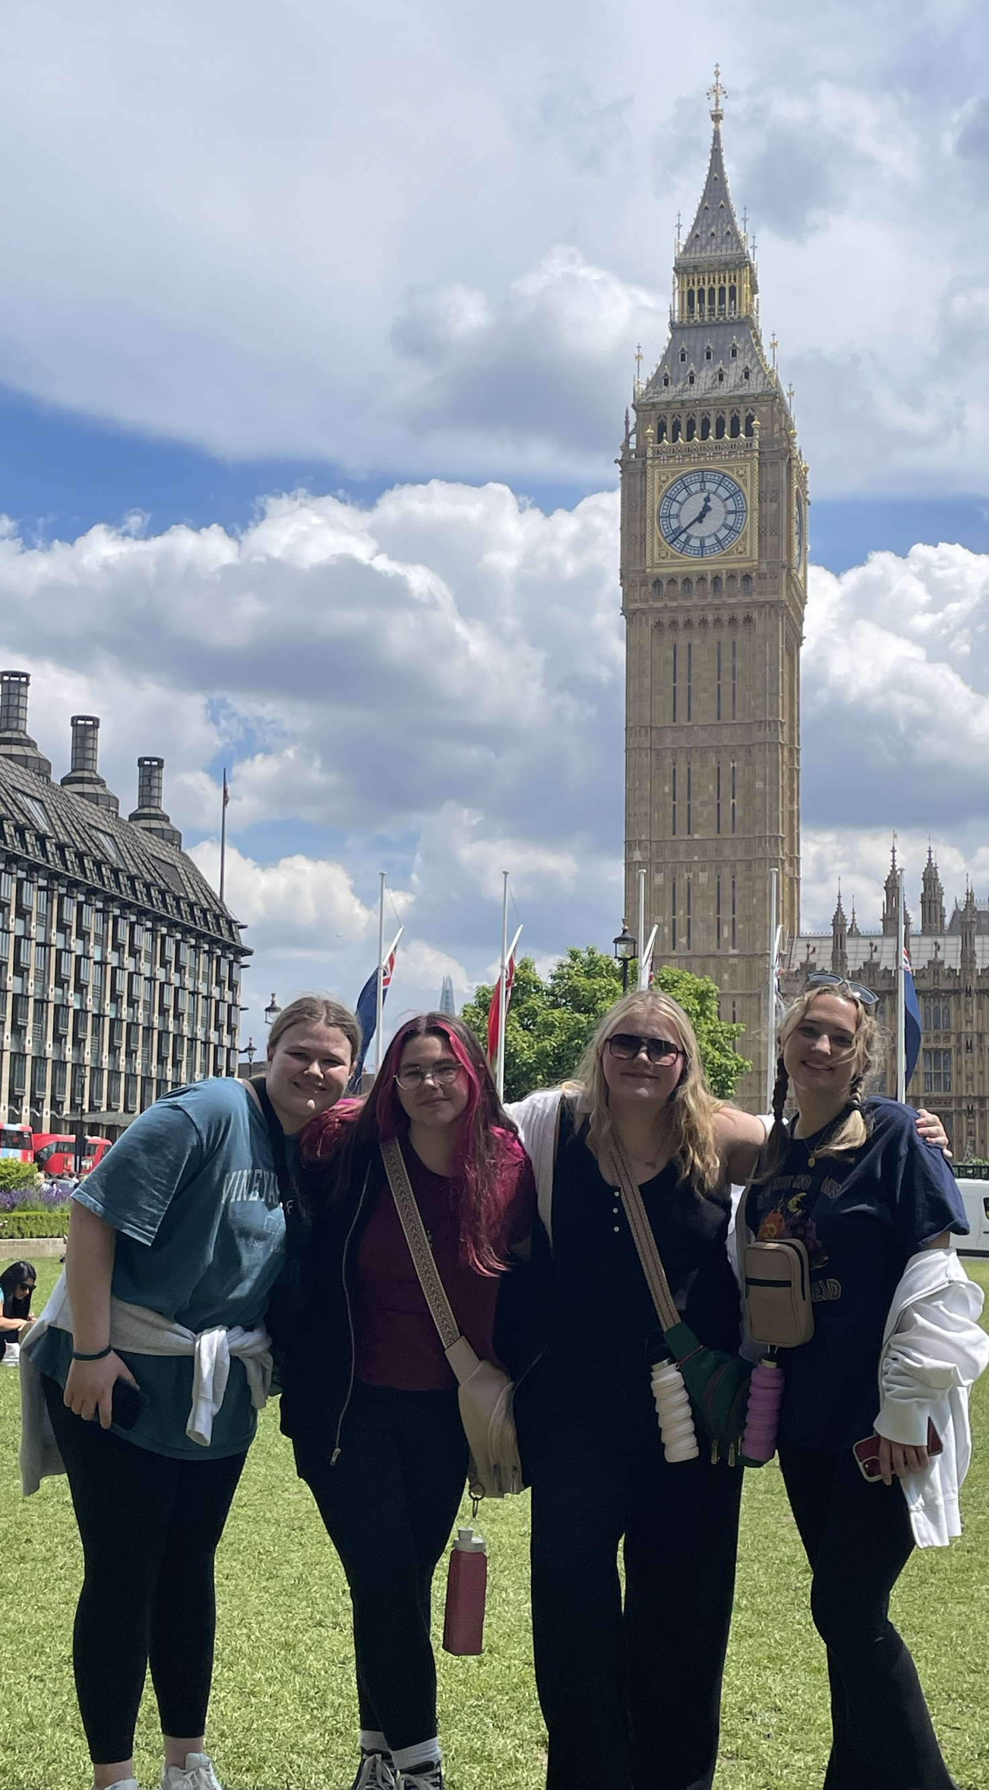
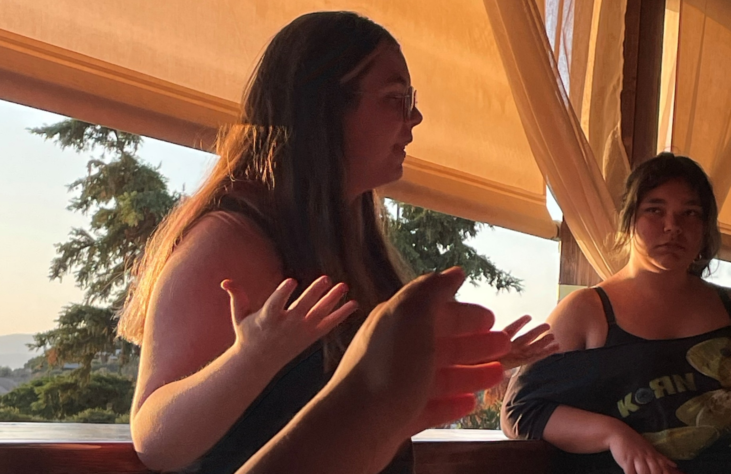
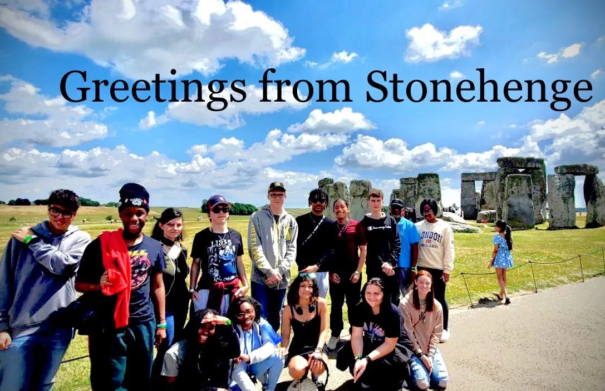
Why I travel…
Notes:
SPEAKER:
Travel is important now more than ever and I really want all of you to have this experience of a lifetime
GOAL:
Show students and families your passion for travel– the amazing things you’ve seen and the transformation that’s happened along the way OR your excitement about having new experiences with the group!

Slide 7

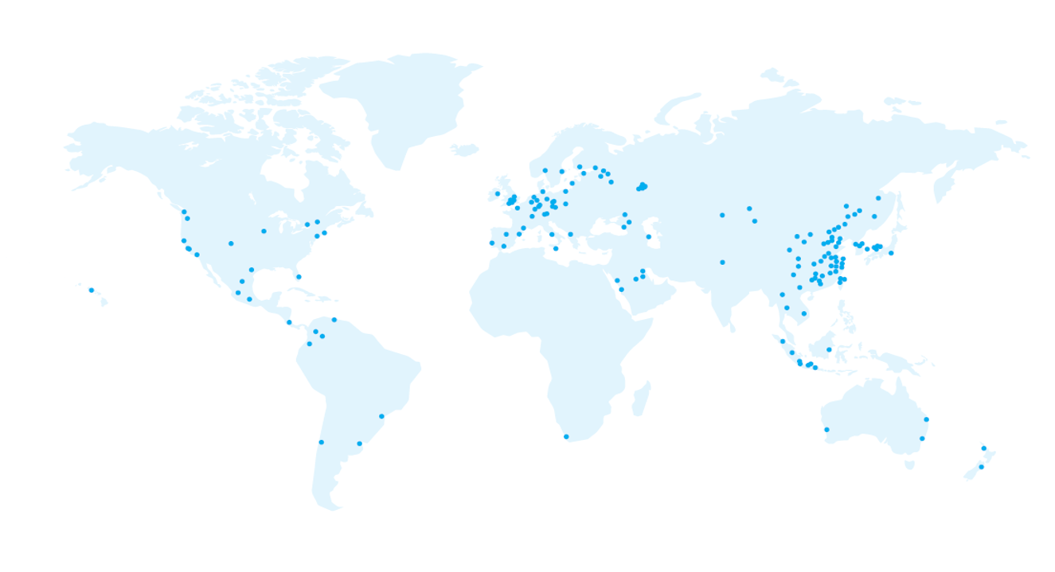
EF Educational Tours
Our educational travel and safety partner
Nearly 60 years of experience
Staff on the ground 365 days a year in over 50 countries all over the world!
World leader in international education
Accredited, just like our school
These blue dots are everywhere EF has an office!
Notes:
SPEAKER:
Before we dive into the incredible itinerary we’ve selected for our trip, let’s talk about our travel & safety partner, EF Educational Tours.
Nearly 60 years of experience
Largest provider of international, travel-based learning experiences – by far
Many schools in our area travel with, and trust, EF
Staff on the ground in over 50 countries
They’re a global organization with a local personalized feel
EF always knows what is happening on the ground which is critical in an everchanging environment
They know how to safely navigate a city as true locals
They have an office close to us on tour in case we were to need extra support
World Leader in international education & accredited
EF is an accredited educational organization, just like our school. We’re going to have fun but also learn a lot too!
I feel extremely confident that partnering with EF is the best way to stay safe and supported while we’re having this life-changing experience! I’ve done my research, and I’m comfortable traveling with them.
GOAL:
To start to get parents to trust EF, by explaining your reasons for partnering with EF

Slide 8
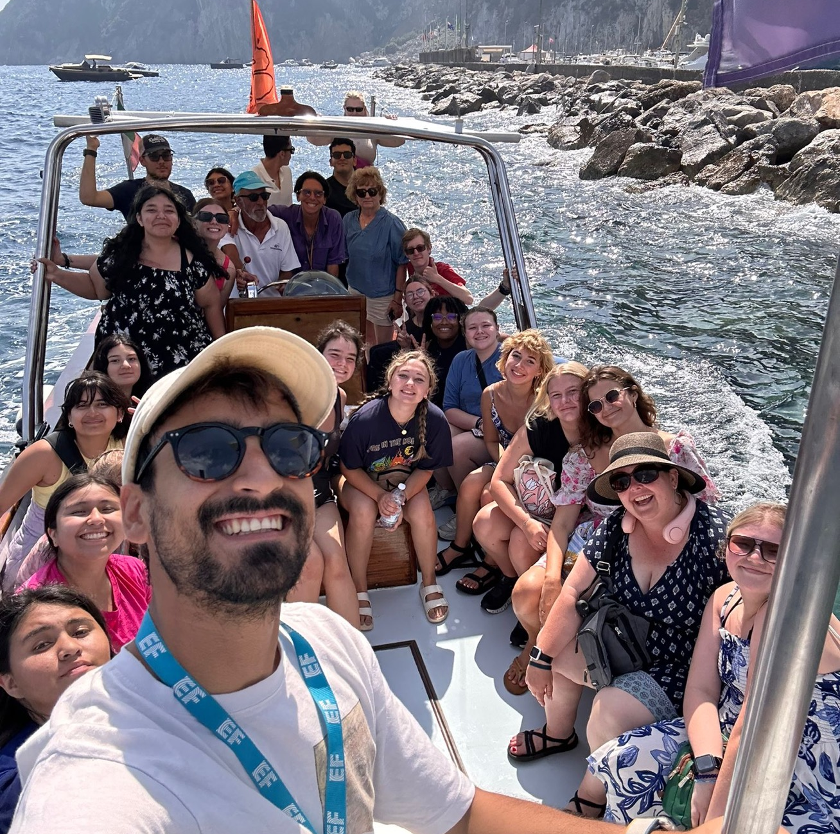




Our safety & support partner
Local support and insight worldwide
EF’s Safety and Incident Response Team
Flexibility to adapt our tour due to unforeseen circumstances
24/7 Tour Director and chaperone team support
Notes:
SPEAKER:
Let’s talk about safety and support. I’ve done my research and feel incredibly confident partnering with EF because...
EF has our back, they’ve thought of everything, and I trust their safety policies
They have multiple programs in place to help keep us safe
EF will be right there to support us (locally, globally, pre-tour and on-tour) to help us through any situations that arise
Bottom line: we are safer traveling with EF than we ever would be on our own.
Local Support and Insight
As you have already seen, EF is a global company! Because of this, EF has local knowledge to keep our groups safe no matter where we are in the world.
Safety & Incident Response Team
• EF has a team of experts located around the world, their #1 priority is safety
• They are always ready to respond to ensure that a train strike or a sprained ankle won’t slow us down
Their emergency support team is available 24/7, 365 days a year
Flexibility to adapt tour due to unforeseen circumstances
We’ll discuss this later, but if we’re uncomfortable traveling on our tour due to unforeseen circumstances, our group has the flexibility to modify our dates or itinerary before we leave to ensure we feel confident.
24/7 Tour Director and chaperone team support
• EF provides us with the support of a local Tour Director while on tour, who’s with us 24/7 and can liaise between our group and EF as necessary. Students will also have the support of myself and my chaperone team to ensure we have plenty of eyes on the kids during the trip.
GOAL:
Continue building trust in EF. Safety is both parents’, and EF’s, #1 priority.

Slide 9



Our education partner
The best way to help students gain new perspectives and build skills for the future is through experiential learning
EF’s Personalized Learning Guide
Students can earn 0.5 high school credits (included) by using this guide. This guide puts a more personal lens on their tour by tapping into their own interests and passions.
College Credit
Students can earn 3 college credits by taking a 16-week, tuition-based, course related to their tour experience
post-tour.
College essay
help
EF’s college essay guide helps students use their tour as inspiration for a personal essay that admissions officers can’t resist.
www.eftours.com/credit
Notes:
SPEAKER:
Another reason I partner with EF is because they’re an education company. Beyond our educational tour, there are other ways to continue your students’ personal and educational growth.
Personal Learning Guide
This guide helps students put a personal lens on their travel experience by having them view their trip through their own interests & passions
This often leads to a more engaging, meaningful and interactive experience on tour
EF is accredited, just like our school – so students to complete this will receive 0.5 high school credits (and it’s free)
College Credit
Students have the option of earning 3 college credits through a course from Southern New Hampshire University
You can add this college class when you enroll for tour.
Since we’re traveling with EF we get a big discount – it’s only $120/credit! That could save you a lot of money on college credits!
College essay help
This is designed to help students level up their personal college essay, using their tour experience for inspiration
*Registration for both high school and college credit needs to happen prior to tour. Learn more at www.eftours.com/credit
GOAL:
Show the value in this experience, and help parents understand that this type of travel is different than a family vacation

Slide 10
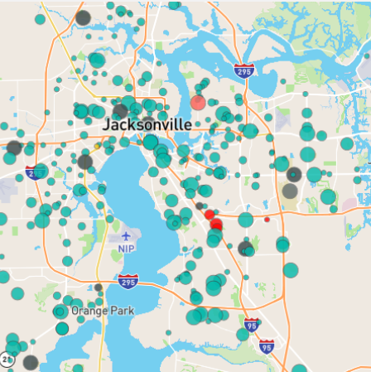
Atlantic Coast High
Creekside High
Mandarin Middle
Fleming Island High
Allen D Nease High
Sandalwood High
Notes:
EF is the largest provider of educational student travel in the area
Many schools and teachers in our area already partner with them
Here are some examples of schools actively traveling with EF…

Slide 11
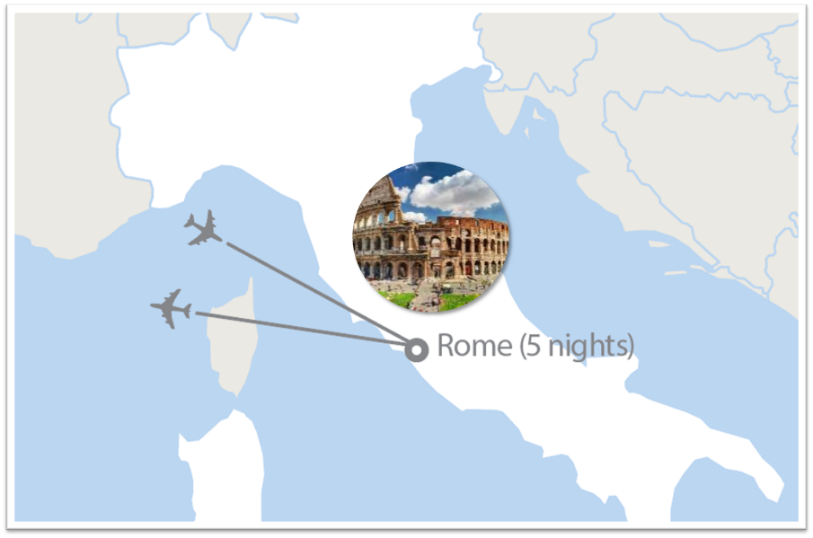
Rome: The City Stay

Slide 12
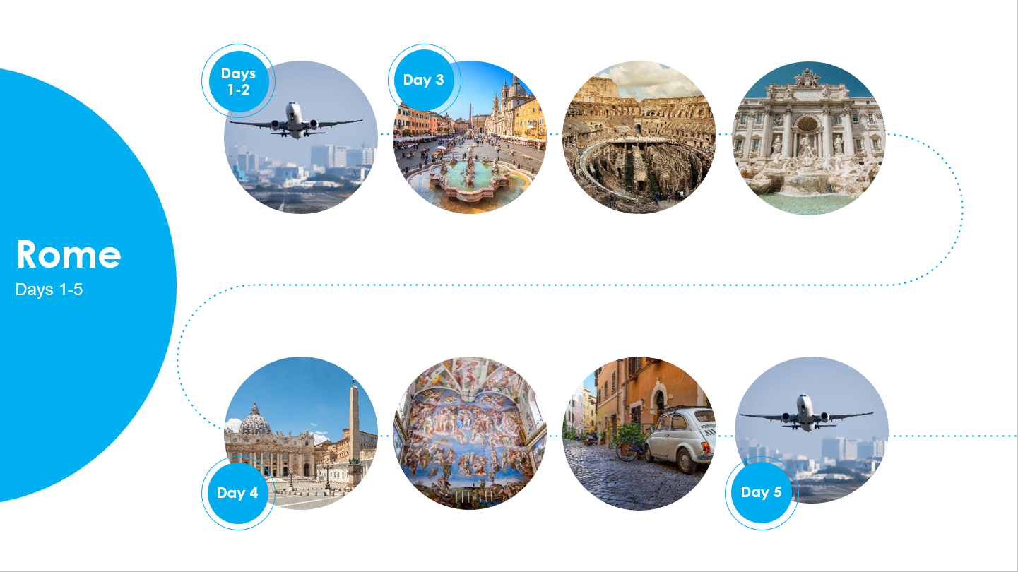
Fly overnight to Italy
Take a guided tour of Rome
Visit the Colosseum & Roman Forum
See iconic sites of Rome like the Trevi Fountain
Take a guided tour of Vatican City
Visit the Sistine Chapel & St. Peter’s Basilica
Explore Rome with your group
Fly Home

Slide 13
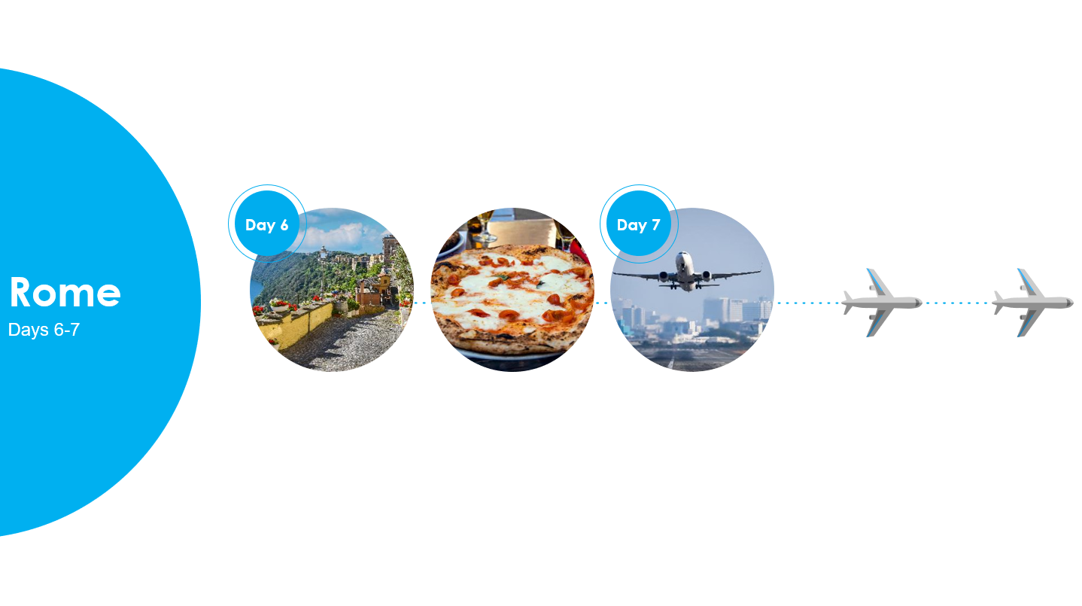
Take a guided tour of Castel Gandolfo
Explore & enjoy the cuisine of Rome
Travel home

Slide 14


Slide 15
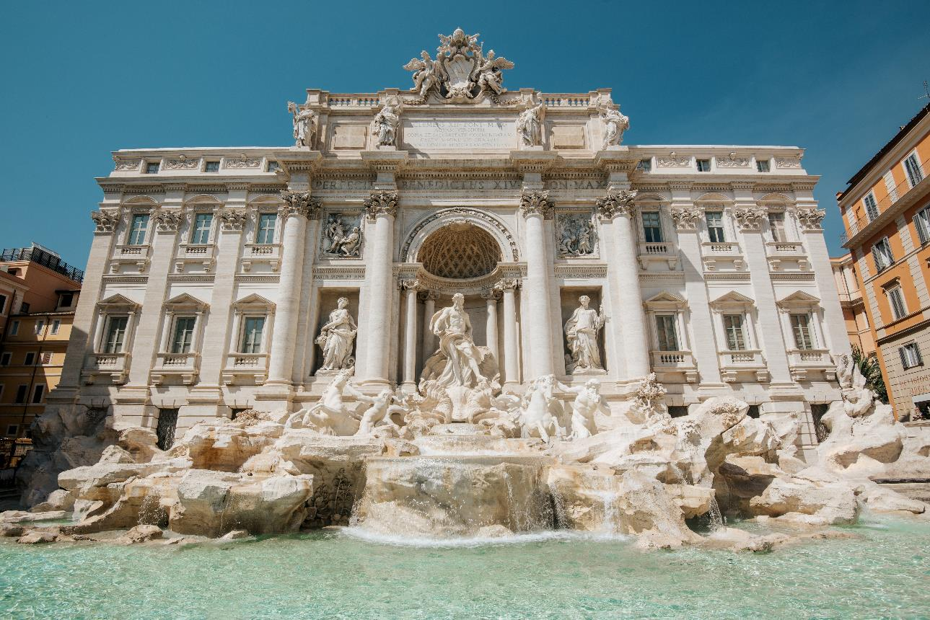
Add large beautiful images
Toss a coin in the
Trevi Fountain

Slide 16
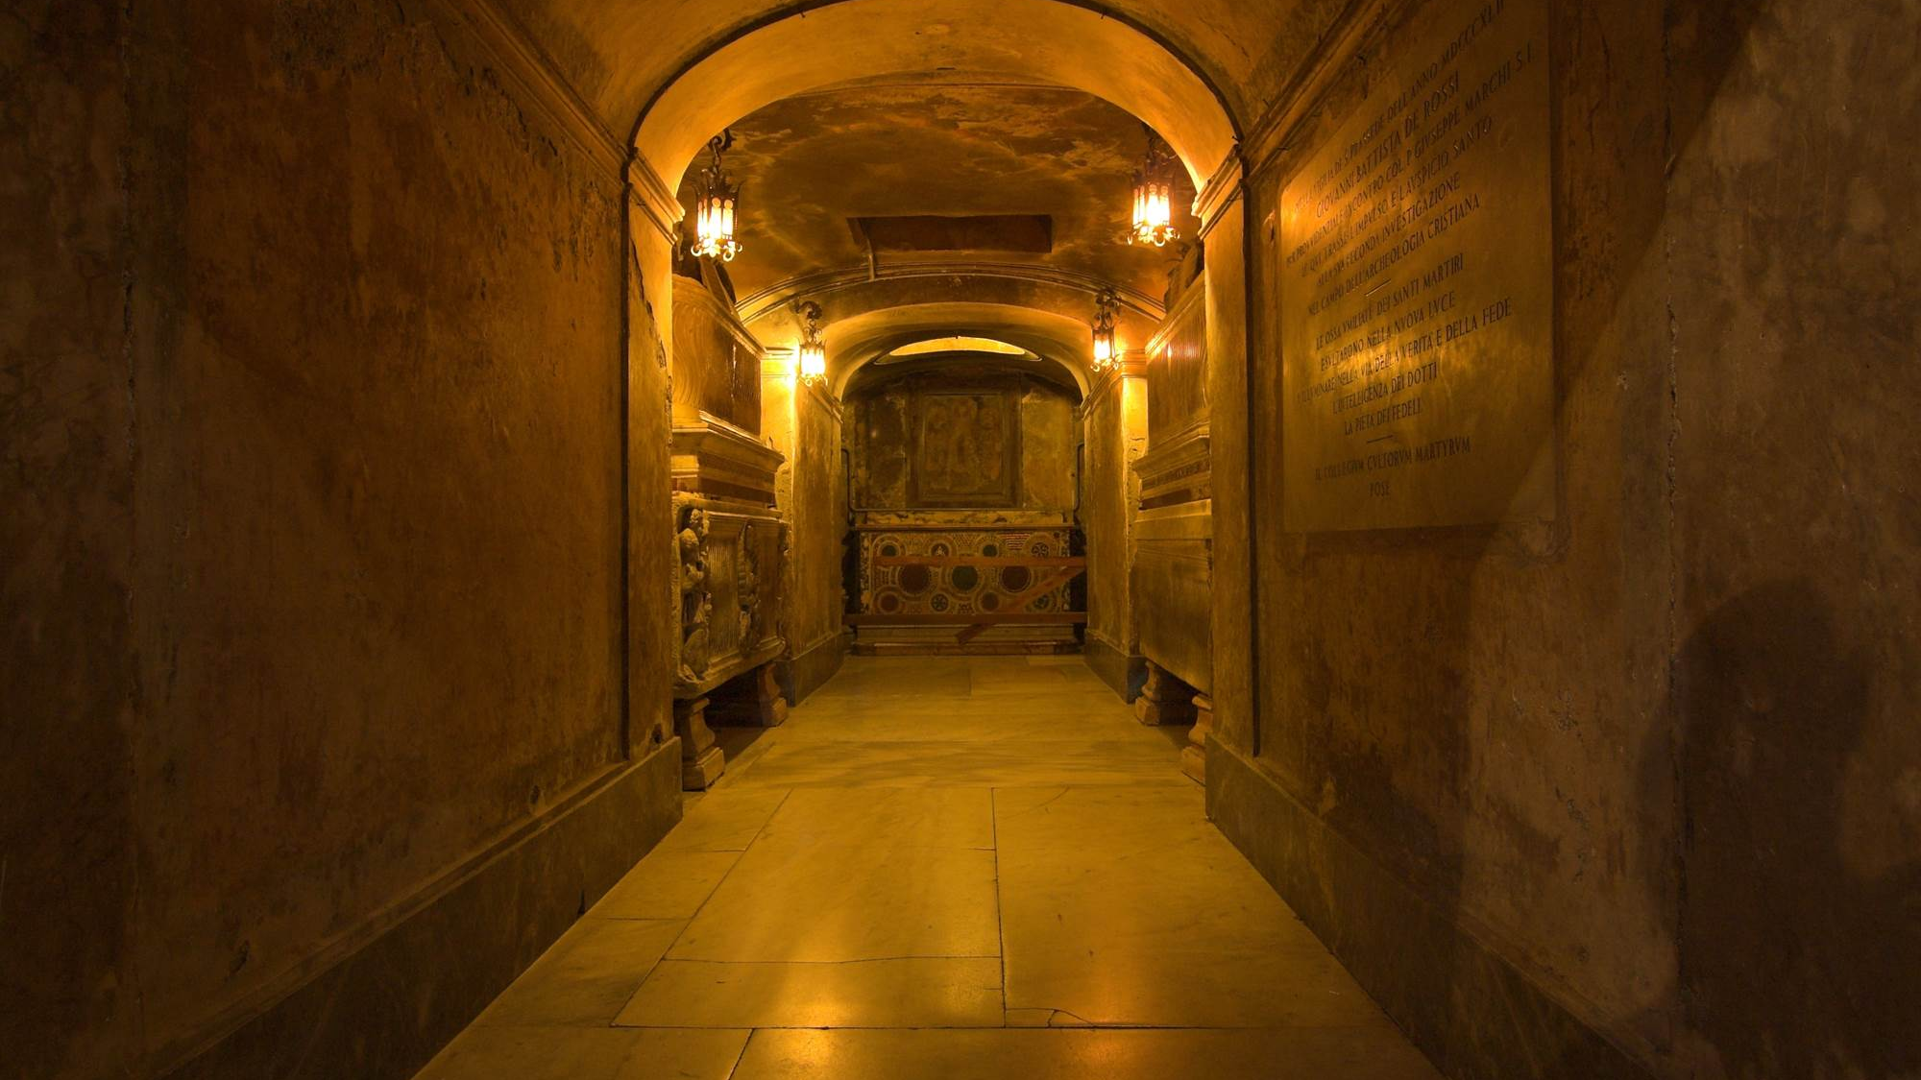
Included
Roman Catacombs

Slide 17

Included
Rome Cooking Class

Slide 18

Our travel dates
*Block off your calendars from the earliest departure to the latest return*
Mar 14, 2026
Mar 15–Mar 21
Mar 22, 2026
7 Day Tour
Earliest Departure
Requested Dates
Latest Return
Our flexibility with these dates will help EF create the best on-the-ground experience for us
We will receive our confirmed dates 2-3 months before tour
Our group could be combined with another school, requesting similar dates and destinations, which will be a great opportunity to meet students from another part of the country
Notes:
SPEAKER:
To help ensure we have the best experience possible, we need some flexibility when it comes to travel dates. With that, we have a flexible travel window, which means we could be leaving as early as (start date) and returning as late as (end date).
We will find out our exact travel dates 2-3 months before tour, but for now we could be traveling any time within this range.
In the middle of that range falls our (requested departure date). You will see these dates as you enroll, but again, note that we can depart as early as (start date) and return as late as (end date).
We also have the chance of traveling with another school, which would be a great experience to meet other students!
GOAL:
To help parents understand group travel requires some flexibility. Parents need to block off this entire date range in their calendars, not just the requested travel date range.

Slide 19
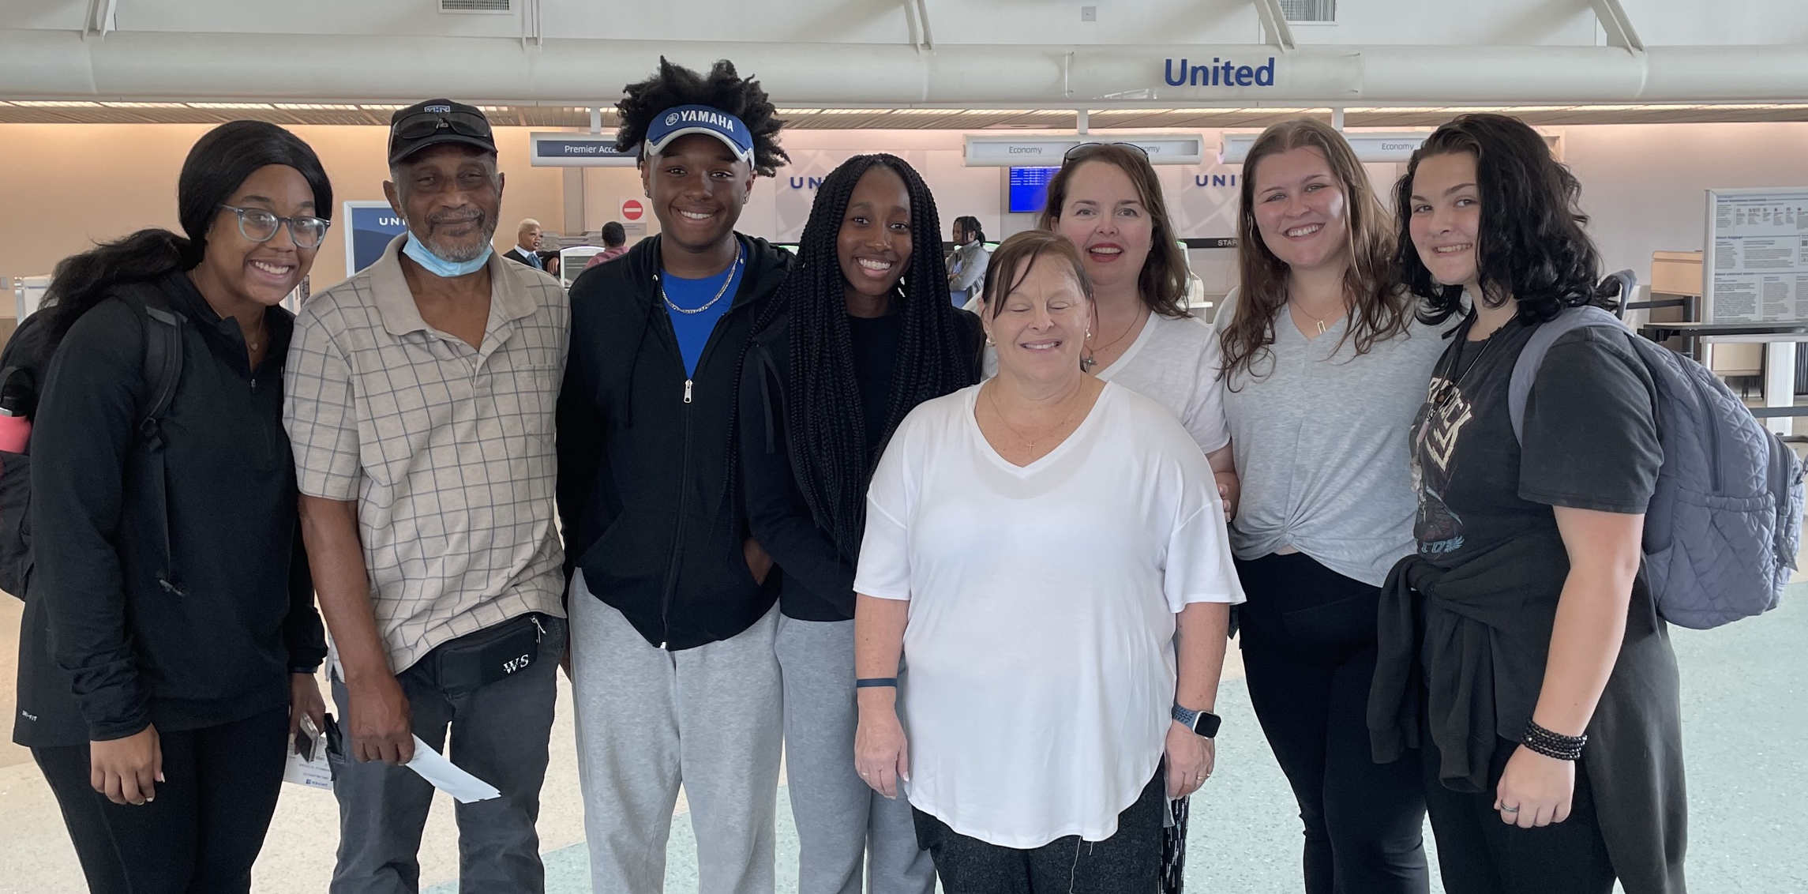
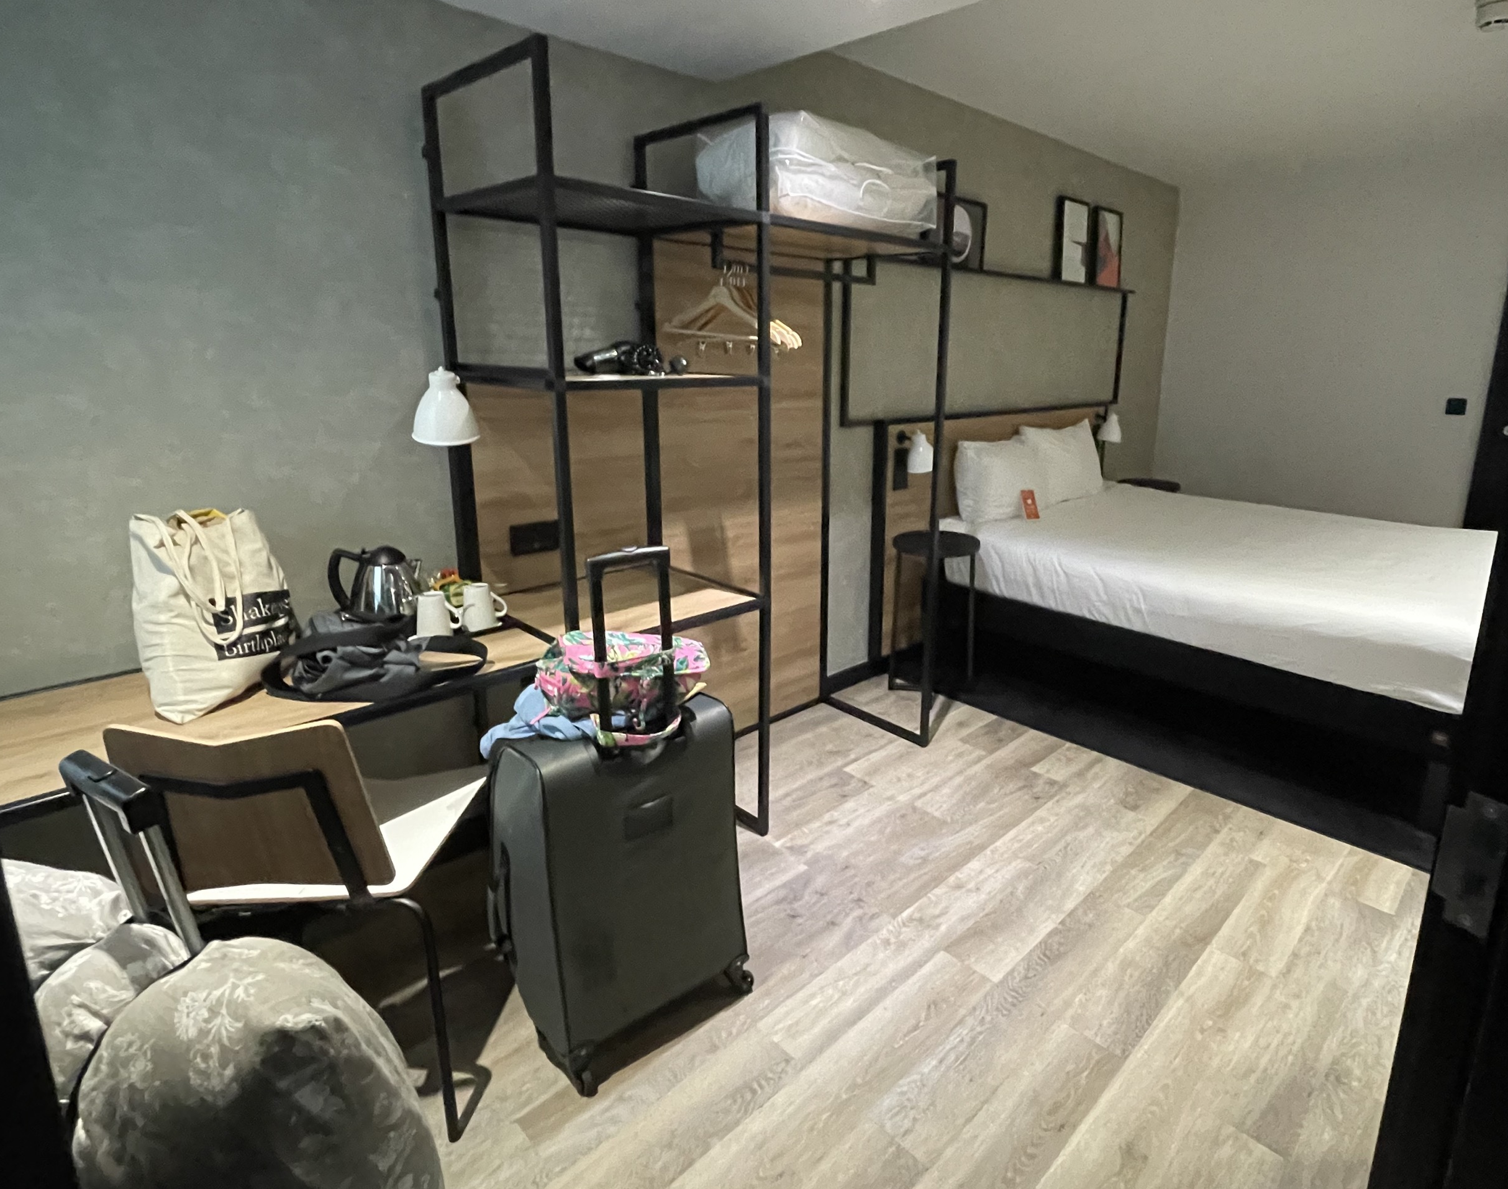

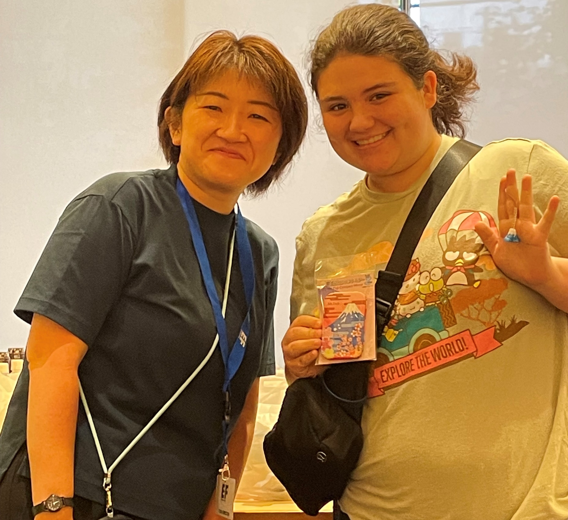
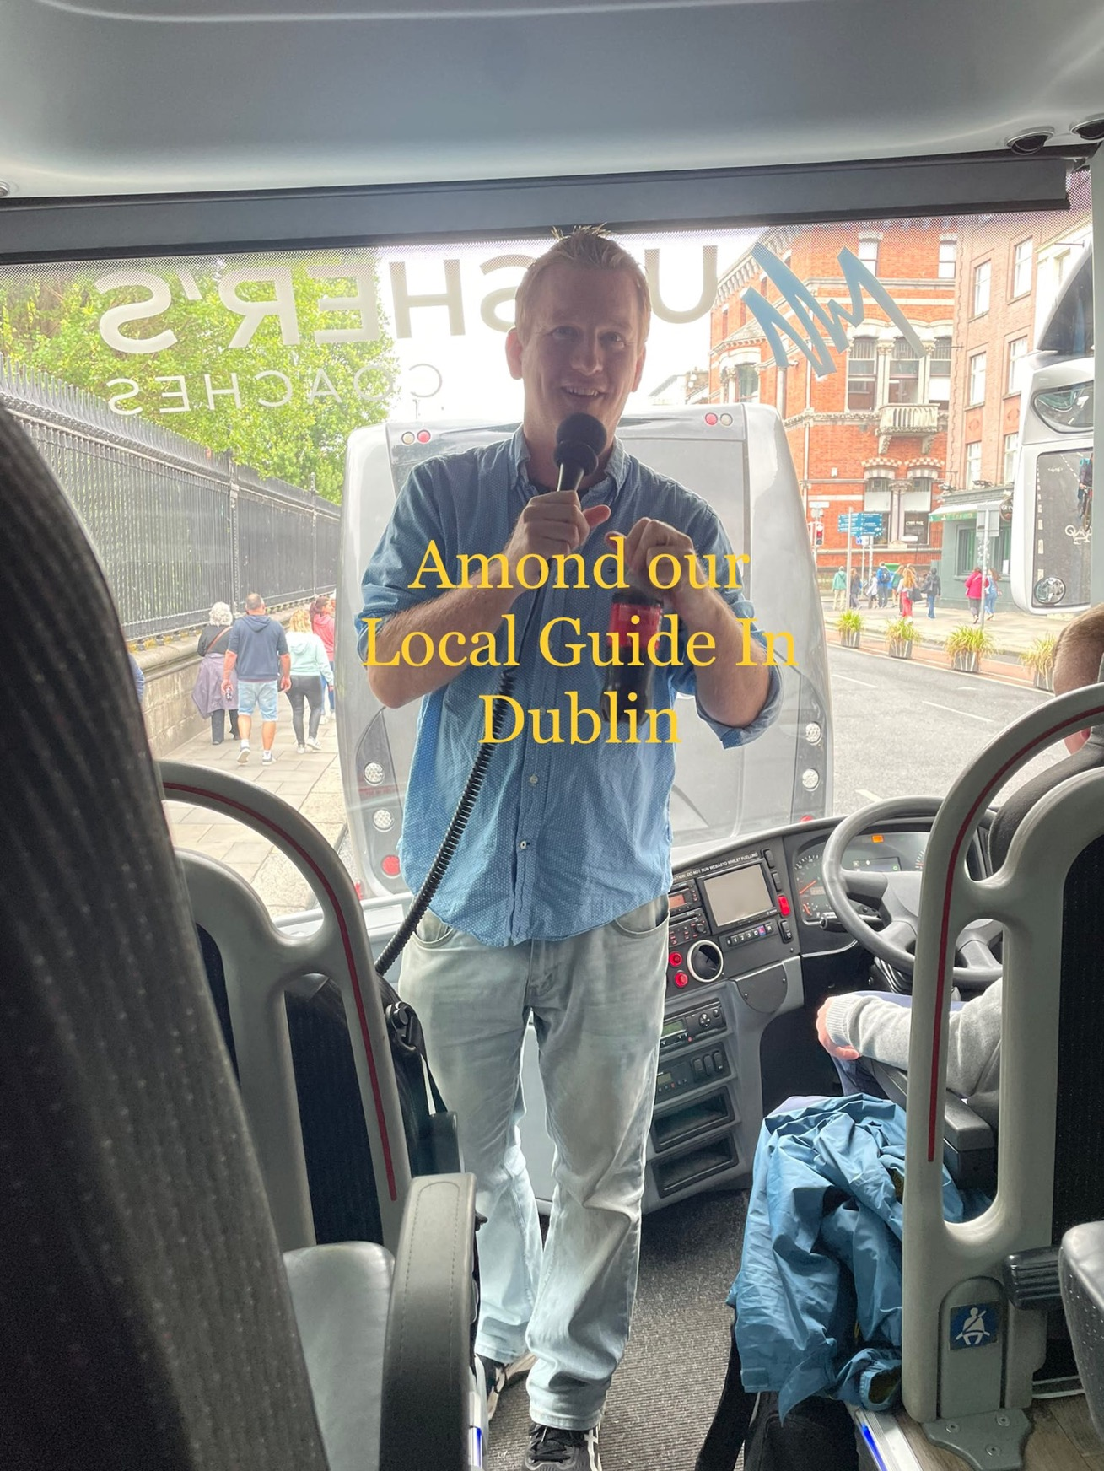
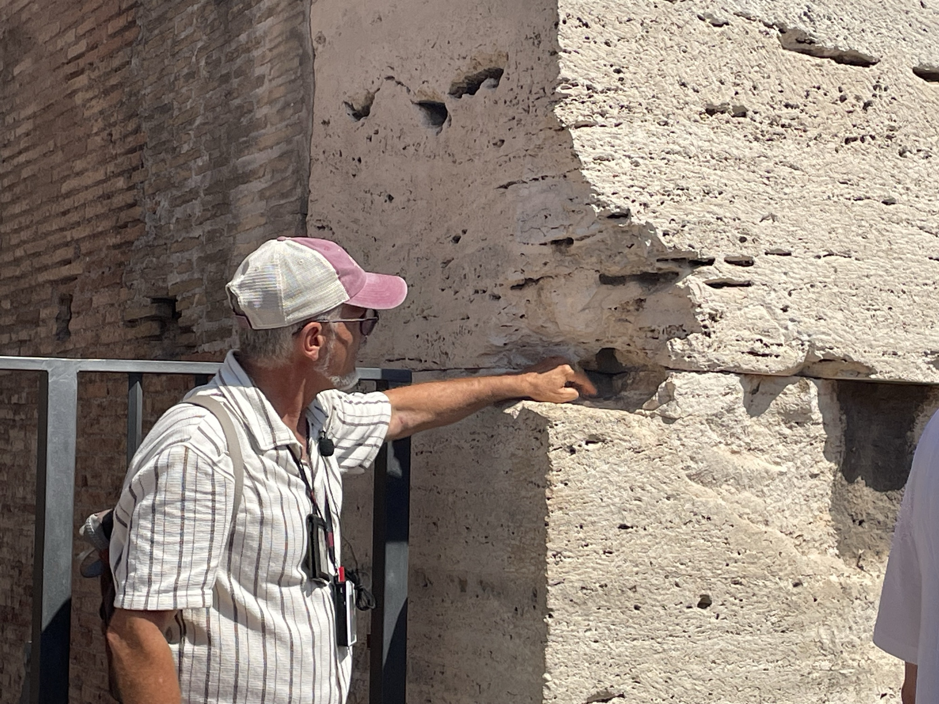
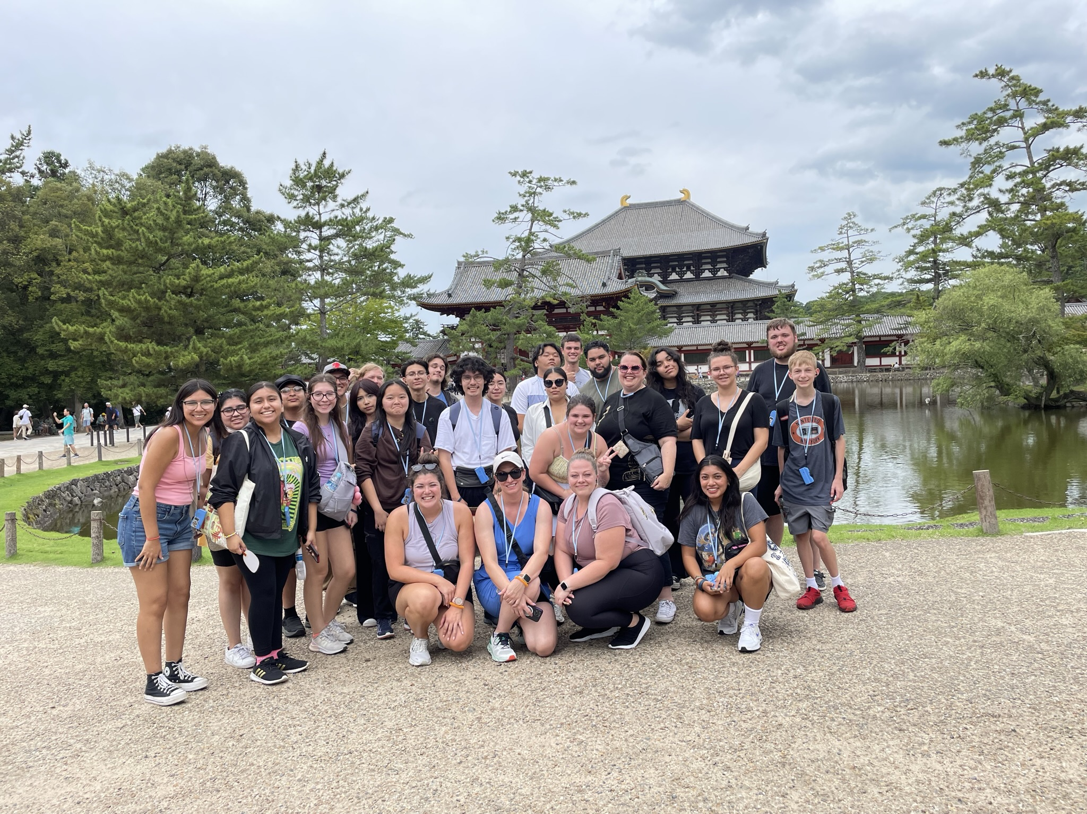
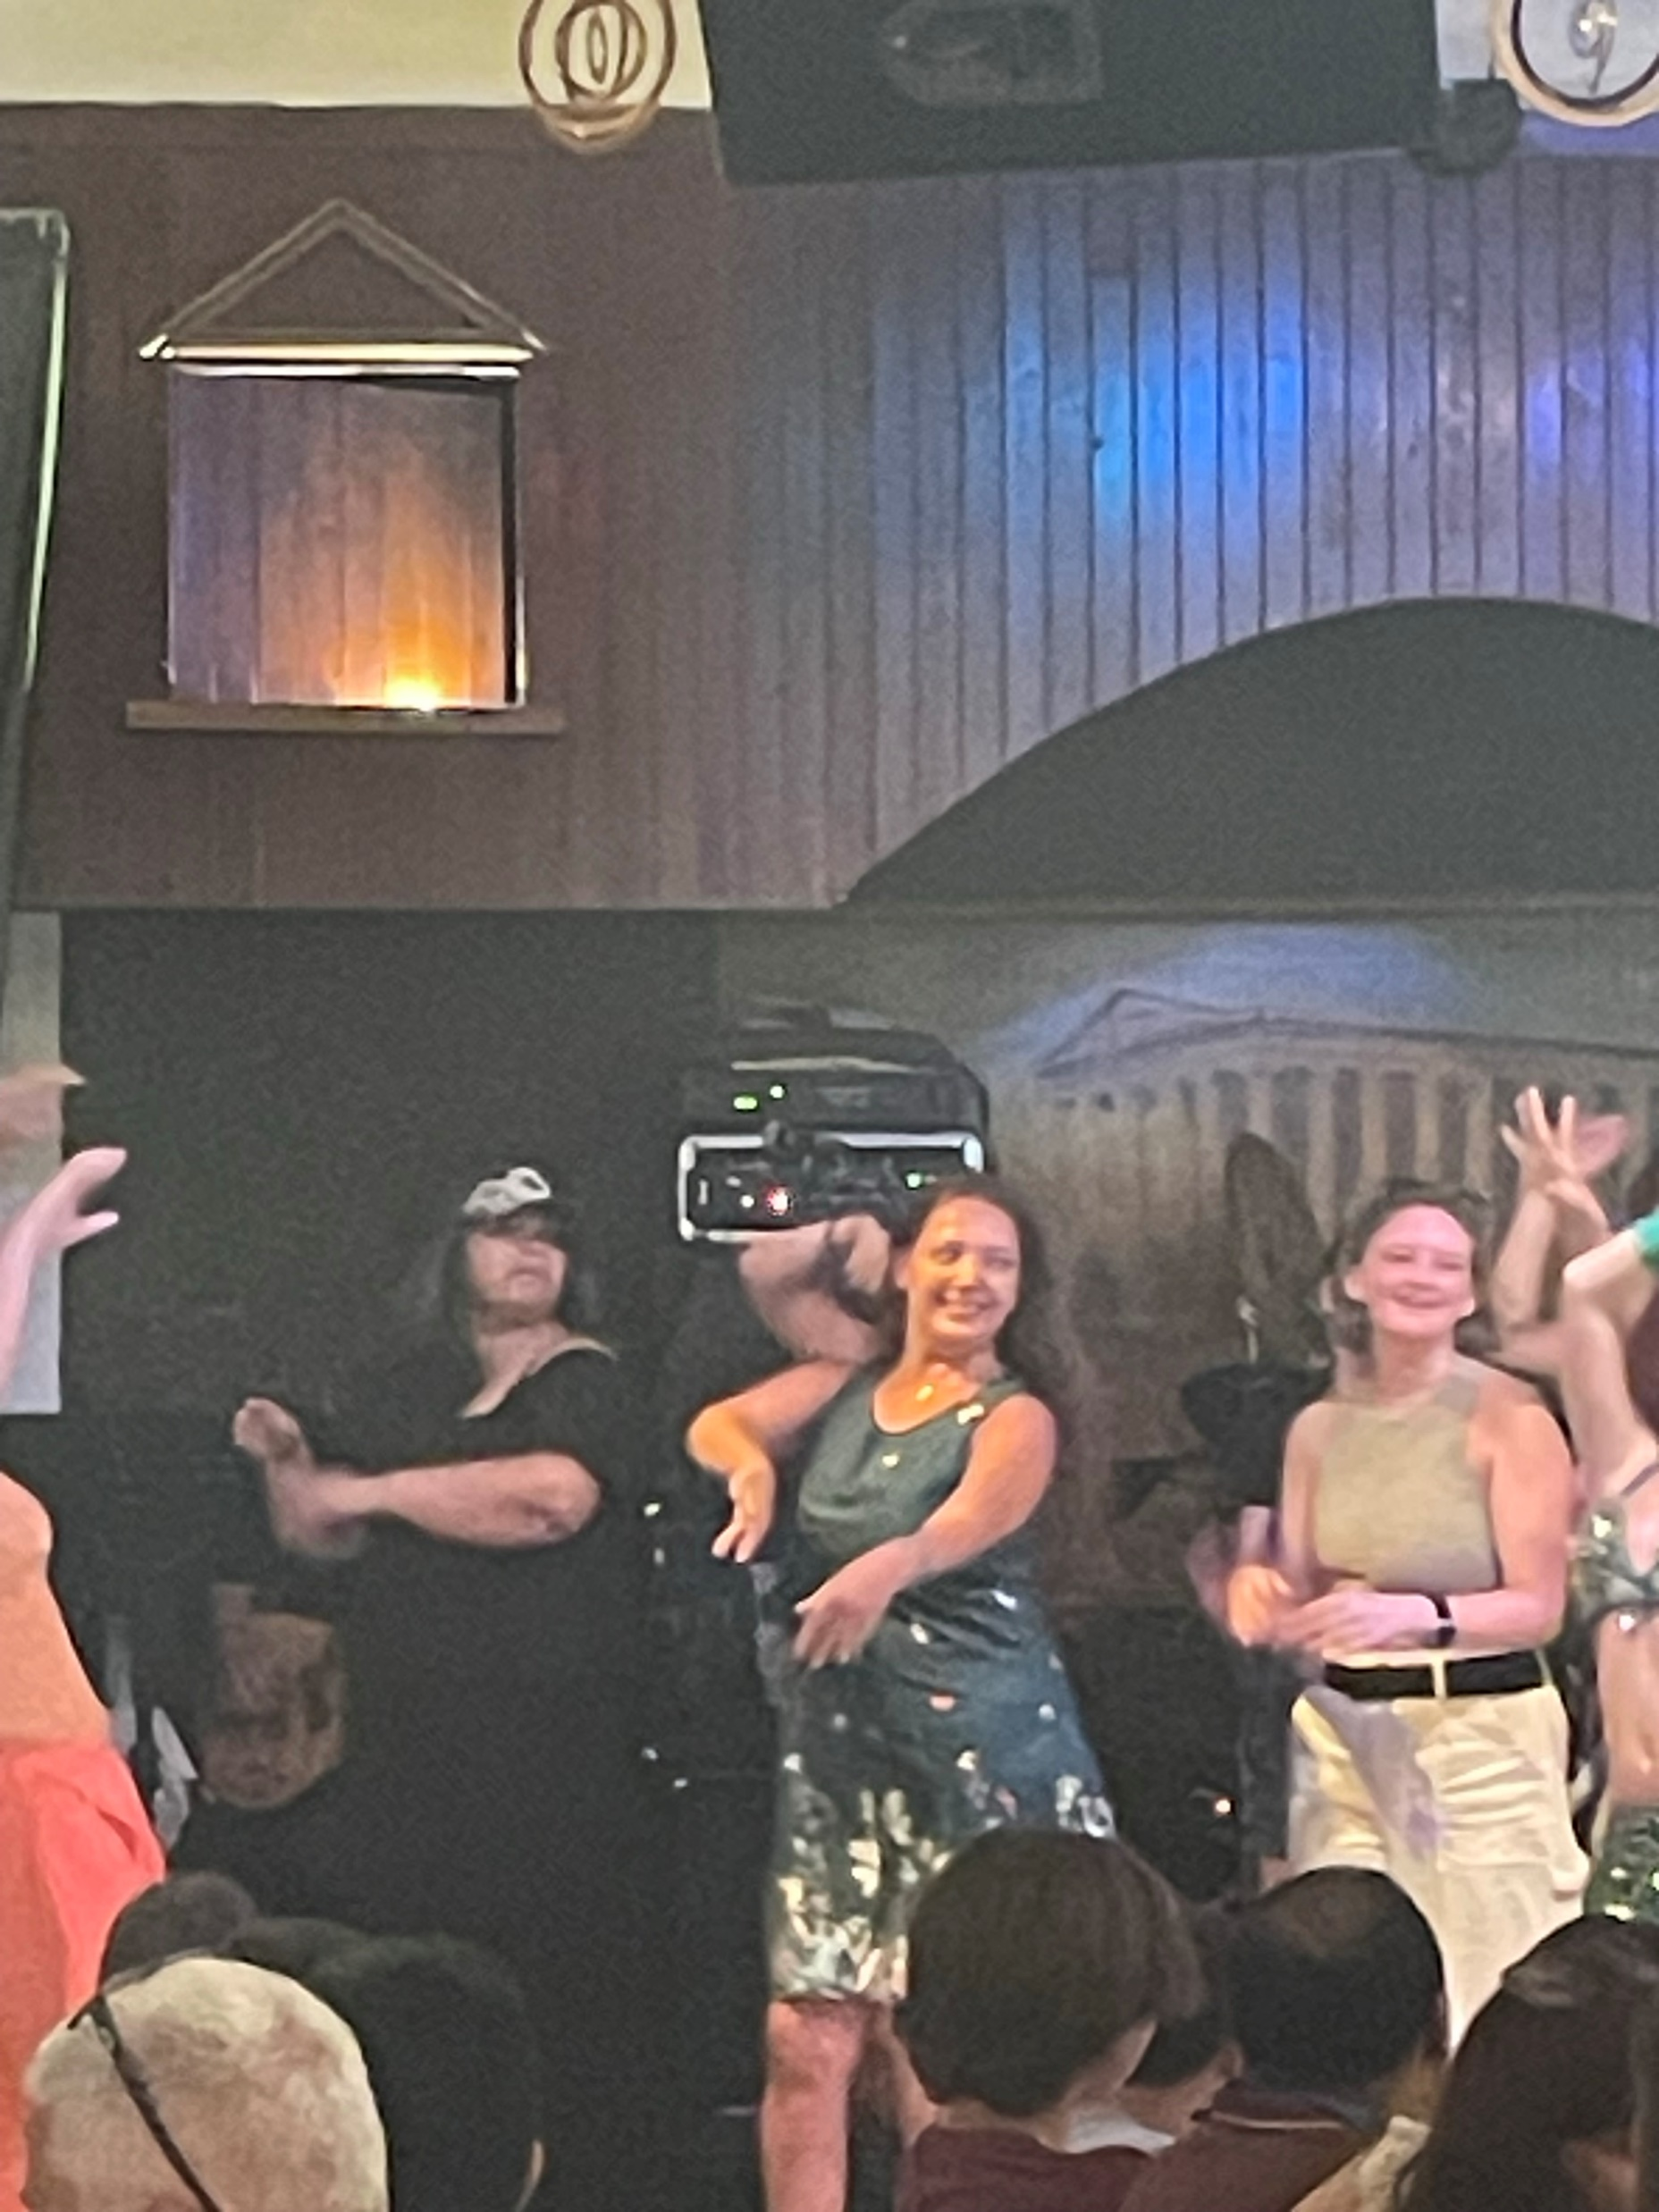
What’s included in our itinerary
Regional-style meals for breakfast and dinner
Notes:
SPEAKER:
[So, what’s included?]
A TON
Directions: read through each one.
GOAL:
Build the value in the experience, through everything that’s included
You want parents to think the will cost twice as much as it actually does

Slide 20
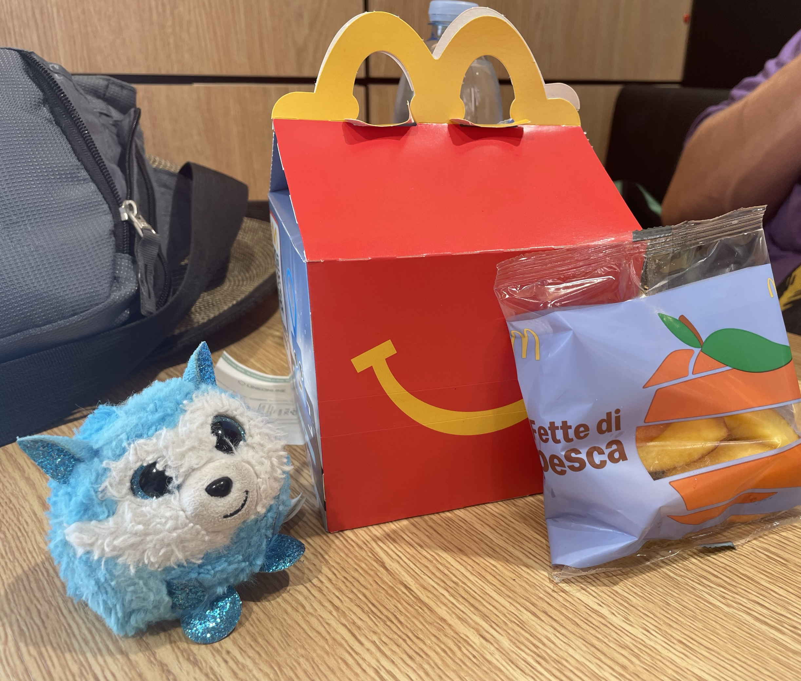
What you are responsible for
Passports (and visas, if applicable)
Baggage fees
Tips for local guides, bus drivers and your Tour Director
Snacks and some meals
Notes:
SPEAKER:
So what’s not included? A few things, but no real surprises here.
As we get closer to departure, I’ll hold a meeting for our enrolled travelers to talk through passports, tips, etc.
GOAL:
Help parents understand the few things they’ll need to budget for outside of the cost of the tour

Slide 21
Book with confidence
For our group:
For each traveler:
Peace of Mind Program
This program provides our group with flexibility to change our trip due to unforeseen circumstances.
Global Travel Protection (included)
Coverage for medical, baggage, trip cancellation and more
Global Travel Protection Plus (+$400)
Same coverage benefits with the addition of cancel for any reason protection up to 24 hours prior to departure
Risk-free enrollment period
Travelers who enroll by December 20, 2024
can cancel for any reason up to 7 days after enrollment for a full refund of 100% of the money paid to EF.
*We will provide more information about all these benefits after this info session
Notes:
SPEAKER:
EF offers a few things to help us protect our investment, to give us the confidence to book our travel experience now, while monthly payments are so affordable. Here are some of the ways they do that…
Peace of Mind Program
EF’s Peace of Mind Program gives our group the flexibility to modify our tour or dates if we’re uncomfortable traveling as we get closer to departure.
Global Travel Protection
Custom-designed travel protection unique to EF, provides both pre-tour and on-tour benefits like medical coverage, baggage coverage, flight delay coverage as well as some trip cancellation protections.
Global Travel Protection Plus is also available, and adds a cancel for any reason coverage up until 24 hours prior to tour.
Risk-Free Enrollment Period
Travelers who enroll by [X Date] will qualify for EF’s risk-free enrollment period
EF has thought of everything, they protect our tour, they protect us on tour, and they protect us in the event you change your mind and have to cancel.
GOAL:
Build trust in EF and help parents understand how they’re protected, so they feel comfortable and confident enrolling.

Slide 22

Industry-Leading Protection of Investment
Cancellation Fee
Within 7 days of enrollment
Cancellation Fee
Up to 1 year prior to departure,
if enrolled in the Global Travel Protection Plan
$0
$95
*Additional details can be found on our tour enrollment page
Notes:
SPEAKER:
EF has our back when it comes to protecting our investment because they know we're planning this tour far in advance and plans can change. Like I said earlier, if you change your mind within a week of enrolling - you get all your money back, but what's even more reassuring is that if you have to cancel up to a year prior to our tour you get all your money back, less $95, if you've purchased the Global Travel Protection. So it’s comforting to know that you’re well protected if plans change.
GOAL:
Build trust in EF, help parents understand how their investment is protected if plans change.

Slide 23



Making it happen
Global Citizen Scholarship
EF awards up to $100,000 in scholarships each year
Any enrolled traveler may apply
Information found on EF’s website
Tour Fundraising Page
Enrolled travelers receive an individual tour fundraising page
Anyone can contribute
100% of donations go toward tour balance
Notes:
SPEAKER:
EF offers a few additional opportunities to help fund our travel as well.
Global Citizen Scholarship
$1,000 needs & merit-based scholarship
To be eligible, complete application and submit a 2-3 minute video that answers the question: How will this tour change the way you think or feel about the world, or act within it?
All enrolled students are eligible to apply for the Global Citizen Scholarship. Find out more specific information online at eftours.com/global-citizen
Personal Tour Fundraising Page
Once you enroll, you can send out your personal tour Fundraising URL from your traveler page.
This page works just like a “Go Fund Me page” but better because you see 100% of the contributions applied to your tour balance
Great for holiday/birthday gifts, payment for baby sitting/mowing lawns, or just sending to friends/family who want to help you see the world!
GOALS:
Show families a couple of the ways they can make their tour even more affordable

Slide 24







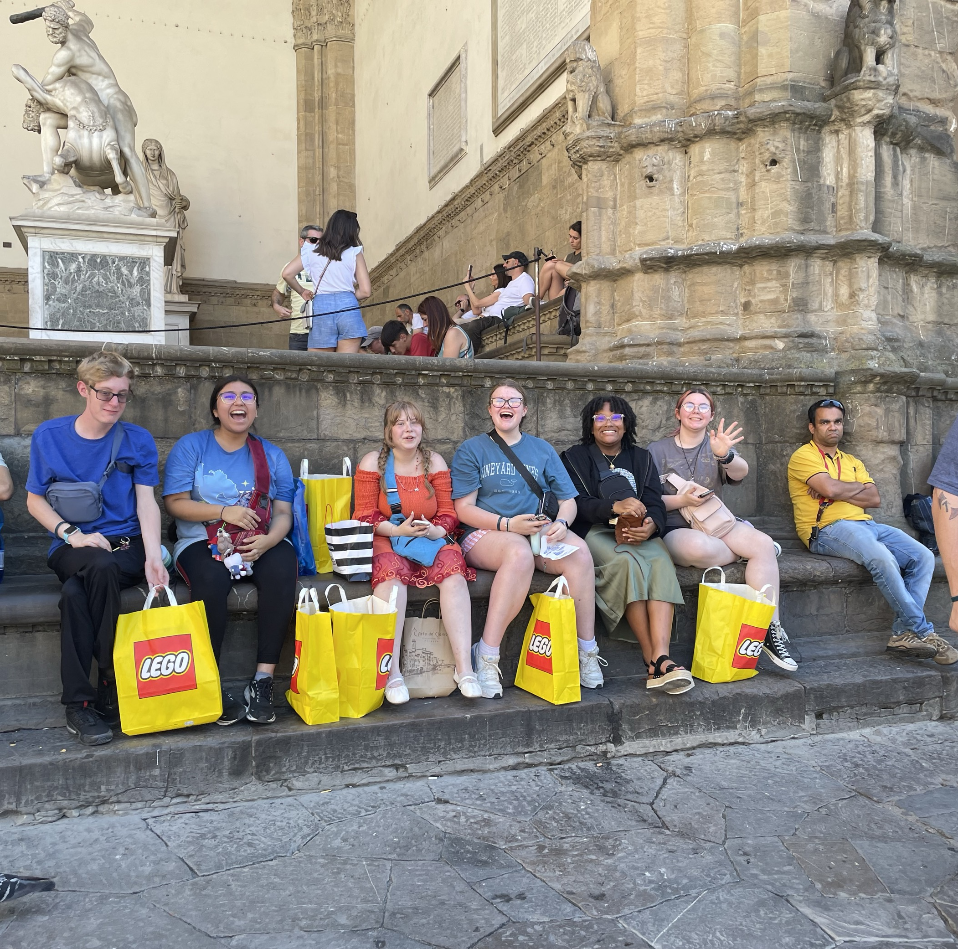
Itinerary & logistics
Payments & protection
Safety & support
Personalized learning
Everything we talked about getting on tour!
Flexible payment options
Personal Tour Fundraising Page
Global Travel Protection Plan options
Protection of Investment
Personal traveler account online
Traveler Support Team
24/7 Safety & Incident Response Team
Peace of Mind Program
Project-based learning guide
High school and college credit options available
College essay help
Notes:
SPEAKER:
Like I said, we get SO much more than just our tour when we travel with EF. Not only does our tour package include everything we talked about related to the itinerary, it also includes all your flexible payment options, fundraising resources, built-in protection of your investments, unmatched safety policies, local and global support, and personalized learning opportunities that can help students grow and get a head start on the next chapter of their lives. This is a once-in-a-lifetime experience that you will never forget, there is no safer or more impactful way to travel – and there is no better time in life than now.
GOAL:
Summarize the value of this experience, to help parents understand everything they get, before you review pricing options

Slide 25
Making it happen
Flexible payment options
for adults
$153
$306
$4,069
BI-WEEKLY
MONTHLY
IN FULL
(includes $95 enrollment fee)
(includes $95 enrollment fee)
$4,619
This pricing includes EF’s current $200 Early Enrollment Discount!
Included discount only applicable if you enroll before midnight on February 7, 2025
Contact EF’s Traveler Support Team for additional payment options
Notes:
SPEAKER:
So what does it cost? The reason I’m planning this far in advance, is to help keep the payments affordable, and EF offers a variety of ways to pay for this experience. The easiest and most common ways to pay are the bi-weekly and monthly payment plans, which allow you to budget for your tour just like any monthly expense.
Bi-weekly payments are (X dollars) after the initial $95 dollar fee
The most popular way to pay is Monthly, and if you enroll by our deadline, the monthly payments are (X dollars) a month
And for those who want to Pay in Full and not worry about monthly payments, the total cost is (X dollars)
Adults can travel too - Same flexible options, but the price is a bit more.
Discount
To help us kickstart the planning process, these prices include a ($$ discount), which is available through my enrollment deadline of (date). After this deadline the discount will expire, which will increase the price of the tour.
Need Additional Payment Options? Call EF’s Traveler Support Team
If you need to explore other payment options – call EF’s Traveler Support Team, they can review all the options with you. Just be sure to call them before our enrollment deadline so you don’t miss out on our enrollment incentives.
GOAL:
Help parents understand they don’t have to pay in full now to register. Most families pay monthly and work this into their monthly budget, this shows them how they can do the same.

Slide 26

Time to enroll!
Earn $200 discount & qualify for risk-free enrollment if you enroll by our deadline!
Secure your spot with a $95 enrollment fee.
GUARANTEED SPOTS AVAILABLE:
10
ENROLLMENT DEADLINE:
February 7, 2025
Notes:
SPEAKER:
It’s time to enroll! There has been a lot of interest in this trip and I expect it to fill up quickly, in fact…
(##) Families have expressed interest in our trip
and (##) of them registered to be here tonight
I only have (20) spots available, and I expect those spots to fill up quickly. The interested families who couldn’t attend tonight will receive the information about our trip after this meeting, but you all have first crack at our available spots since you’re here.
The deadline to enroll for our trip is (enrollment deadline), and if you enroll by the deadline you lock in your price, you lock in the $$ discount and you lock in that 7-day Risk Free Enrollment period we discussed.
Lastly, like I said before - I think our tour will fill up quickly, so if you plan to go I’d recommend enrolling right away while we still have spots available.
GOAL:
Keep this simple and straight forward. Help parents understand how much interest the community has shown, how many spots are available and what benefits they’ll receive if they enroll by your deadline.

Slide 27
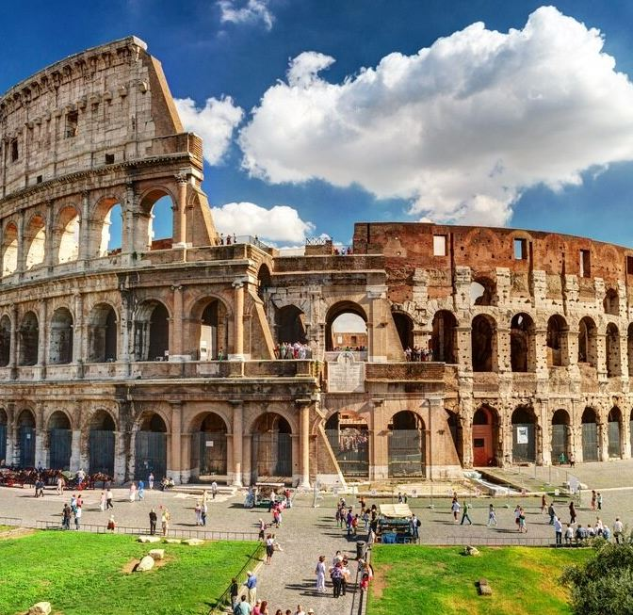
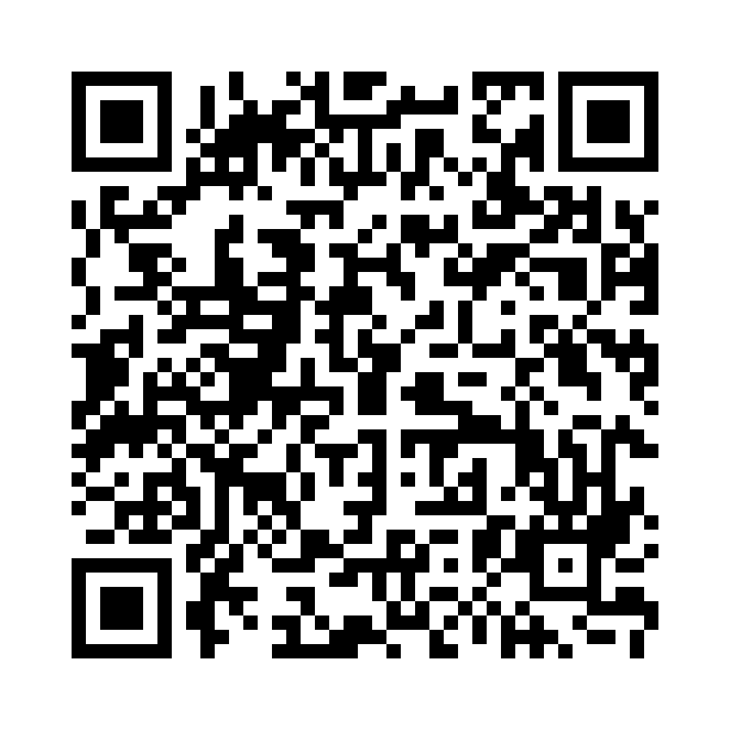
Enrollment is open!
OUR ENROLLMENT PAGE
eftours.com/2854166SZ
QUESTIONS?
Fill out our Sign In Form
Chat with EF: www.eftours.com
Or Call EF’s Traveler Support Team
800-665-5364
Notes:
SPEAKER:
And with that, enrollment for our tour is officially open!
So, how do you enroll on this experience?
QR Code – for Tour Enrollment Page (or use the link)
Email - I’ll be sending an email after this meeting with the enrollment link – this is when all the other interested families will learn about this experience
OUR ENROLLMENT PAGE
Covers all the details specific to our tour that I went over today, plus additional info if you want to do more research.
The easiest way to enroll is online but you can also call EF
QUESTIONS?
We’re not going to do a group Q+A because I value your time and I know you want to get back to your evenings
If you do have questions:
Come talk to us individually or write your questions in the Sign-in Form you opened at the start of the meeting
OR connect with EF directly
You can chat with them at www.eftours.com
Or you can call Traveler Support at 800-665-5364 (this the fastest way to get your questions answered)
THANK YOU
Thank you all so much for coming. This is truly a once in a lifetime experience that will have ripple effects on your students for the rest of their lives, so I hope you all can join us. Here’s to (destination) and have a great night!

