Slide 1
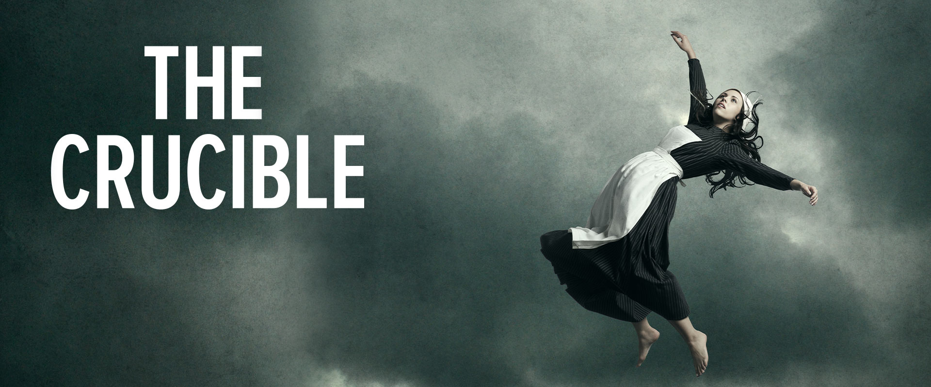
CRUCIBLE – A SEVERE TRIAL OR TEST

Slide 2
What happens when fear gets the best of a society?
It happened in 1692. It happened in the 1950’s.
Is it still happening?

Slide 3
Theme – a central message about life that is relayed
through a work of literature, especially concerning
topics like love, fear, sacrifice, pride, gratitude, etc.
Historical fiction – a work of fiction that includes actual
historic people, events, and settings, but weaves in a
fictional narrative and other fictional elements.
Extended metaphor – when a section of a literary work,
or the whole work, serves as a metaphor for something else.

Slide 4
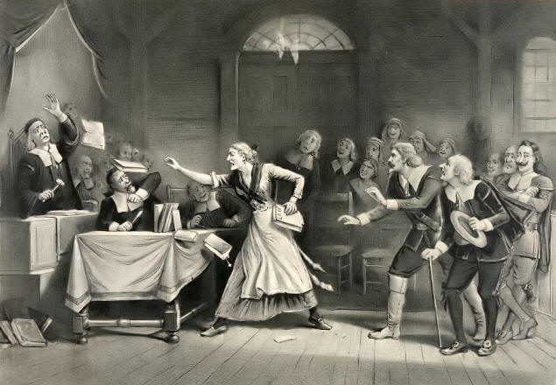
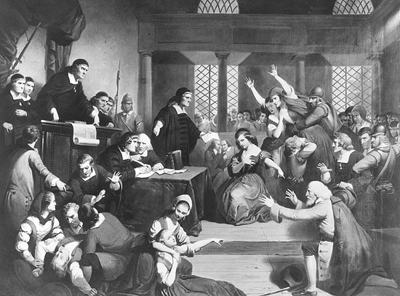
Literally … The Crucible is a play about how widespread fear
and hysteria in Puritan society, led to “witch hunts” and ultimately the infamous
Salem Witch Trials of 1692. Based on false accusations that were motivated
by greed and revenge, innocent people were labeled as witches, hunted down
by the Puritan government, and put to death.

Slide 5
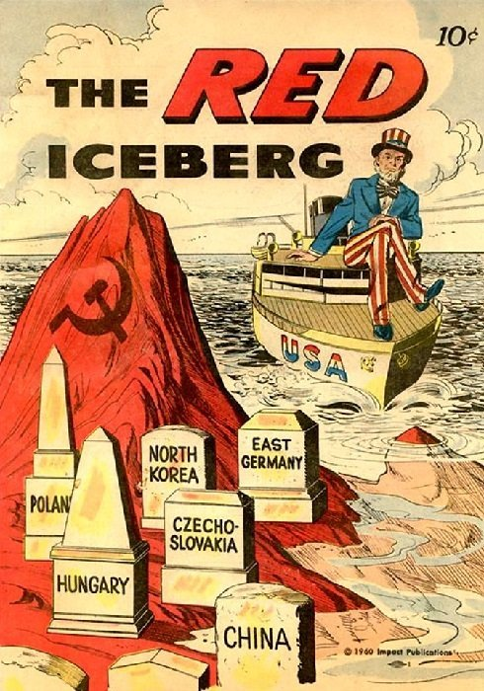
Metaphorically … The Crucible
illustrates how widespread fear and hysteria
that Communists were using both our
government and the influence of Hollywood
to destroy American society in the 1950’s
(The Red Scare) resulted in “witch hunts”
led by Senator Joe McCarthy. People
suspected of having Communist ties were
tracked down and “blacklisted” or deemed
unemployable, thus ruining their
livelihoods and reputations.

Slide 6
Parallels between Salem, the Red Scare,
and recent history?
Government power trips – Government officials (today with the help of media) manipulate the public with skewed facts, hypocritical legislation, and/or self-preserving abuses of power. Critics are often treated harshly.
Fear-based society – People get so consumed with fear of an outside threat (or of getting trouble with the government) to the point that they are willing to give up certain freedoms and even relationships with friends or family.
Mob mentality – Fear-mongering propaganda stirs up “mobs” of people who take it upon themselves to engage in reckless, destructive behavior (public shaming, blacklisting, riots) that often end up and hurting the innocent more than anyone else.

Slide 7
Parallels between Salem, the Red Scare, and post 2020:
Strict government responses to threats of witchcraft in Salem, Communism in the 1950’s share a lot in common with each other, and with our response to the Covid epidemic.
Strong authoritarian tactics, flawed logic, and strict punishments allowed governments to manipulate and turn people against each other out of fear.
Acting out of fear, people started publicly shaming, blacklisting, and/or “canceling” individuals who refused to comply with authoritarian policies they did not support.

Slide 8
Parallels between Salem, the Red Scare, and post 2020:
Often, the “scapegoats” are those people who are only guilty of questioning that which did not make sense to them, standing up for their beliefs, or simply operating a business in the wrong place at the wrong time.
As public backlash to illogical reasoning, ridiculous charges, and mass manipulation grew, all three “witch hunts” lost support.
As time goes on, politics fans the flames of division, sometimes leading frustrated mobs to commit physically destructive crimes such as rioting, looting, or arson.

Slide 9

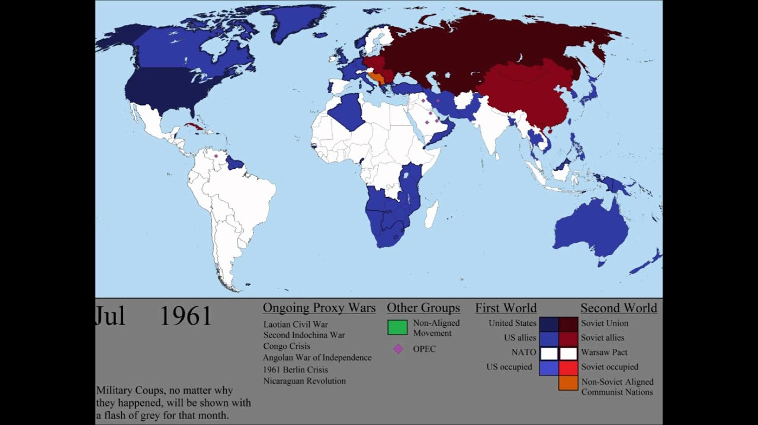
What is Communism and why the big deal?
Communism is an economic system incompatible with and opposed to the way we live in the U.S. Communist Russia (USSR) was America’s biggest rival throughout the 1900’s. This rivalry became known as the Cold War, and many countries throughout the world were influenced by one side or the other. The idea that Communists were trying to infiltrate American society was proven to be true (and still happens today), but Senator McCarthy’s methods went too far, hurting innocent people and making his own name synonymous with injustice.

Slide 10
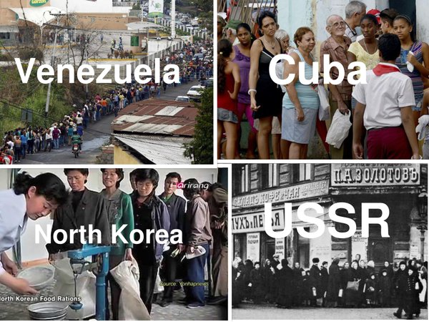
In theory, Communism sounds
attractive because it promises an idealistic equality for those who feel capitalism isn’t fair. This is why Communists often target people who feel oppressed and seem to struggle to get ahead under capitalism. In practice, the implementation of Communism has led to totalitarian dictatorships where most people end up equal in their dependence upon the government, lack of personal freedom, and inability to improve their standard of living.

Slide 11
Wasn’t the Puritan government a theocracy?
How does that relate to Communism?

Slide 12
Theocracy -
a government in which
a country is ruled by religious leaders (Puritans)
Other faiths & atheism
seen as a threat to
society
Examples: New England colonies like Mass. in The Crucible (Christian), Biblical-era Israel (Jewish), Present-day Iran (Islamic)
Communism -
often characterized by the banning
of all or certain religions or the
mandated worship of a dictator
(Cold War Russia, North Korea)
Religions are seen as a threat to
the supremacy of government
Communist governments act
somewhat like atheistic theocracies
in the sense that the leaders themselves
rule as though having a god-like status.
|
|
|
|
|
|
|

Slide 13
Just as Communism sounds attractive in theory, it also makes sense for people of a shared faith to establish a theocracy, as many colonists did in the New World. In practice, however, power corrupts. Rulers may develop a god-complex. Instead of a faith-based society, a fear-based society can result as people live in fear of getting in trouble, since those who disagree with authority may be seen as disagreeing with God. In the play, such corruption leads to the infamous Salem Witch Trials.

Slide 14
Senate hearings inspired The Crucible.
Some people in Hollywood who were not actually Communists but
either had connections to others who were Communist or refused
to confirm if friends/co-workers were Communists, found
themselves brought before Senate hearings. Such suspicions, and
the fear of being found guilty by association, led to people being
blacklisted and losing their careers. Arthur Miller wrote
The Crucible as an act of protest after he and close friends of his
in Hollywood were implicated. The unfair nature of McCarthy’s
“witch hunts” for Communists reminded him of the unfair nature
of the witch hunts that brought about the Salem Witch Trials.

Slide 15
Witch hunts & blacklisting still happen in America today.
Witch hunts and blacklisting still happen to varying degrees whenever
fear takes hold. Divisive political issues and bias in the media can often lead to stereotyping, shaming, bullying, and eventually silencing, as targeted groups and/or public figures become afraid to share their political views and/or religious beliefs at the risk of public humiliation, losing one’s employment, or other forms of marginalization and punishment.
Essentially, people living in fear lash out in ways that instill fear in others.

Slide 16
The Puritans’ witch hunts were literally hunts for witches.
So, why was witchcraft such a big concern in Salem?
Witchcraft includes casting spells, fortune telling, conjuring
the dead, and making sacrifices to spirits. These practices
are forbidden in the Bible, and the Puritans believed witchcraft
was a major threat to their society for a few reasons.

Slide 17
Witchcraft was already a major concern in Europe, where witch hunts took place
prior to the one in Salem.
The slave trade brought slaves from the Caribbean, where voodoo rituals were
(and still are) practiced in areas.
Concerns about nearby Native American tribes and their rituals and sacrifices
to spirits may also have fueled additional fears.
People learned to blame their misfortunes on witchcraft, and then accused others
they did not like of bewitching them. Accused people who denied guilt were executed.
Accused people who confessed were imprisoned and destined to live the rest of their
lives in shame. Nobody would want anything to do with a confessed witch. Innocent
people had to choose between facing execution or compromising their moral
convictions and living a lie.

Slide 18
Where is Salem?
https://www.google.com/maps/place/Salem,+MA/@35.7459165,-77.1624736,5.27z/data
=!4m5!3m4!1s0x89e369646af856b7:0x81e0b8a2a5a55945!8m2!3d42.51954!4d-70.8967155

Slide 19
The Crucible
CHARACTERS

Slide 20
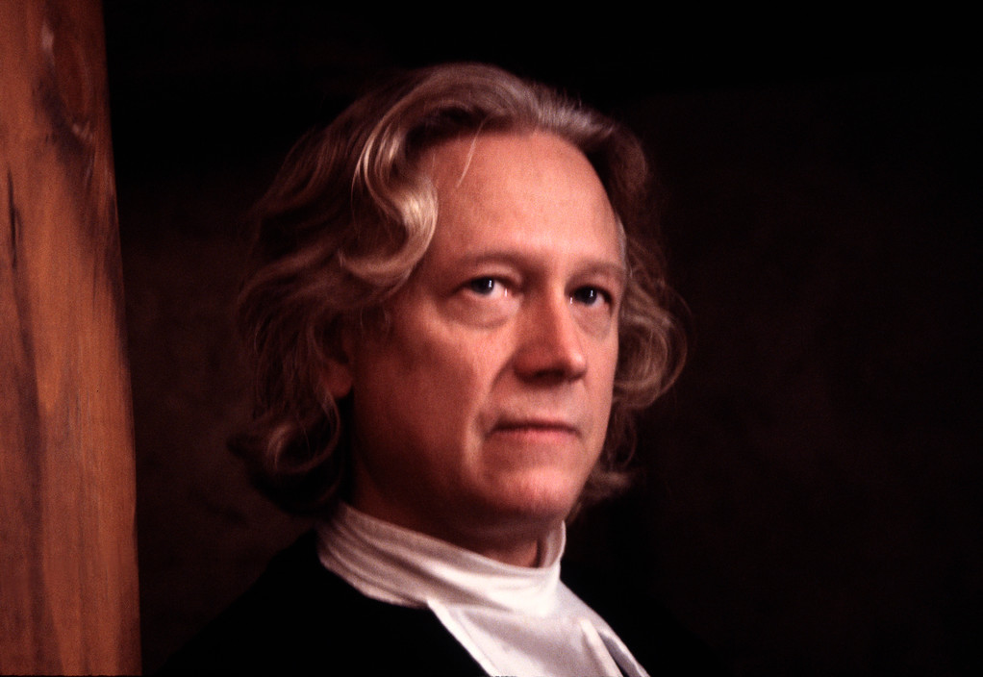
Rev. Samuel Parris
minister in Salem
concerned about his status and
reputation
growing opposition against him
rumors start when his daughter
(Betty) doesn’t wake up one
morning
The night before he caught his
niece (Abigail), slave (Tituba),
Betty and other girls in the
woods engaged in some ritual

Slide 21
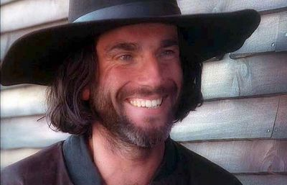
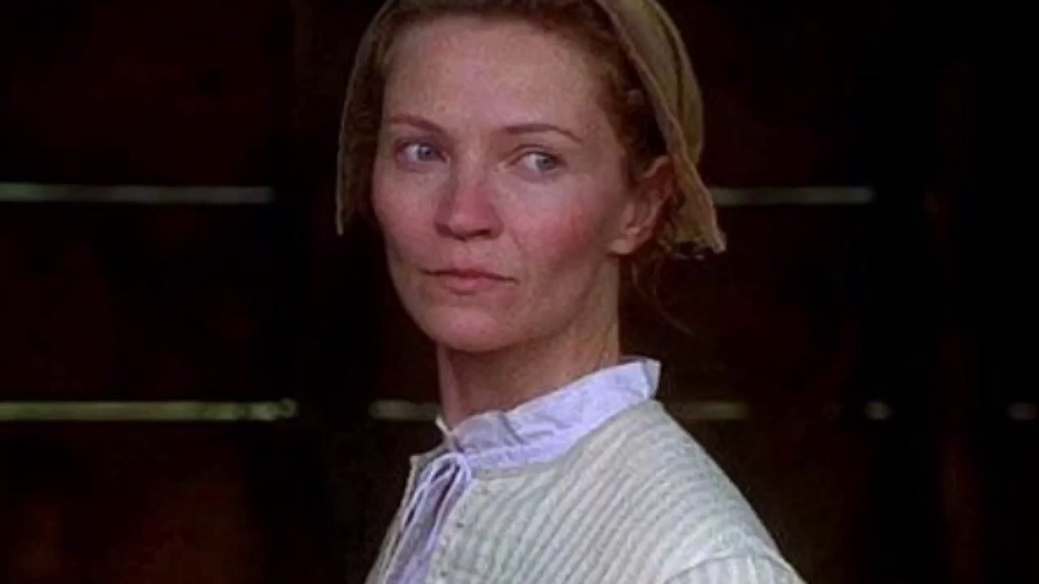
John & Elizabeth Proctor
Farmers who live outside Salem
John hates hypocrisy and the
leadership of Rev. Parris
He knows the girls are lying about
their accusations
Elizabeth is a “good woman” of
strong faith and character
John seems a good, honest man
but has a secret sin …

Slide 22
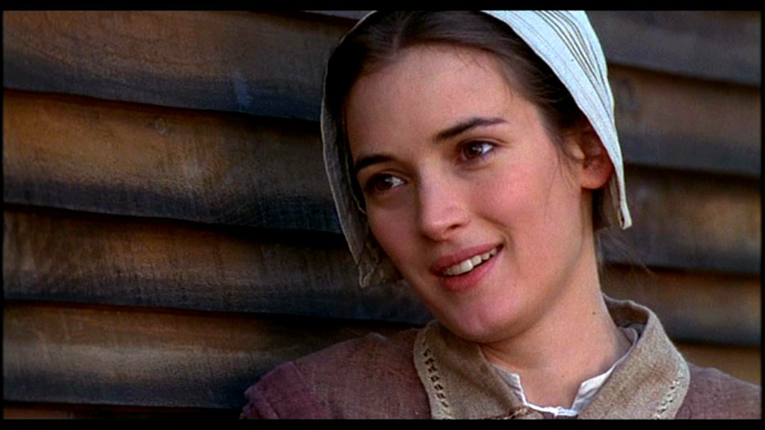
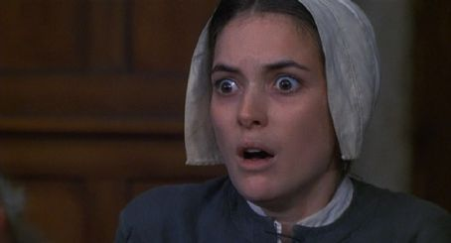
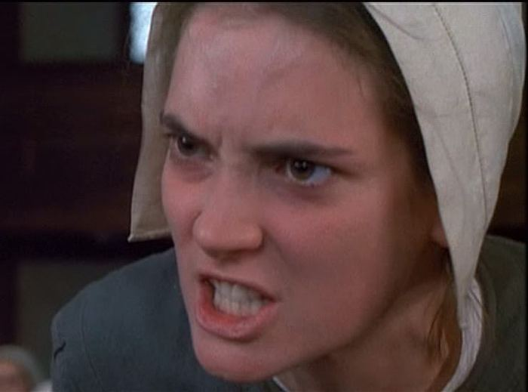
Abigail Williams
teen who lives with her uncle,
Rev. Parris
intimidating leader of the
witchcraft girls
clever liar, manipulates others
when challenged
- used to work for the Proctors
she also had an affair with
Proctor (secret sin)
she was fired by Elizabeth
due to the affair and has hated
Elizabeth ever since

Slide 23
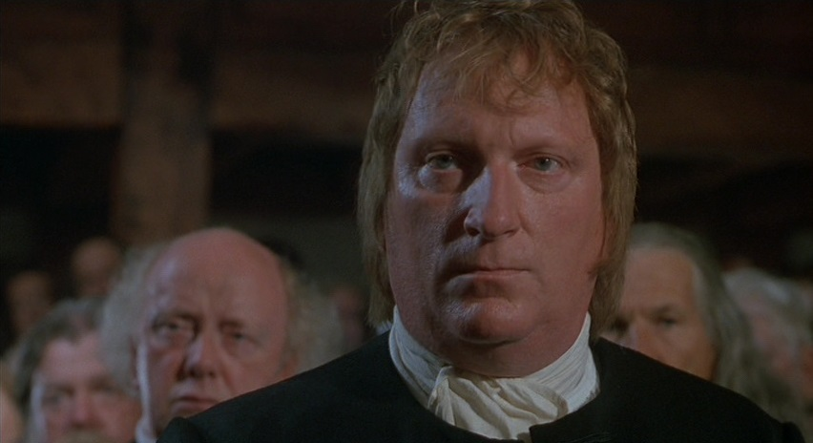
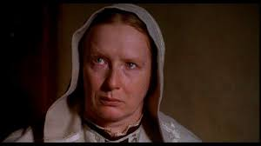
Thomas & Ann Putnam
Salem’s wealthiest couple
7 of 8 of their children died
after childbirth
Ruth, their only surviving child,
is one of two young girls who won’t
wake up at the start of the play
- Suspicion spreads that they are using
witch accusations to kill
neighbors and get their land (wealth)

Slide 24
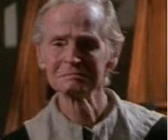
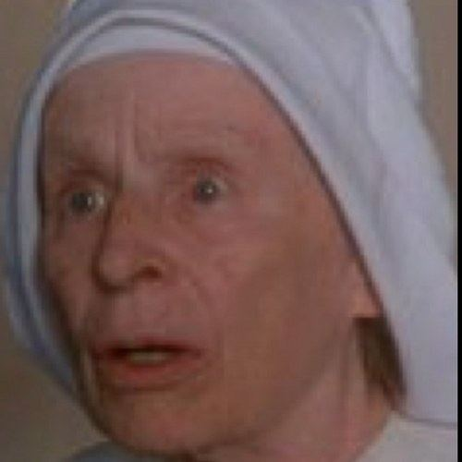
Francis & Rebecca Nurse
Highly esteemed elderly
couple with 11 children and
26 grandchildren
Rebecca is considered the “brick & mortar” of the church, known well for her great charity work
She fears bad things will happen if the village starts looking for witches

Slide 25
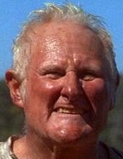
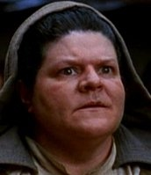
Giles & Martha Corey
- farmers and good friends of
the Proctors.
- they aren’t afraid to speak
their minds
- Giles is cranky, has been the
defendant in court 33 times,
and won’t let others take
advantage of him

Slide 26
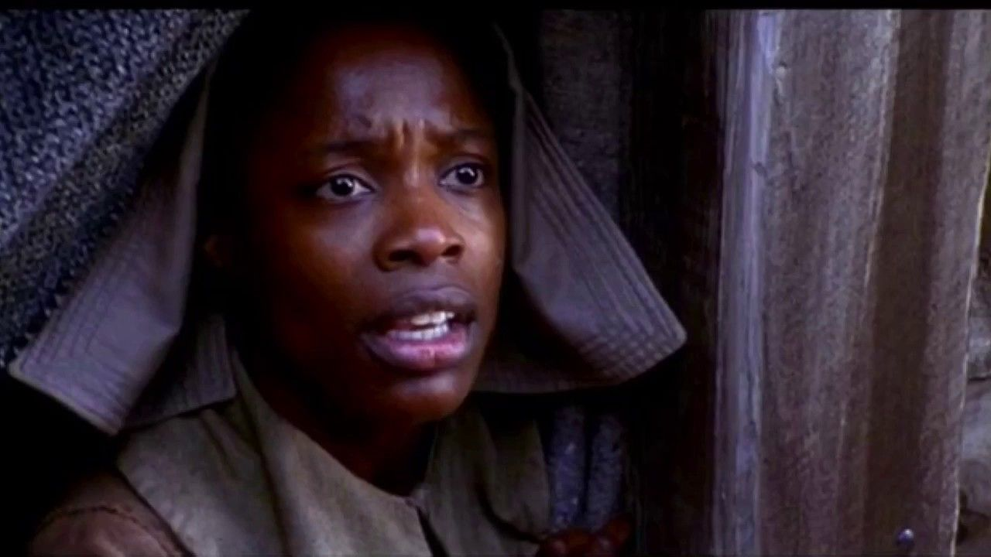
Rev. Parris’ slave
From Barbados; brings
knowledge of witchcraft
rituals
Introduces the girls to
witchcraft at Abigail’s
insistence but does not
approve of Abigail’s
murderous intentions
- First easy target when
girls start accusing
Tituba

Slide 27
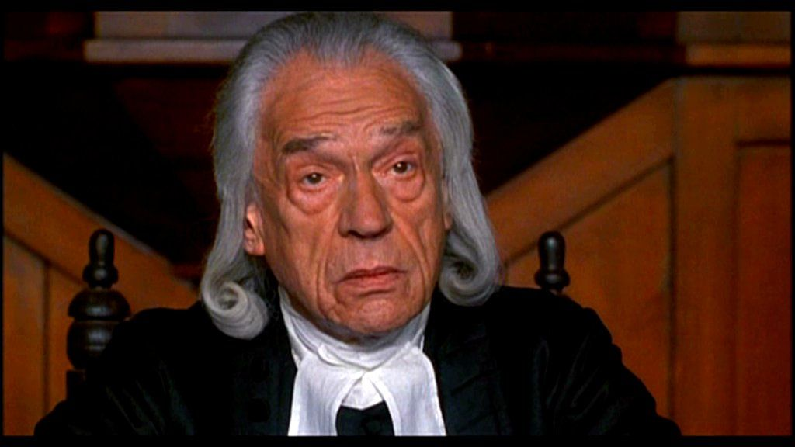
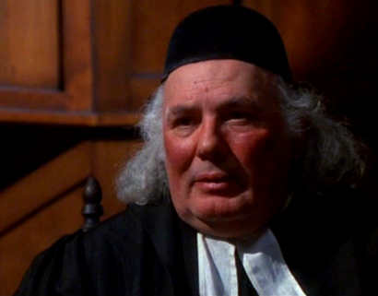
Judges Danforth & Hathorne
strict judges who preside
over the witch trials
Danforth is also the deputy
governor of Massachusetts Colony
they are mostly concerned about
making sure the court looks good
they consider Abigail & the girls
to be officials of the court

Slide 28
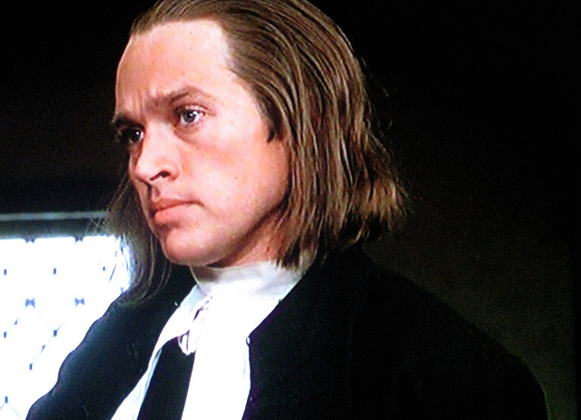
Reverend Hale
witchcraft expert invited to
town by Rev. Parris
not part of the town’s
cliques, no allegiances
actually cares about the truth
interviews and examines
those accused of witchcraft

Slide 29
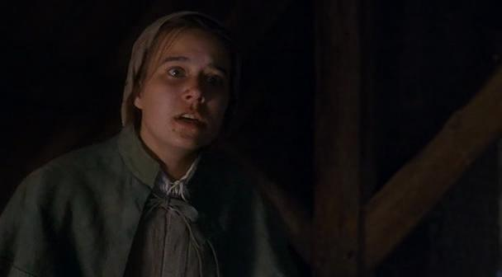
Mary Warren
weakest of the witchcraft
girls (very timid)
Works for the Proctors
since Abigail was fired
subjected to intense
intimidation
conflict: Will she side with
Proctor or side with Abigail?

Slide 30
Other characters:
Sarah Good - mentally unstable homeless lady
Sarah Osburn - sick widow
- has not attended church in a long time
- has legal issues with the powerful Putnams
George Jacobs - the Putnams’ next door neighbor
Ezekiel Cheever - clerk of the court (searches homes)
Herrick - town marshall (runs the jail)
Mercy Lewis - Putnam’s servant girl, a witch accuser, and
Abigail’s closest friend
Susanna Wolcott - the village doctor’s servant girl, a witch accuser,
and Abigail’s friend

