Slide 1
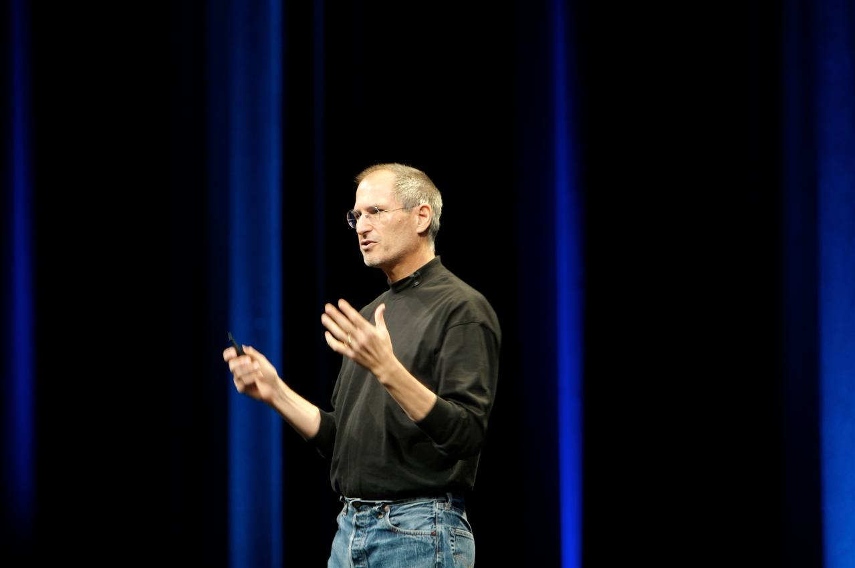
The Seven Sins of Speaking: Posture
Here’s what to do, and what NOT to do, in your next speech.
Objective:
I can list and describe the movement, posture, and nonverbal
qualities of (un)successful speakers.

Slide 2
About This List
These sins are just guidelines. They aren’t rules that everyone in the world knows and follows, but they ARE things that people either knowingly or subconsciously find annoying.
These sins are (somewhat) forgivable. If you make one of these mistakes, don’t panic. In small, occasional doses, it’s fine. If you have a consistent pattern or find that your audience is getting distracted, then consider working on it!
This list isn’t perfect. There might be other movements (or lack thereof) that an audience might find distracting.
The sins in this list CAN be fixed! Relax! We are discussing this SO THAT we can HELP you! ☺

Slide 3

Q: “But who cares how I stand while I talk?”
A: Your audience does! How you stand and move (nonverbal behavior) will impact both our impression of YOU and our ability to hear your speech content.
You don’t want us to be distracted by your hands, judging your posture, or deciding that you’re nervous our incapable of something.

Slide 4
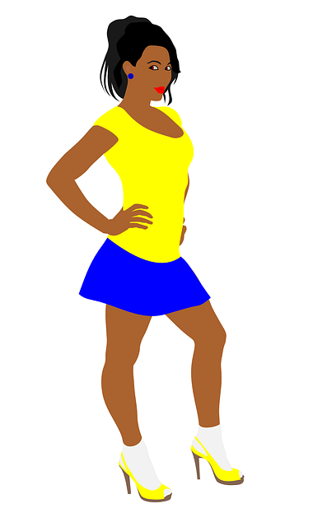
#1: The HIP
The Look: Hip is popped out to the left or right, knee bends, hands might be on hips (or at sides, or holding note cards).
Why it’s an issue: It can cause you to slouch, seem unprofessional, and/or seem nervous.
Why it happens: Inattention, shifting your weight, or nervousness.
What IS okay: It’s good to bend your knees SLIGHTLY. Don’t “lock” them, or you could pass out!
Fix it: Keep both feet firmly planted and balance in the center. If you “hip”, come back to center as soon as you can (without awkwardly “swaying” – see #6).

Slide 5
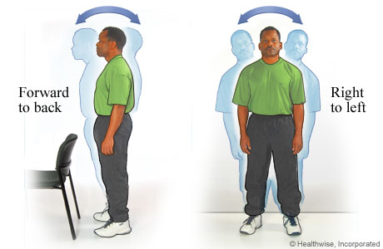
#2: The SWAY
The Look: Repeatedly swaying front/back or left/right, either very slowly or at a quicker tempo.
Why it’s an issue: It is IMMENSELY distracting to the audience! Our brains will watch you instead of listening.
Why it happens: Usually just nervousness. This is also often a subconscious issue, and people don’t realize that they’re doing it.
What IS okay: Staying “loose” instead of stiff, and taking STEPS to the left or
Fix it: Plant your feet, pick something to look at, OR walk around a little!

Slide 6

#3: The LEAN
The Look: Leaning on an object, and either 1) staying there too long, or 2) doing so at an angle/position that is unprofessional.
Why it’s an issue: Depending on how you do it, it can either make you look aggressive, TOO relaxed, arrogant, or even just lazy.
Why it happens: Usually sub- conscious, but it’s also comfortable and can make people feel more solid/safer.
What IS okay: Placing hands on a podium (IF you have one) to lightly “anchor” yourself.
Fix it: Stay standing! ☺

Slide 7

#4: The FIDGET
The Look: “Playing” with or touching things in a nervous manner: hair twirling, picking at clothes or hands, wringing hands, or any other nervous movement
Why it’s an issue: This is another EXTREMELY distracting thing for us to “watch” instead of listening.
Why it happens: This is a sign of either nervousness or just adrenaline/ energy. It can be a sign of self-consciousness.
What IS okay: Moving your hands in actual motions/ gestures is great!
Fix it: Either hold onto an item (like your notes) OR keep hands out and open, as in gestures (see a later slide for more on this)

Slide 8
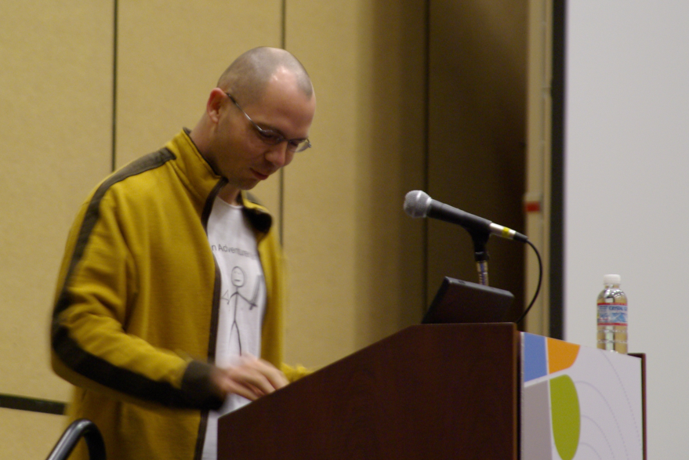
#5: The READ-ALOUD (& “The Bobble-head”)
The Look: Either…
1) Reading directly off of a screen, index cards, or paper, never or rarely looking up (“the read-aloud”) or
2) looking up, but only for a second, before going back to notes, usually repeatedly (“the bobble-head”).
Why it’s an issue:
Only certain celebs get teleprompters!
You have to either memorize your content OR learn how to use notes correctly (still giving us sufficient eye contact).
Eye contact dramatically helps our ATTENTION and our emotional CONNECTION with you (and therefore whatever you’re saying).
Why it happens: The speaker is not prepared or does not have “enough” of the speech memorized. The person has to rely on notes.
What IS okay:
Having notes, sometimes. The necessity of memorizing will vary by the occasion.
Reading a direct quote off of notes or a screen, especially if you don’t want to mess it up.
Fix it: Either memorize it, or learn “chunks” of the information so that you can look up more often. You can also write on your notes WHERE you should look up, such as for dramatic effect.
Side note:
Has anyone ever read out loud to you, or have you ever attended a “reading” of something? A speech should be more than just reading aloud – it should feel like an engaging conversation between the speaker and the audience! Even if you are “reading” a prepared speech out loud, it doesn’t need to feel like a boring version of storytime!

Slide 9
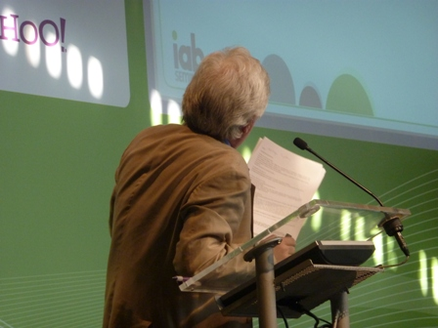
#6: The BUTT
The Look: The speaker turns AWAY from the audience for too long, probably to look at or read from a screen, therefore “giving you the butt”.
Why it’s an issue: Don’t turn your back on the audience, either for too long or repeatedly! Make eye contact with us!
Why it happens: The speaker is relying on the screen (lack of memorization).
What IS okay: Looking at and pointing to a screen for VERY SHORT seconds of time, occasionally.
Fix it: Work on memorization, and practice both your eye contact and movement beforehand.

Slide 10

#7: The SLOUCH
The Look: A “slouch” posture, usually with shoulders in, head down, and the body is curving “in” or “down”.
Why it’s an issue: It can signal nervousness, lack of confidence, unprofessionalism, and other negative connotations, which you do NOT want your audience to feel about you!
Why it happens: Again, nervousness, self-consciousness, or sometimes just not paying attention.
What IS okay: Not being as stiff and upright as a robot. You don’t have to have military-level posture.
Fix it:

Slide 11

Q: “But how do I avoid these sins?”
A: Practice, practice, practice!
Some ideas are to:
Practice reading your speech out loud
Practice it standing, not just sitting
Record yourself on video and watch it
Perform it for a trusted friend (and get feedback)
Practice REPEATEDLY until it is comfortable
Optional: Make note cards and practice with them (to not rely on a screen, a sheet of paper, and/or your memory)
Optional: Memorize it (or get close) so you don’t rely on note cards OR a screen

Slide 12
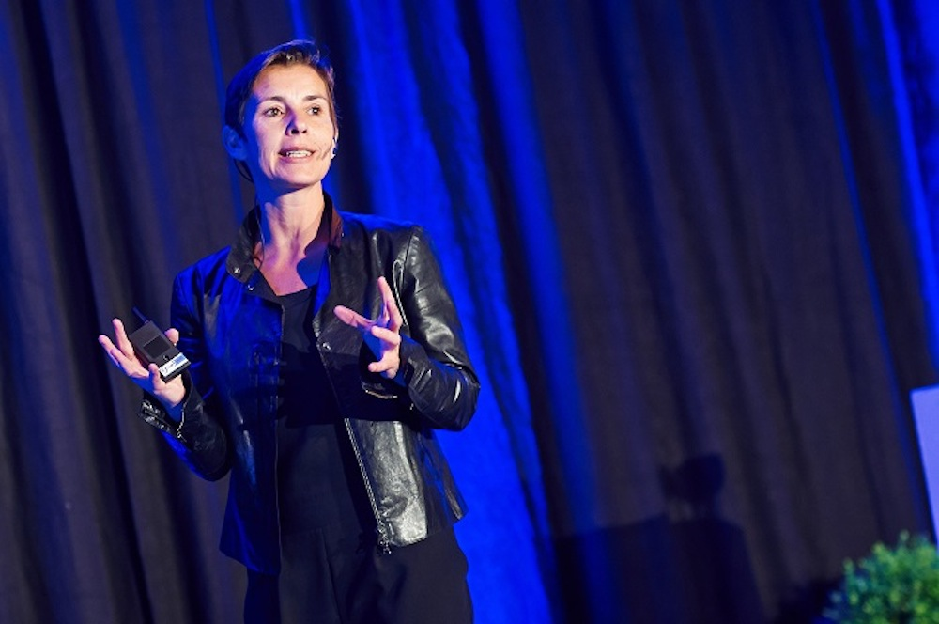
Q: “Okay, so how SHOULD I stand?”
A: Two words: “relaxed” and “professional”.
You will appear calm and confident with:
Head up, looking out, with as much eye contact as possible
Shoulders back (but not rigid/robotic)
Knees loose (to maintain blood flow)
Hands loose and open (see next slide)
Feet slightly apart (mostly for balance)
Either staying in place or walking, even just taking a small step or two to the sides (just not swaying)

Slide 13
Q: “What should I do with my hands & arms?”
A: Do’s (stay “open”)
Don’ts (stay “closed”)
Hands loose at sides
Natural arm movements, gestures, pointing, etc.
Arms “out” and “open” are fine!
Hold your note cards at chest level when needed
Lightly rest hands on the podium (don’t grip it tightly or lean on it)
Repeatedly point at the audience (or make someone feel targeted)
Repeat the same gesture TOO much (distracting)
Put hands in your pocket
Cross arms
Both hands on hips
Hands clasped (either in front of, or behind you)

Slide 14
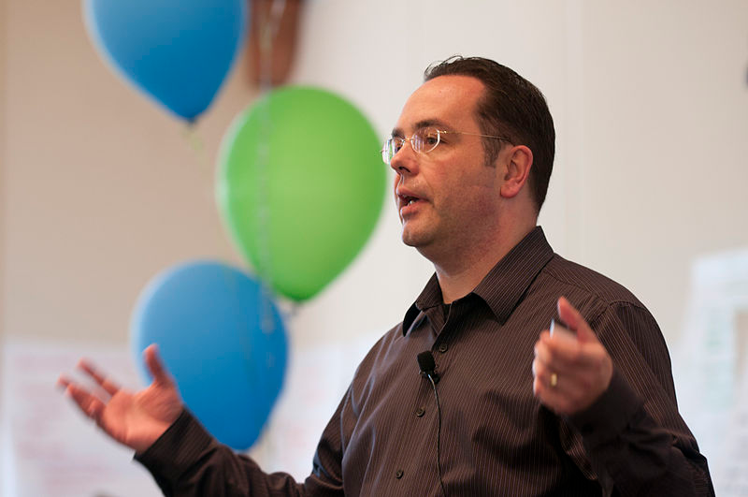
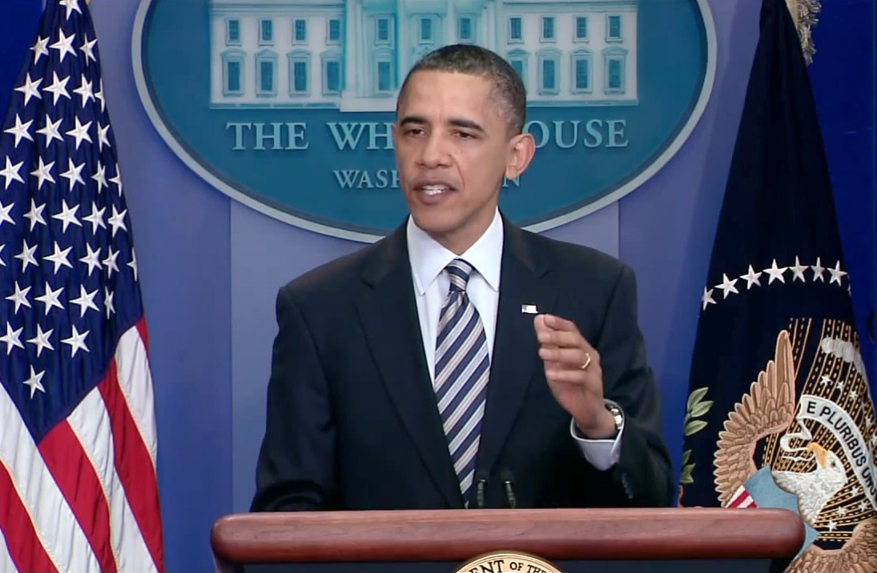
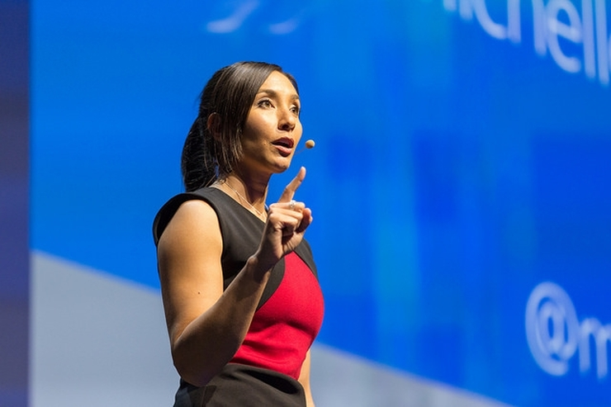
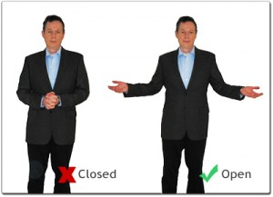
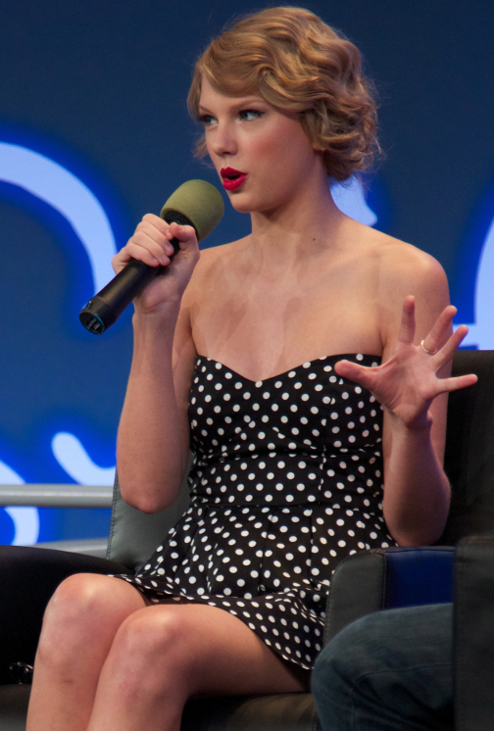
Examples of “Out” and “open” hands/arms

Slide 15
Need to see more examples?
View the TedTalks on the Class Website
When you do, watch how they…
Use their visual aid
Memorize their speech
Move naturally around the stage with walking, posture, facial expressions, and their hands
Make good eye contact with the audience
Put good emphasis on certain words with their voices

Slide 16
Practice: Quick Write & Practice
Pick ONE of the following four topics and write about it for two minutes. It does not have to be perfect and will not be graded.
Should school be year-round, with multiple short breaks instead of a long summer vacation? Tell me why/why not.
Should students be required to do public speaking in school?
At what age should teenagers be allowed to drive?
At what age should teenagers be allowed to vote?
When you’re done, you will recording these and critiquing YOURSELF! ☺

Slide 17
INDIVIDUAL PRACTICE
Look at the checklists on the bottom of page 2 of the Notes.
Choose anyone you want to watch you speak at LEAST once, even if only for 1 minute, and have him or her give you feedback on your strengths and weaknesses.
Record your Rehearsed Speech & Upload to the ASSIGNMENTS in Teams (Completion Item-all you have to do is try).
After that, it’s up to you to reflect on that feedback and PRACTICE more before the next graded speech in class.

